Slide 1
Online Bible Resources

Slide 2
Agenda
Getting Started
We’ll focus on applications from a desktop computer
Only looked at non-member capabilities
Most resources are free, but priced options and offer powerful tools
Considerations
Ten on-line resources
Apologetics, Pastoral Blogs & multi-media

Slide 3
Considerations
Approach
Doctrinal Non-negotiables
Scriptural Interpretation
Translations

Slide 4
Approach to consider reliable sources…
Published with a clear Statement of Faith
Includes well-known and reliable sources
Include a diverse and recognizable set of bible translations, commentaries and tools
Diversity is not necessarily bad; poor theology is bad!

Slide 5
The DTS Seven non-negotiables
For Dallas Theological Seminary…
For students:
The Trinity
The full deity and humanity of Christ
The spiritual lostness of the human race
The substitutionary atonement and bodily resurrection of Christ
Salvation by grace alone through faith alone in Christ alone
The physical return of Christ
The authority and inerrancy of Scripture
7 Essential Doctrinal Commitment Statements
For board and faculty:
21 full doctrinal articles
Where is your line for non-negotiable doctrinal stances and why?
Notes:
The Trinity
The full deity and humanity of Christ
The spiritual lostness of the human race
The substitutionary atonement and bodily resurrection of Christ
Salvation by grace alone through faith alone in Christ alone
The physical return of Christ
The authority and inerrancy of Scripture

Slide 6
Scriptural Interpretation (Immanuel Bible Church)
Normal - understanding the words of Scripture in their common usage unless otherwise indicated by the context.
Literal - understanding the meaning of Scripture in its ordinary sense unless the context requires a figurative interpretation.
Grammatical - using the recognized rules of grammar to interpret the text.
Historical - understanding the words of Scripture in the context of the times in which they were written.
Systematic - categorizing and comparing the teaching of the Scriptures with the whole of Scripture in view.
Acrostic = NoLiGHtS

Slide 7
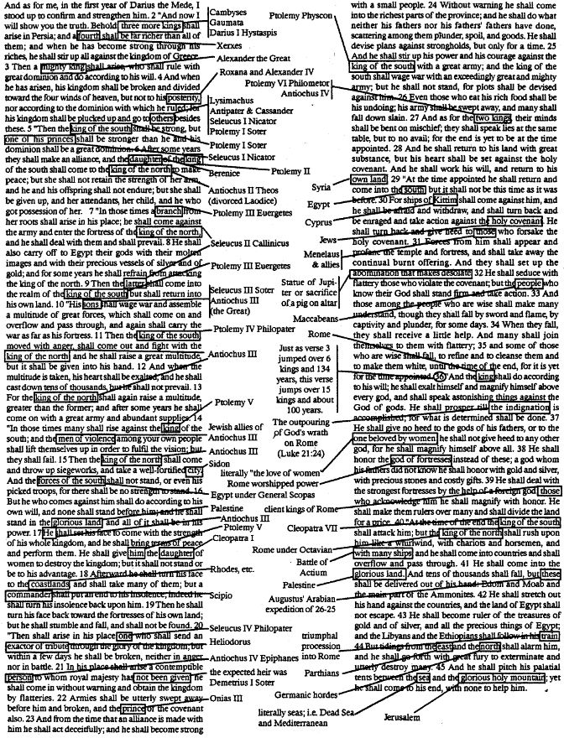
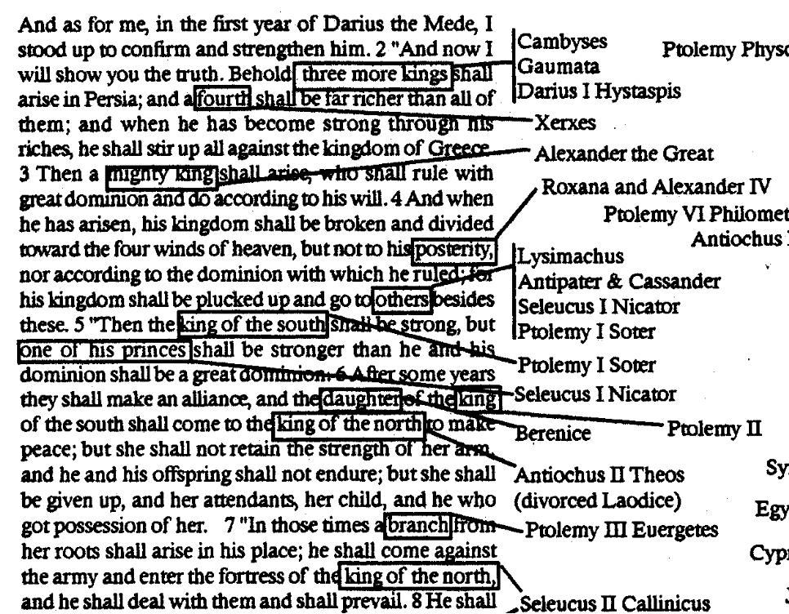
For example
http://www.thywordistruth.com/
(sounds good)
(looks good)
(not good)
RSV
www.ThyWordIsTruth.com

Slide 8
Translations

Slide 9
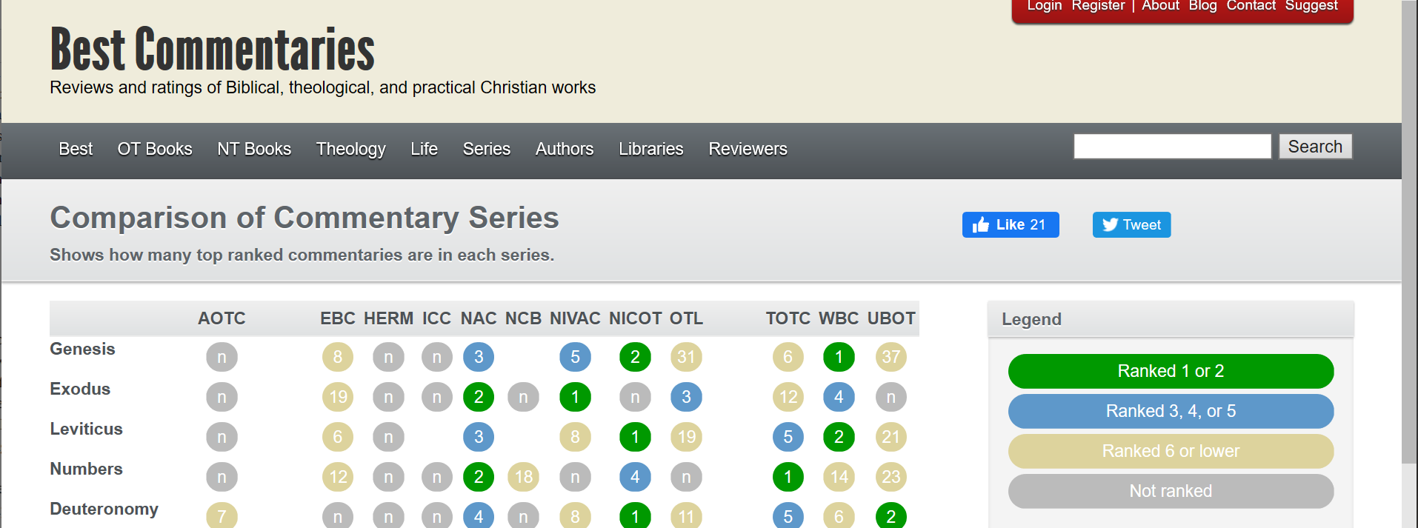
www.bestcommentaries.com

Slide 10
Online Resources
Concordance/Tools
Integrated Features
Study Resources
Linked Resources
Strong's/Lexicon
Priced Upgrades
Bible Dictionary
Commentaries
Reading Plans
FACTORS
Downloadable
Comparison
Mobile App
Top Bibles
Interlinear
Ten Resources to consider
Snapshot Comparison
Apologetics Summary (another video)
Pastoral Blog Summary (another video)
Multi-Media (another video)

Slide 11
Snapshot
Concordance/Tools
Integrated Features
Study Resources
Linked Resources
Strong's/Lexicon
Priced Upgrades
Bible Dictionary
Commentaries
Reading Plans
Downloadable
Comparison
Mobile App
Top Bibles
Resources
Interlinear
Biblegateway.com
Blueletterbible.org
Biblehub.com
Dr. Constable's Notes
StudyLight.org
Biblelessonsintl.com
Biblestudytools.com
Precept Austin
Biblewebapp.com
Olivetree.com $
Logos.com $
$
?
$
$

Slide 12
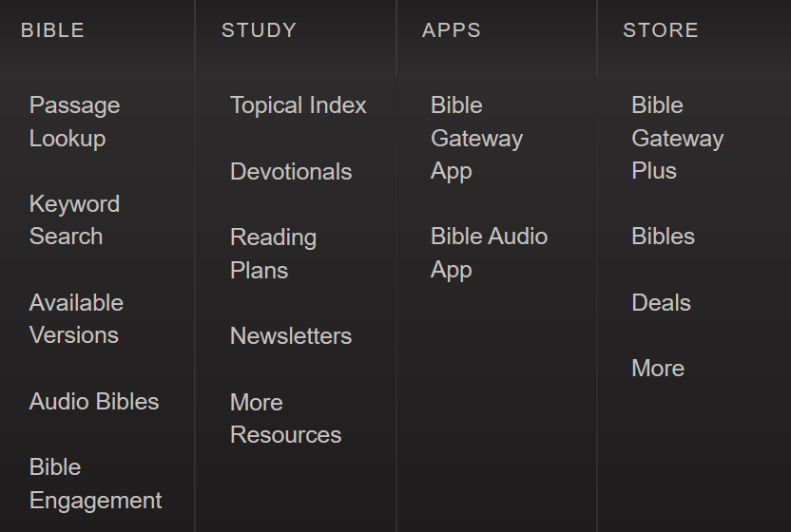
biblegateway.com
Bible Gateway is a searchable online Bible in more than 200 versions and 70 languages that you can freely read, research, and reference anywhere. With a library of audio Bibles, a mobile app, devotionals, email newsletters, and other free resources, Bible Gateway equips you not only to read the Bible, but to understand it.

Slide 13
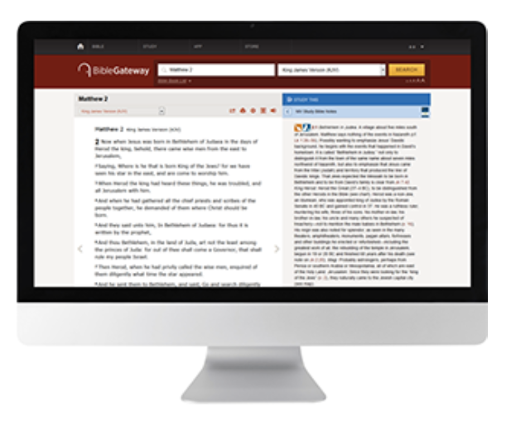
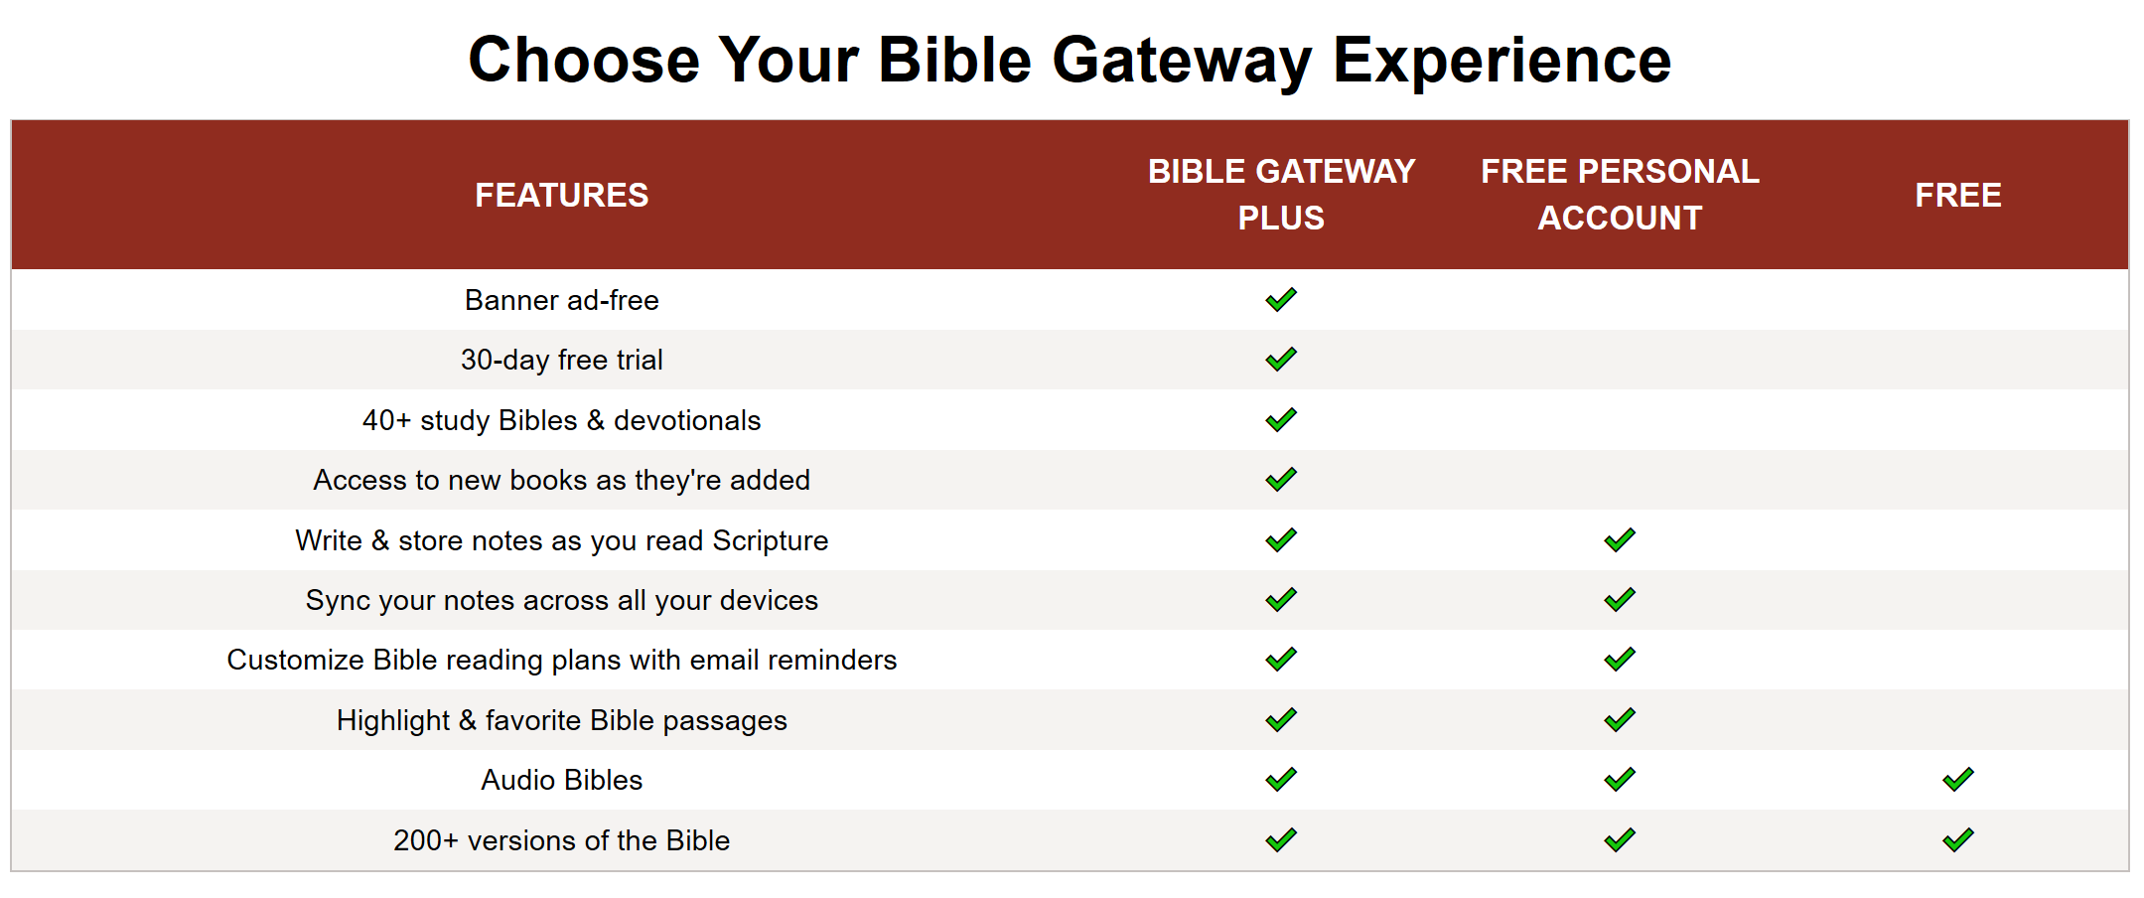
Bible Gateway Plus ($)
Bible Gateway Plus is a paid service that gives members a banner ad-free Scripture reading experience on Bible Gateway.

Slide 14
Snapshot
Concordance/Tools
Integrated Features
Study Resources
Linked Resources
Strong's/Lexicon
Priced Upgrades
Bible Dictionary
Commentaries
Reading Plans
Downloadable
Comparison
Mobile App
Top Bibles
Resources
Interlinear
Biblegateway.com
$
A good bible reference resource to quickly look up a passage or have numerous bible translations. It also has a free audio app!
Strength: Really easy to use bible translations

Slide 15
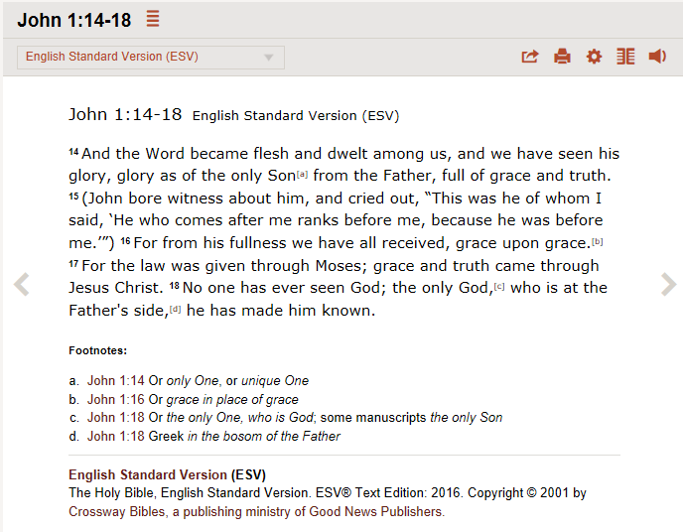
Biblegateway.com – John 1:14-18

Slide 16
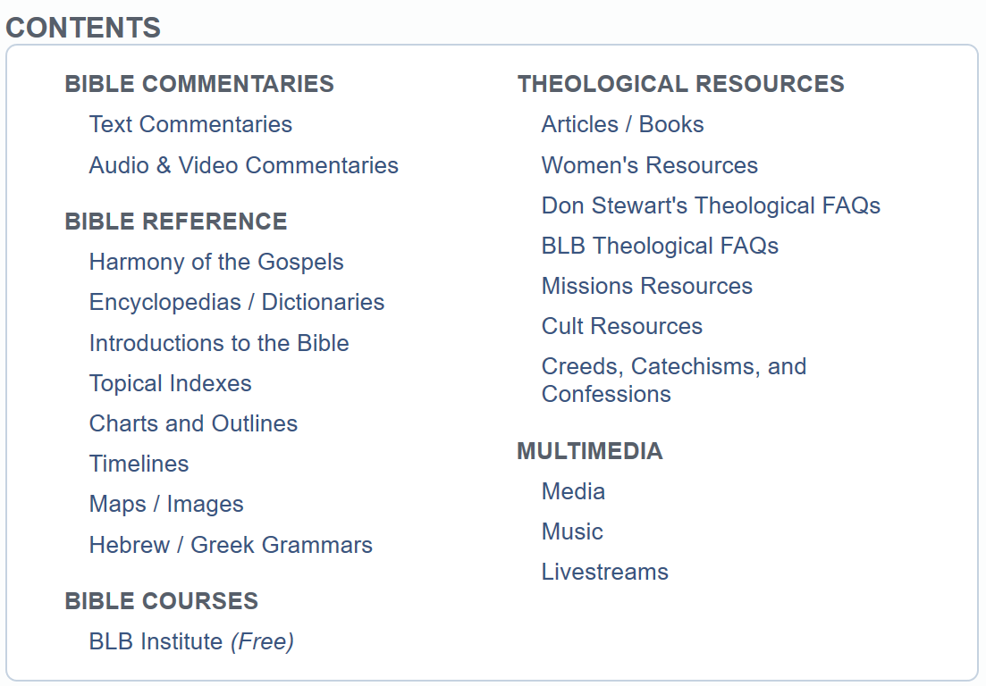
https://www.blueletterbible.org/
Blue Letter Bible is a free, searchable online Bible program providing access to many different Bible translations including: KJV, NKJV, NLT, ESV, NASB and many others. In addition, in-depth study tools are provided on the site with access to commentaries, encyclopedias, dictionaries, and other theological resources.

Slide 17
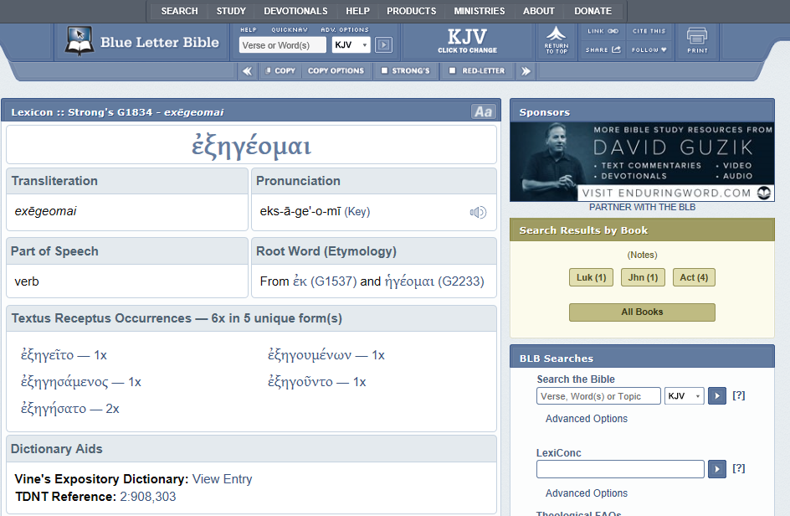
BlueLetterBible.org

Slide 18
Snapshot
Concordance/Tools
Integrated Features
Study Resources
Linked Resources
Strong's/Lexicon
Priced Upgrades
Bible Dictionary
Commentaries
Reading Plans
Downloadable
Comparison
Mobile App
Top Bibles
Resources
Interlinear
Blueletterbible.org
A strong bible search capability and bible tools with lots of bible study resources available. It also has a free app!
Strength: a range of commentaries and references for study

Slide 19
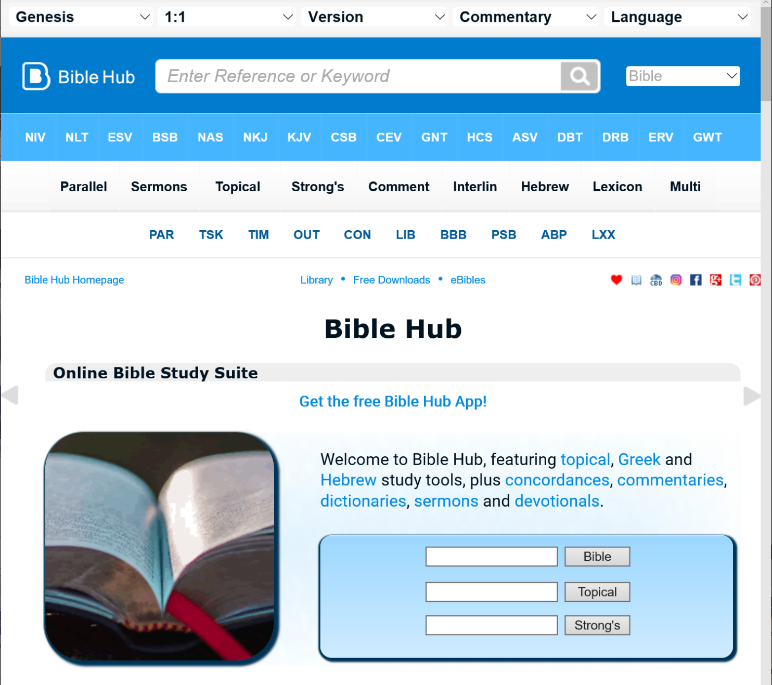
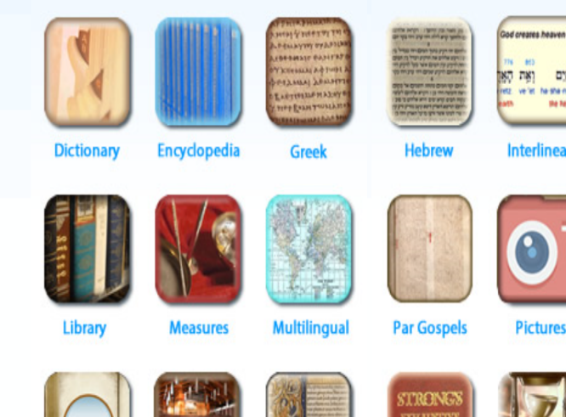
Biblehub.com
Bible Hub features topical, Greek and Hebrew study tools, plus concordances, commentaries, dictionaries, sermons and devotionals.
Biblehub.net includes free downloads of bibles

Slide 20
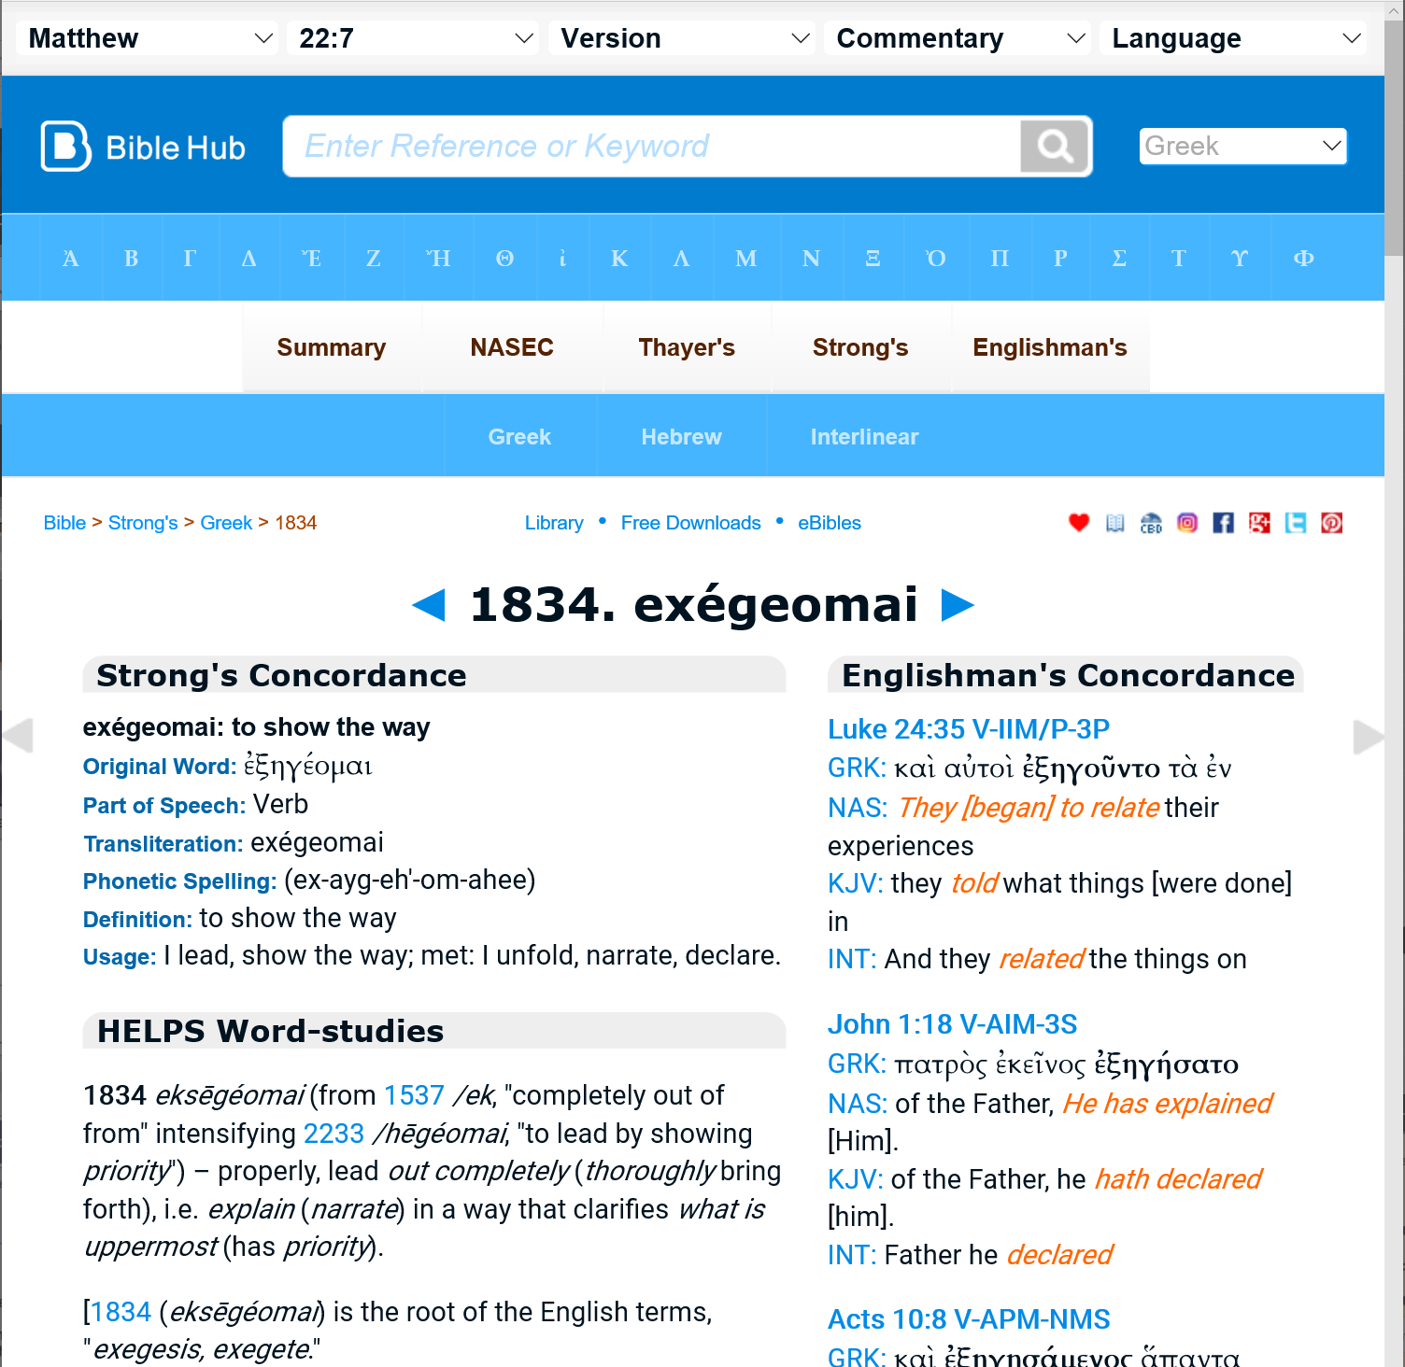
Biblehub.com - exégeomai
Nice summary of the greek words

Slide 21
Snapshot
Concordance/Tools
Integrated Features
Study Resources
Linked Resources
Strong's/Lexicon
Priced Upgrades
Bible Dictionary
Commentaries
Reading Plans
Downloadable
Comparison
Mobile App
Top Bibles
Resources
Interlinear
Biblehub.com
Allows you to dig deeper into the original languages with bible, topical and strong number (lemma) searches.
Strength: provides a very broad concordance and interlinear tools

Slide 22
http://planobiblechapel.org/soniclight/
Dr. Constable's Notes, authored by Dr. Thomas L. Constable since 1985, provide commentary on all 66 books of the Bible, and contain 8,900 pages of material in the .pdf online format.
All notes are also downloadable

Slide 23
Snapshot
Concordance/Tools
Integrated Features
Study Resources
Linked Resources
Strong's/Lexicon
Priced Upgrades
Bible Dictionary
Commentaries
Reading Plans
Downloadable
Comparison
Mobile App
Top Bibles
Resources
Interlinear
Dr. Constable's Notes
A full biblical commentary by a noted seminary professor that is available via online (and also in Spanish and Thai)!
Strength: A high quality commentary for any study level (that is downloadable in .pdf form)

Slide 24
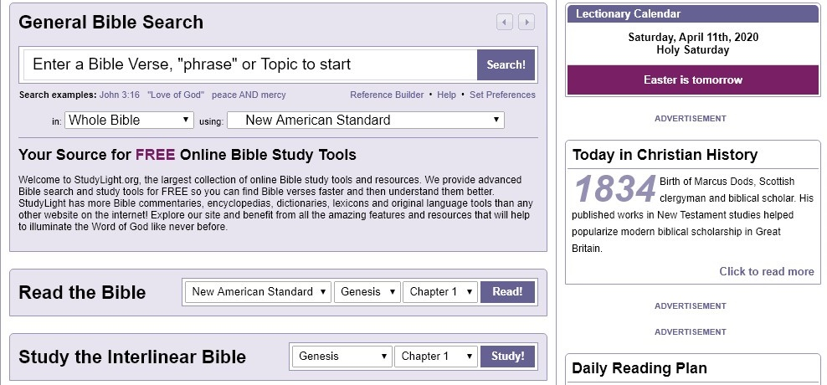
Studylight.org
States they are the largest collection of online Bible study tools and resources. Provide free advanced Bible search and study tools. Includes Bible commentaries, encyclopedias, dictionaries, lexicons and original language tools than any other website on the internet!
Precept Austin links to this resource

Slide 25
Snapshot
Concordance/Tools
Integrated Features
Study Resources
Linked Resources
Strong's/Lexicon
Priced Upgrades
Bible Dictionary
Commentaries
Reading Plans
Downloadable
Comparison
Mobile App
Top Bibles
Resources
Interlinear
StudyLight.org
An impressive mix of bible translations, search capabilities and interlinear and lexicon tools.
Strength: One of the broadest sets of tools on the list to allow you to study at many levels

Slide 26
http://www.freebiblecommentary.org/

Slide 27
Snapshot
Concordance/Tools
Integrated Features
Study Resources
Linked Resources
Strong's/Lexicon
Priced Upgrades
Bible Dictionary
Commentaries
Reading Plans
Downloadable
Comparison
Mobile App
Top Bibles
Resources
Interlinear
Biblelessonsintl.com
?
Dr. Utley includes a lifetime of bible study material. He also has numerous YouTube lessons posted. Also referenced in other reliable resources.
Strength: One of the broadest sets of tools on the list to allow you to study at many levels

Slide 28
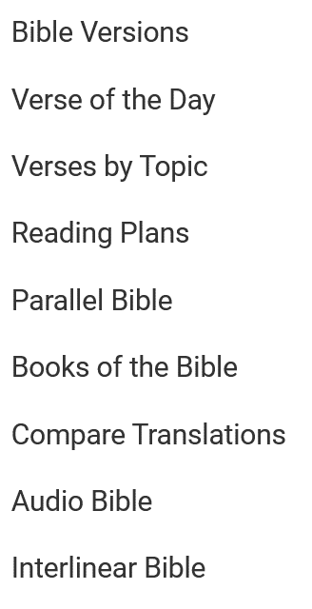
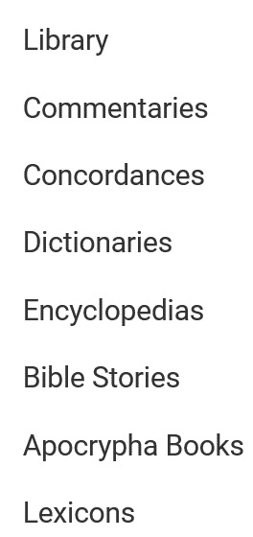
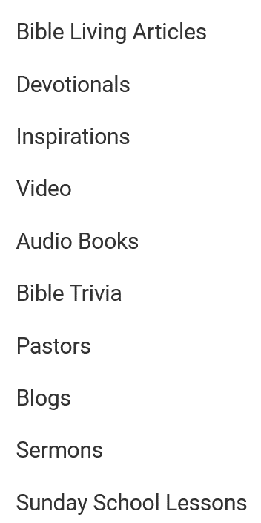
https://www.biblestudytools.com/
BibleStudyTools.com is the largest free online Bible website for verse search and in-depth studies.

Slide 29
Snapshot
Concordance/Tools
Integrated Features
Study Resources
Linked Resources
Strong's/Lexicon
Priced Upgrades
Bible Dictionary
Commentaries
Reading Plans
Downloadable
Comparison
Mobile App
Top Bibles
Resources
Interlinear
Biblestudytools.com
An excellent rundown on the free commentaries, lessons, articles sermons, blogs with comparison and interlinear bible features. Includes an audio bible option
Strength: Lots of resources and cool scripture formatting

Slide 30
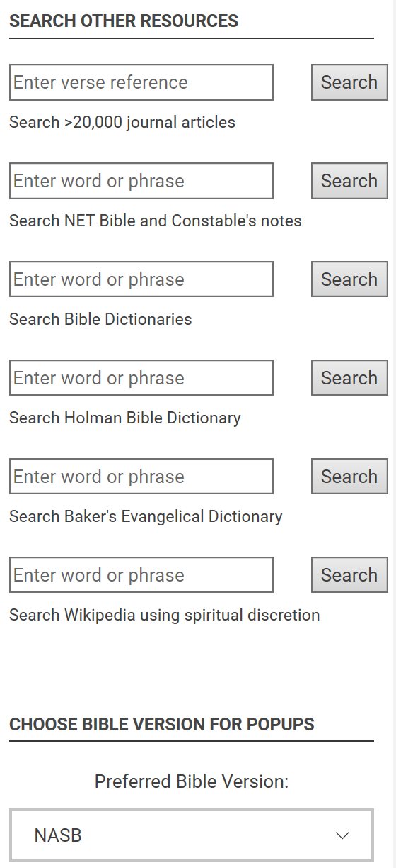
https://www.preceptaustin.org/
Over 2000 pages of commentary, verse-by-verse exposition, and search details for over 20,000 articles and devotionals

Slide 31
Snapshot
Concordance/Tools
Integrated Features
Study Resources
Linked Resources
Strong's/Lexicon
Priced Upgrades
Bible Dictionary
Commentaries
Reading Plans
Downloadable
Comparison
Mobile App
Top Bibles
Resources
Interlinear
Precept Austin
This compilation of material is MASSIVE! Just start with any book or verse and dive in. Lots of study tools and resources.
Strength: Lots of resources and leverages other well used tools

Slide 32
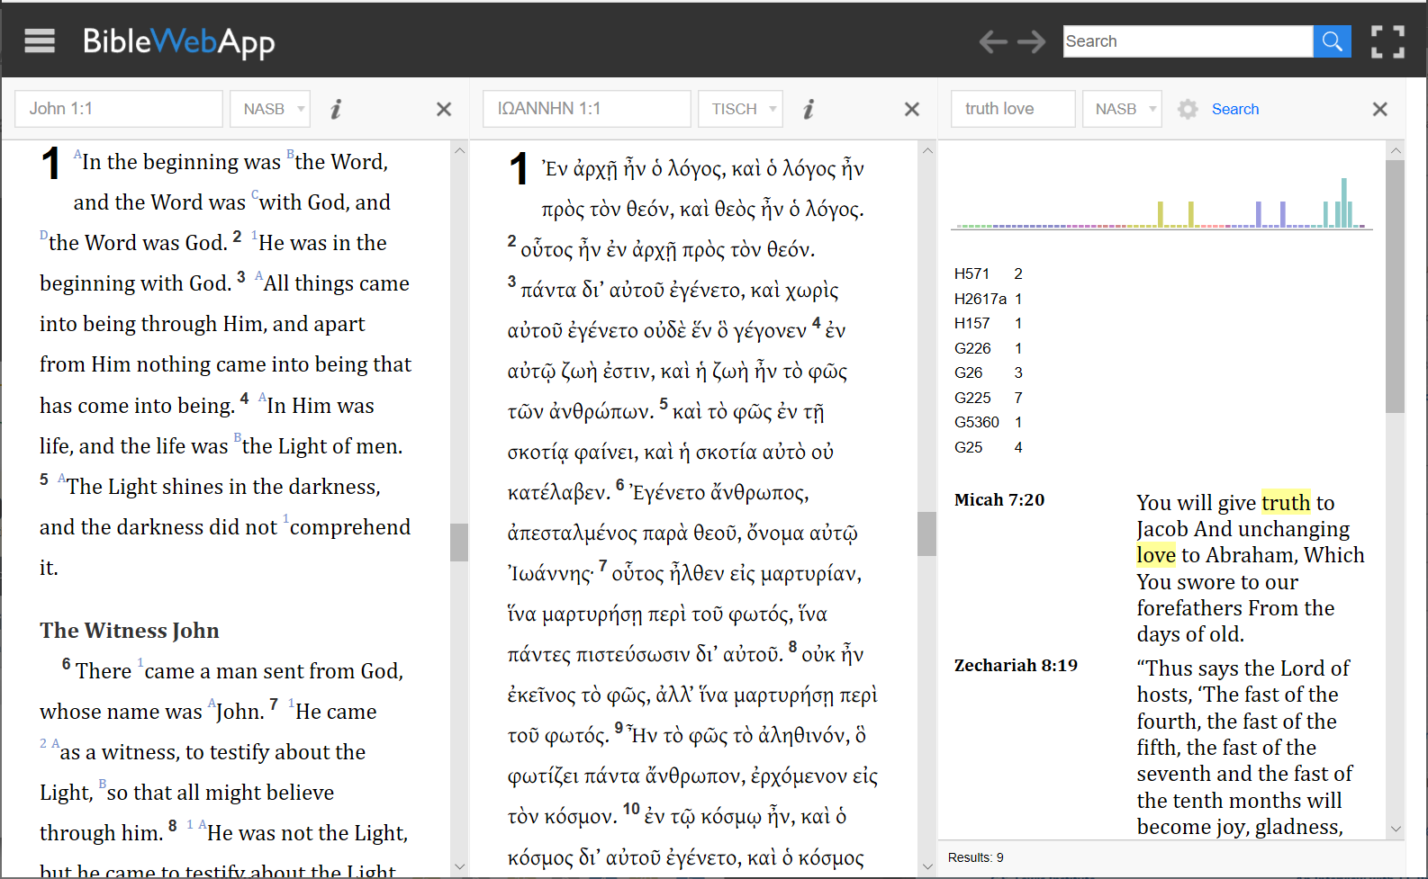
http://www.biblewebapp.com/study/
Bible Web App (3.0)
Online Bible study application with bonus study features for studying Greek and Hebrew.

Slide 33
Snapshot
Concordance/Tools
Integrated Features
Study Resources
Linked Resources
Strong's/Lexicon
Priced Upgrades
Bible Dictionary
Commentaries
Reading Plans
Downloadable
Comparison
Mobile App
Top Bibles
Resources
Interlinear
Biblewebapp.com
The coolest Greek/Hebrew/English online interactive bible tool on the list. It pulls other resources onto the visual display.
Strength: Really powerful visual displays with text comparison and linked resources

Slide 34
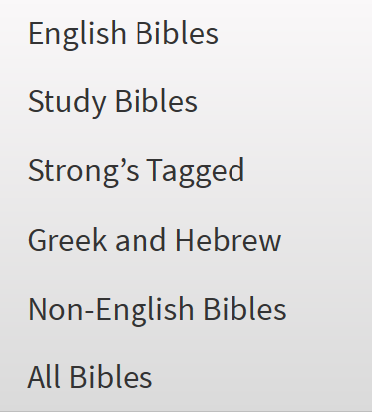
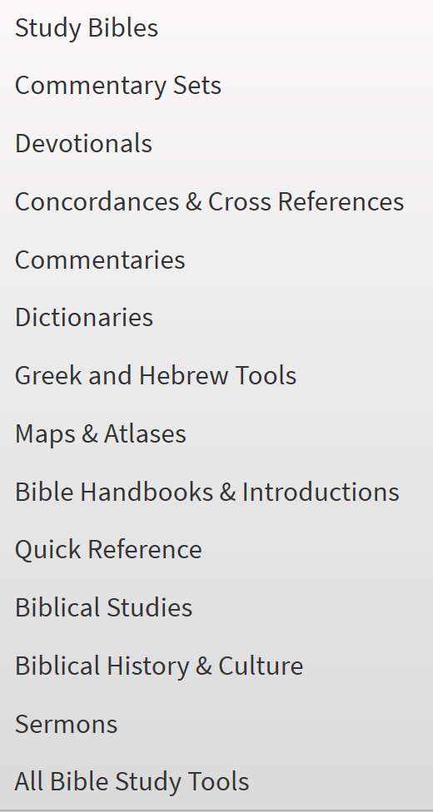
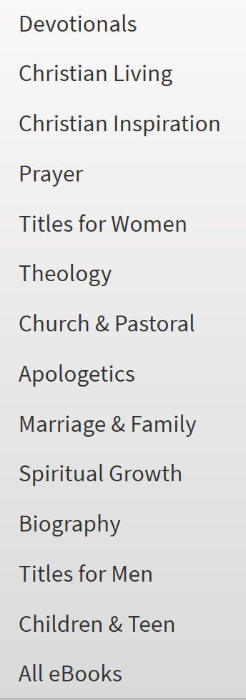
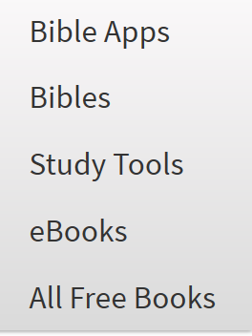
olivetree.com ($)
Extensive Bible app that includes God's Word in numerous translations and languages!
They offer thousands of Bible study resources, such as commentaries, dictionaries, devotionals, and eBooks.
Both desktop and mobile applications are available

Slide 35
Snapshot
Concordance/Tools
Integrated Features
Study Resources
Linked Resources
Strong's/Lexicon
Priced Upgrades
Bible Dictionary
Commentaries
Reading Plans
Downloadable
Comparison
Mobile App
Top Bibles
Resources
Interlinear
Olivetree.com $
$
Covers all the topics as a compact, integrated Bible study tool with a powerful mobile app for Android/Kindle/Mac/Windows.
Strength: My favorite mobile application with integrated features

Slide 36
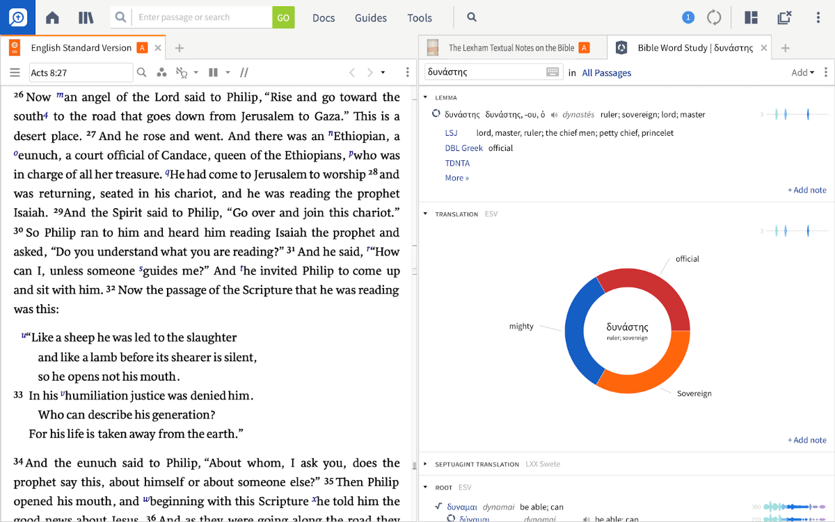
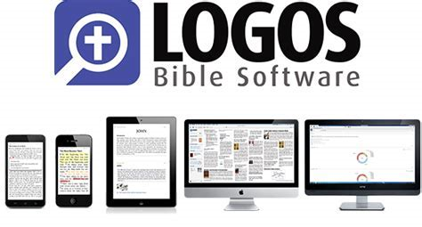
Logos.com ($) – the Cadillac option
Provides the most robust and integrated set of bible study and doctrinal resources, books and tools where a single click can open dictionaries, commentaries, lexicons, and step-by-step guides
Logos Features and Capabilities will be covered in a dedicated set of classes

Slide 37
Snapshot
Concordance/Tools
Integrated Features
Study Resources
Linked Resources
Strong's/Lexicon
Priced Upgrades
Bible Dictionary
Commentaries
Reading Plans
Downloadable
Comparison
Mobile App
Top Bibles
Resources
Interlinear
Biblegateway.com
Blueletterbible.org
Biblehub.com
Dr. Constable's Notes
StudyLight.org
Biblelessonsintl.com
Biblestudytools.com
Precept Austin
Biblewebapp.com
Olivetree.com $
Logos.com $
$
?
$
$

Slide 38
Others to Add
Bible.org
Nondenominational Bible based site that provides free access to over 20,000 articles which represent from trusted evangelical sources. It includes articles, sermon illustrations, men/women/children and pastor sections, and a focused theology section.
Net Bible (https://netbible.org)
This free tool has the NET Bible (2nd edition) with its 58,000+ notes, Greek, Hebrew, texts linked to Strongs numbers, and it allows you to search all the translations of the Bible to find your favorite verses.

Slide 39
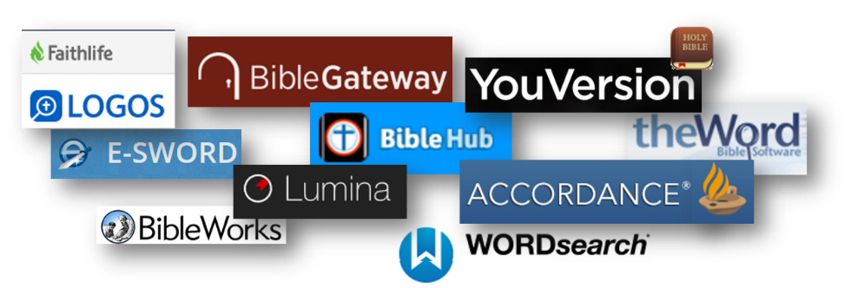
Another Technical Resource Source
http://bibleandtech.blogspot.com/
Online Resource Review, Jan 2018
bibleandtech.blogspot.com/2018/01/online-and-free-bible-study-resources.html

Slide 40
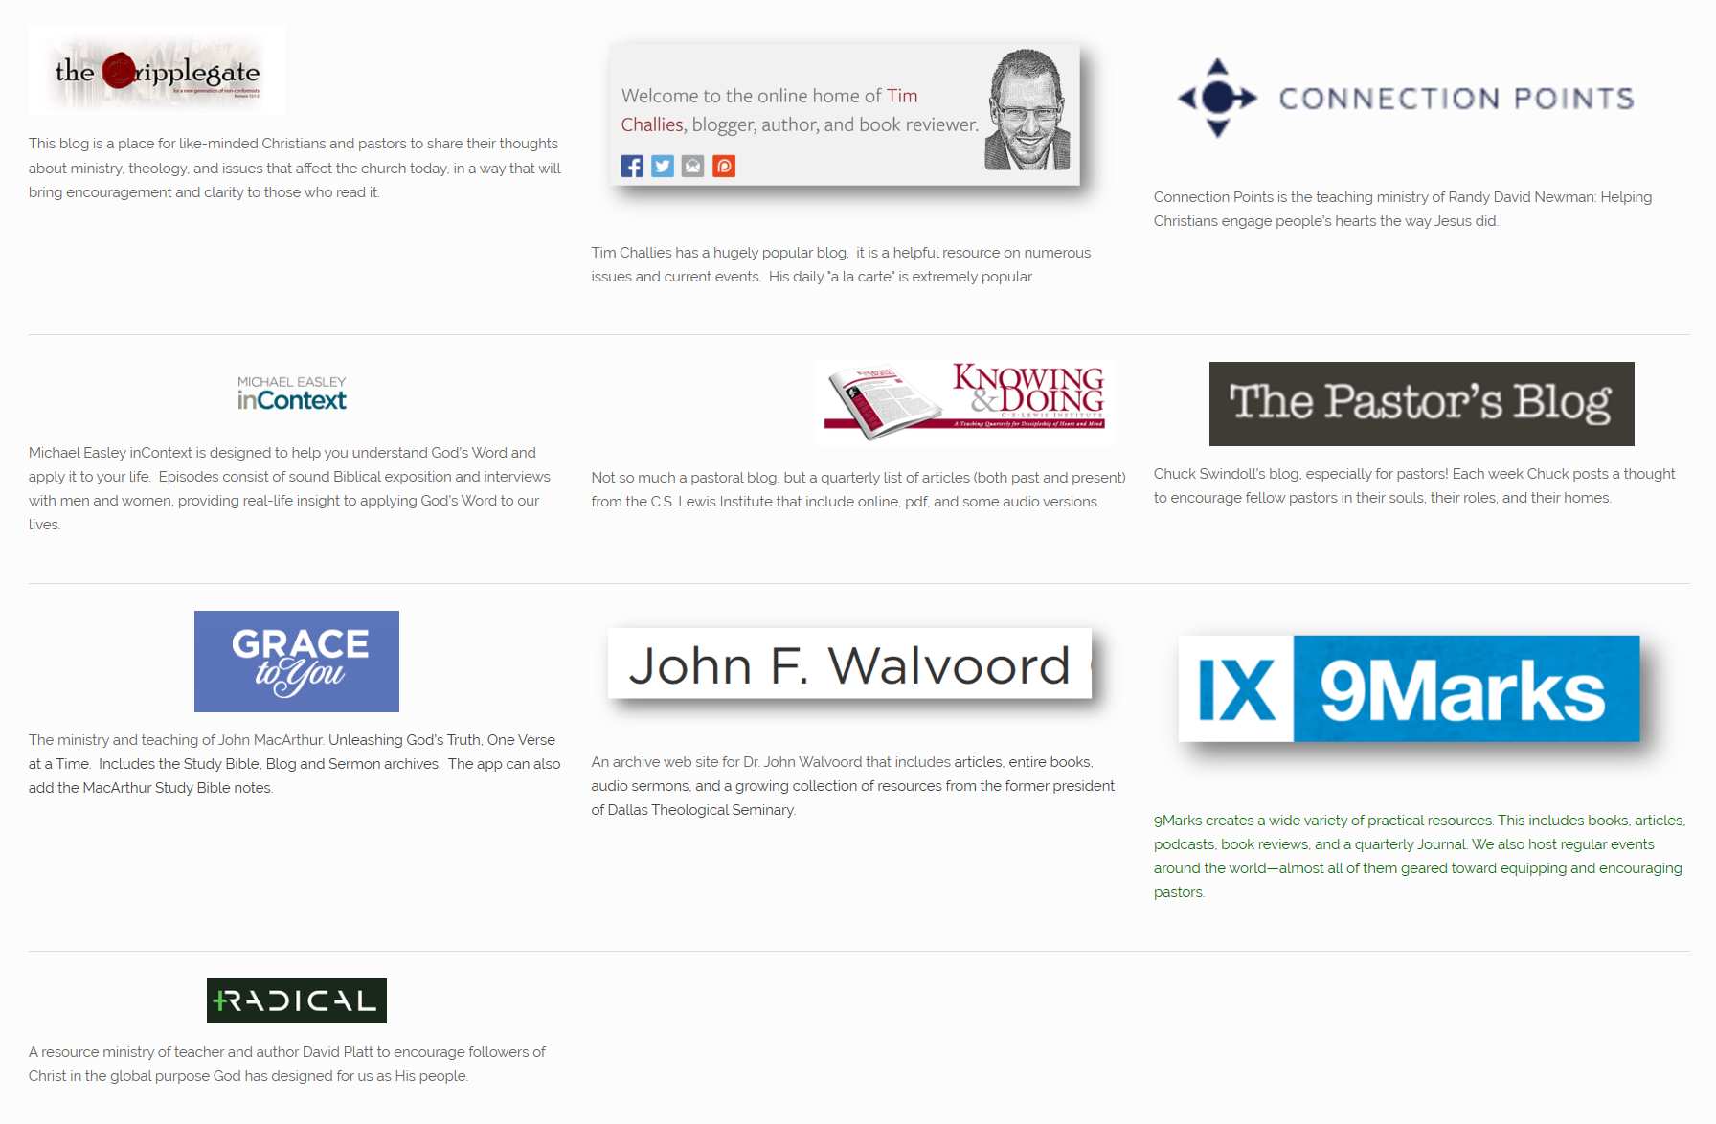
Pastoral Blogs/Resources

Slide 41
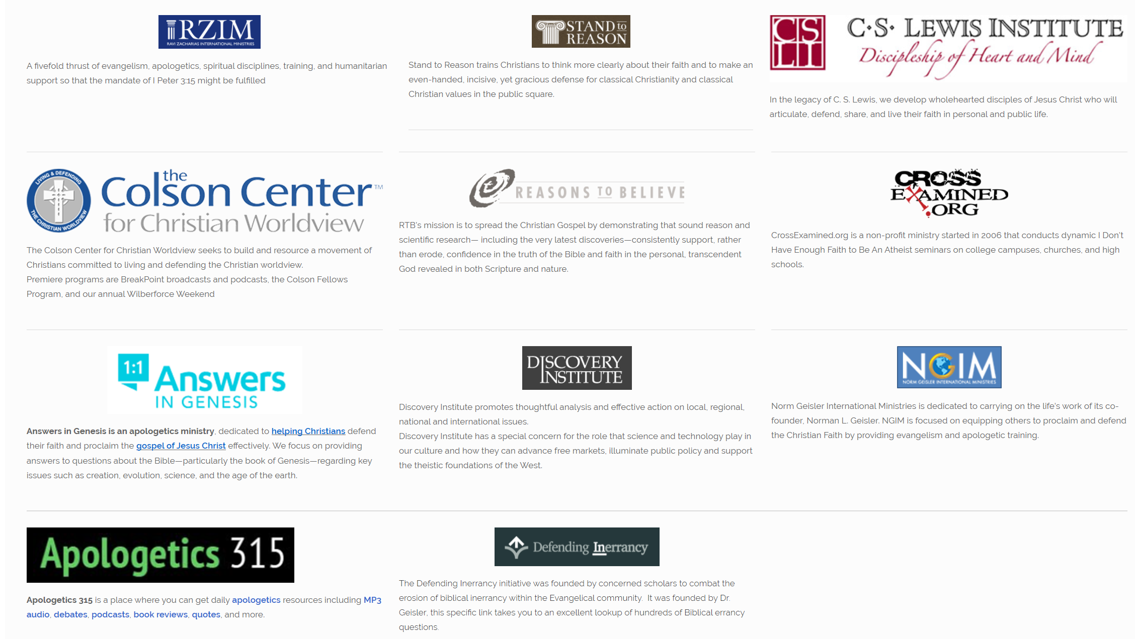
Apologetic Resources

Slide 42
Questions?
Kirk Streitmater
streitmaterk@verizon.net

Slide 43
Multi-Media Resources
Rightnowmedia (rightnowmedia.org)
RightNow Media’s mission is to work with the global church to inspire people to love others before self and Christ above all.
Subscription based…
The Bibleproject.com

Slide 44
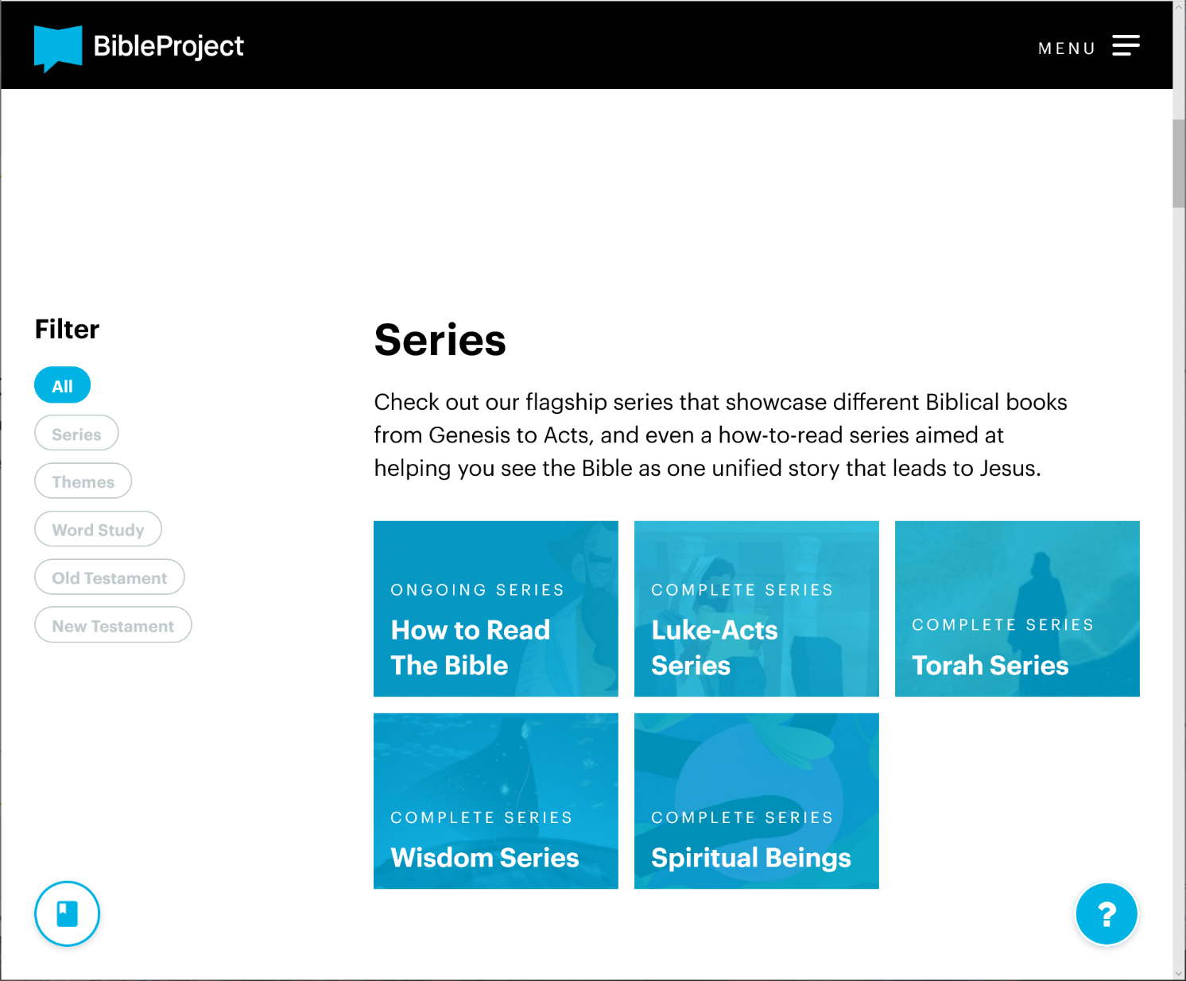
Bibleproject.com
BibleProject is a nonprofit animation studio that produces short-form, fully animated Bible videos and other Bible resources to make the biblical story accessible to everyone, everywhere. We create 100% free Bible videos, podcasts, and Bible resources to help people experience the story of the Bible.
Over 140 videos and 200 podcasts, which can all be viewed on the website, The Bible App, YouTube, Vimeo, and more. There have been over 100 million views across all of their media channels in over 200 countries, and over one million subscribers worldwide.
Series
Themes
Word Studies
Old Testament (TaNaK)
New Testament

Slide 45
Bibleproject.com

Slide 46
Focus on the Family

