Slide 1
Logos IBI Demonstration and Training
Kirk Streitmater

Slide 2
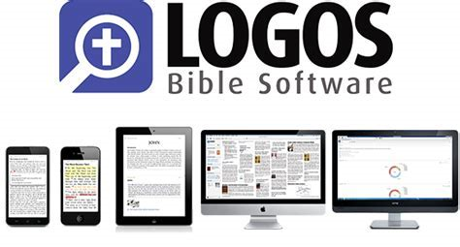
What is Logos?
Logos Bible Software is a tool that combines a digital library of resources indexed to an integrated set of tools and features to support the study of:
Scripture
Theology
Biblical events, places and things
Original language
https://faithlifetv.com/media/677363

Slide 3
Logos can progress to your preferred level
Advanced Language Study (Morphology, Hebrew/Greek Structure, Discourse features)
Language Study (Interlinear, Hermeneutics, Louw-Nida, Seminary Study, Structure, Genre)
Passage/Themed Study (Topics, Factbooks, Theology, Apologetics, Timelines, Patristic, Pericopes)
Linked Study (basic doctrine, study bible, searches, word/concordance, text comparison)
Basic Study (indexed Bible, commentary, dictionary, search, devotional, notes, highlighting, interactive media)
Bronze, Silver, Gold
Targeted Resources
Features/Resources
Starter
Fundamentals
Basic Functionality:
Essential Elements:
Cool Features:
Layouts, Menus & Icons
Prioritized Resources
Home Page
Go Box
Guides
Tools and Docs
QUICKSTART X 3
Linking
Right Click
Basic Search
Hover
Information/Context
Shortcut bar
Highlights/Notes/Tagging
Shortcuts
Specific Resources
Advanced Search
Interactive Media
Passage Analysis
Bible Browser
Floating Windows

Slide 4
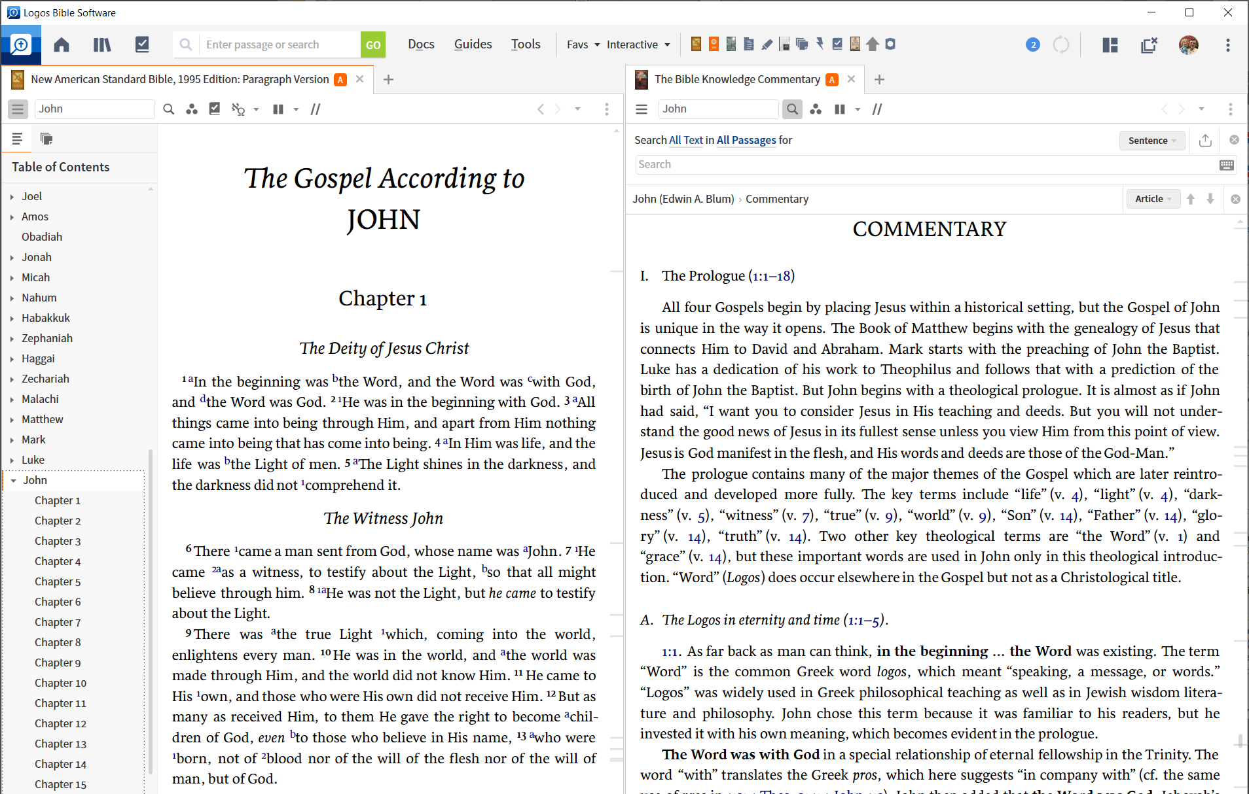
Close All
Shortcuts Bar
Search Panel
Tools
Factbook
Guides
Layouts Menu
Panel Menu
Library (CTRL – L)
Docs
Go Box
Home
The Instrument Panel

Slide 5
Shortcuts Bar
Factbook
Layouts Menu
Go Box
Top 4
Factbook
Go Box
Shortcuts Bar
Layout Menu

Slide 6
Inline Search
Panel Toolbar
The Resource Panel
Sidebar
Panel

Slide 7
Instrument Panel Toolbar (at the top)
Resource Panel Toolbars
(different resource types)

Slide 8
The “Look and Feel” Filter and Menu
Panel Visual Filter | Panel Menu
Addressee Labels (tag) | Set Resource Font Size
Bible Text Formatting | Set / Adjust Link sets
Chapters, Verses, Footnotes, References | Read Aloud (select voice)
One Verse Per Line | Send Hyperlinks Here
Speaker Labels (tag) | Show Locator Bar
Notes and Highlights | Show Table of Contents
Notes and Highlights (Corresponding) | Show Inline Search
Passage Lists | Print/Export
Visual Filters | Show Resource Information
Corresponding Words (hover/click) | Set Columns or Scrolling (column = none)
Footnote Indicators | Reading View
Community Tags | Search: Match All Word Forms
ALSO: FACTBOOK VISUAL FILTER SETTINGS | Search: Match Case

Slide 9
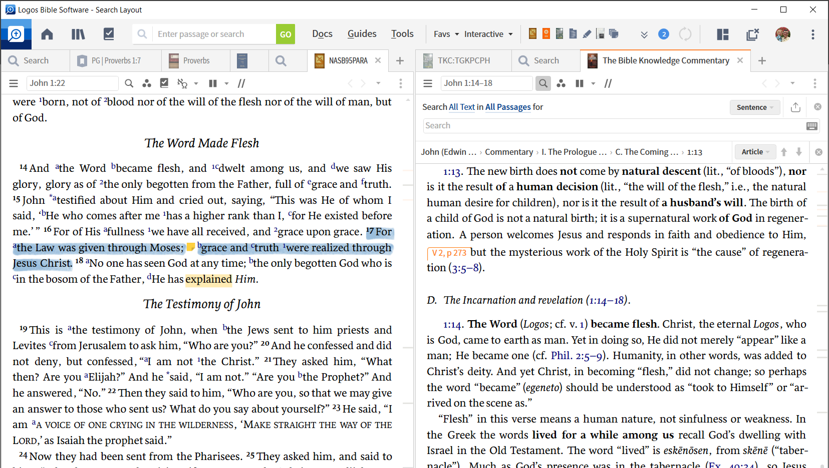
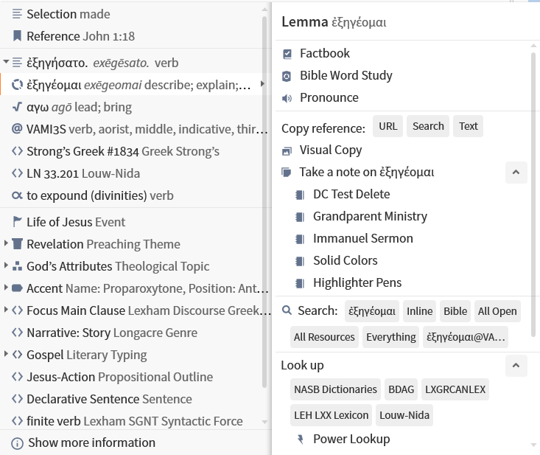
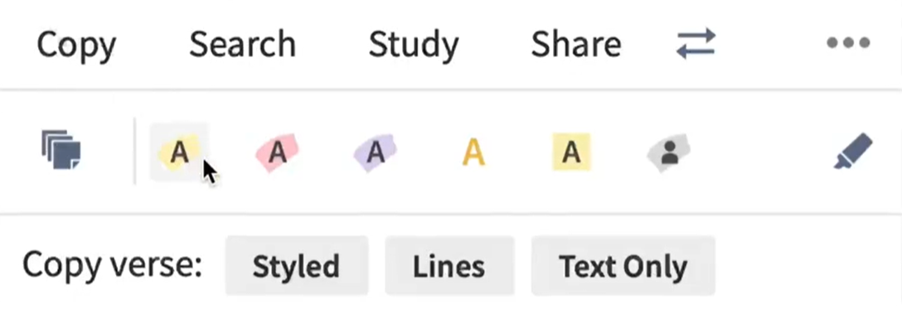
Selection and Context Menus
Selection Menu
(after selecting text)
Context Menu
(right click on a selection)

Slide 10
[Free Webinar] Practical Visual Filters for Bible Reading
Tuesday, Feb 22nd at 1:00 pm CST
Practical Visual Filters for Bible Reading (webinarjam.com)

Slide 11
Notes Panel and Database (+Highlights)
Highlight and/or Note
Personal notes
Pasted Text
Web link
Graphic
Note
Notes Database
Anchors
Bible Verse or Range
Bible Verse or Range
Bible Verse or Range
Text in Resource
always with highlight
Metadata
Type: Highlight or Type: Note
Resource
Bible Book
Notebook
Anchor
Author
Timestamp
Personal Tags
Date
Any Piece of Information
Headword
Anchors to Nothing
Unfiled (i.e. not filed into a notebook)
Notebook

Slide 12
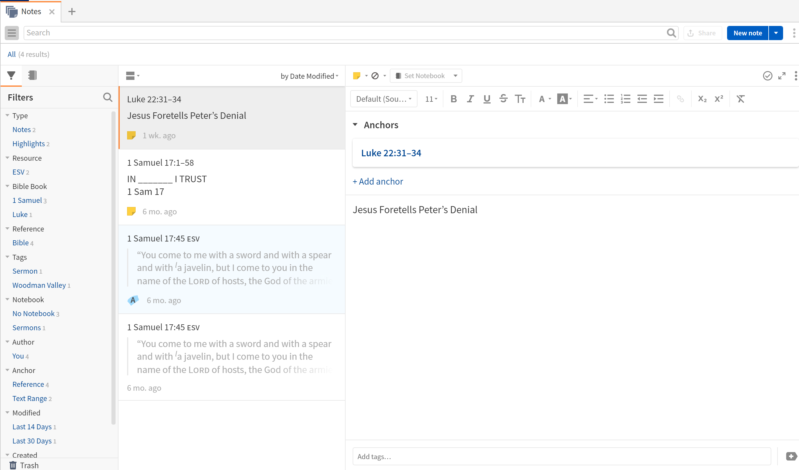
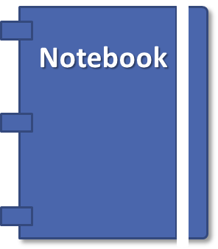
Notes Panel
Add New Note
Pane 1 (Left)
Make Bigger
(aka sidebar)
Add initial anchor (with selection)
Pane 2 (Middle)
Add additional anchors
Search / Filter Results
Type Your Notes Here
Pane 3 (right)
Notes Editor
Add Personal Tags
sidebar

Slide 13
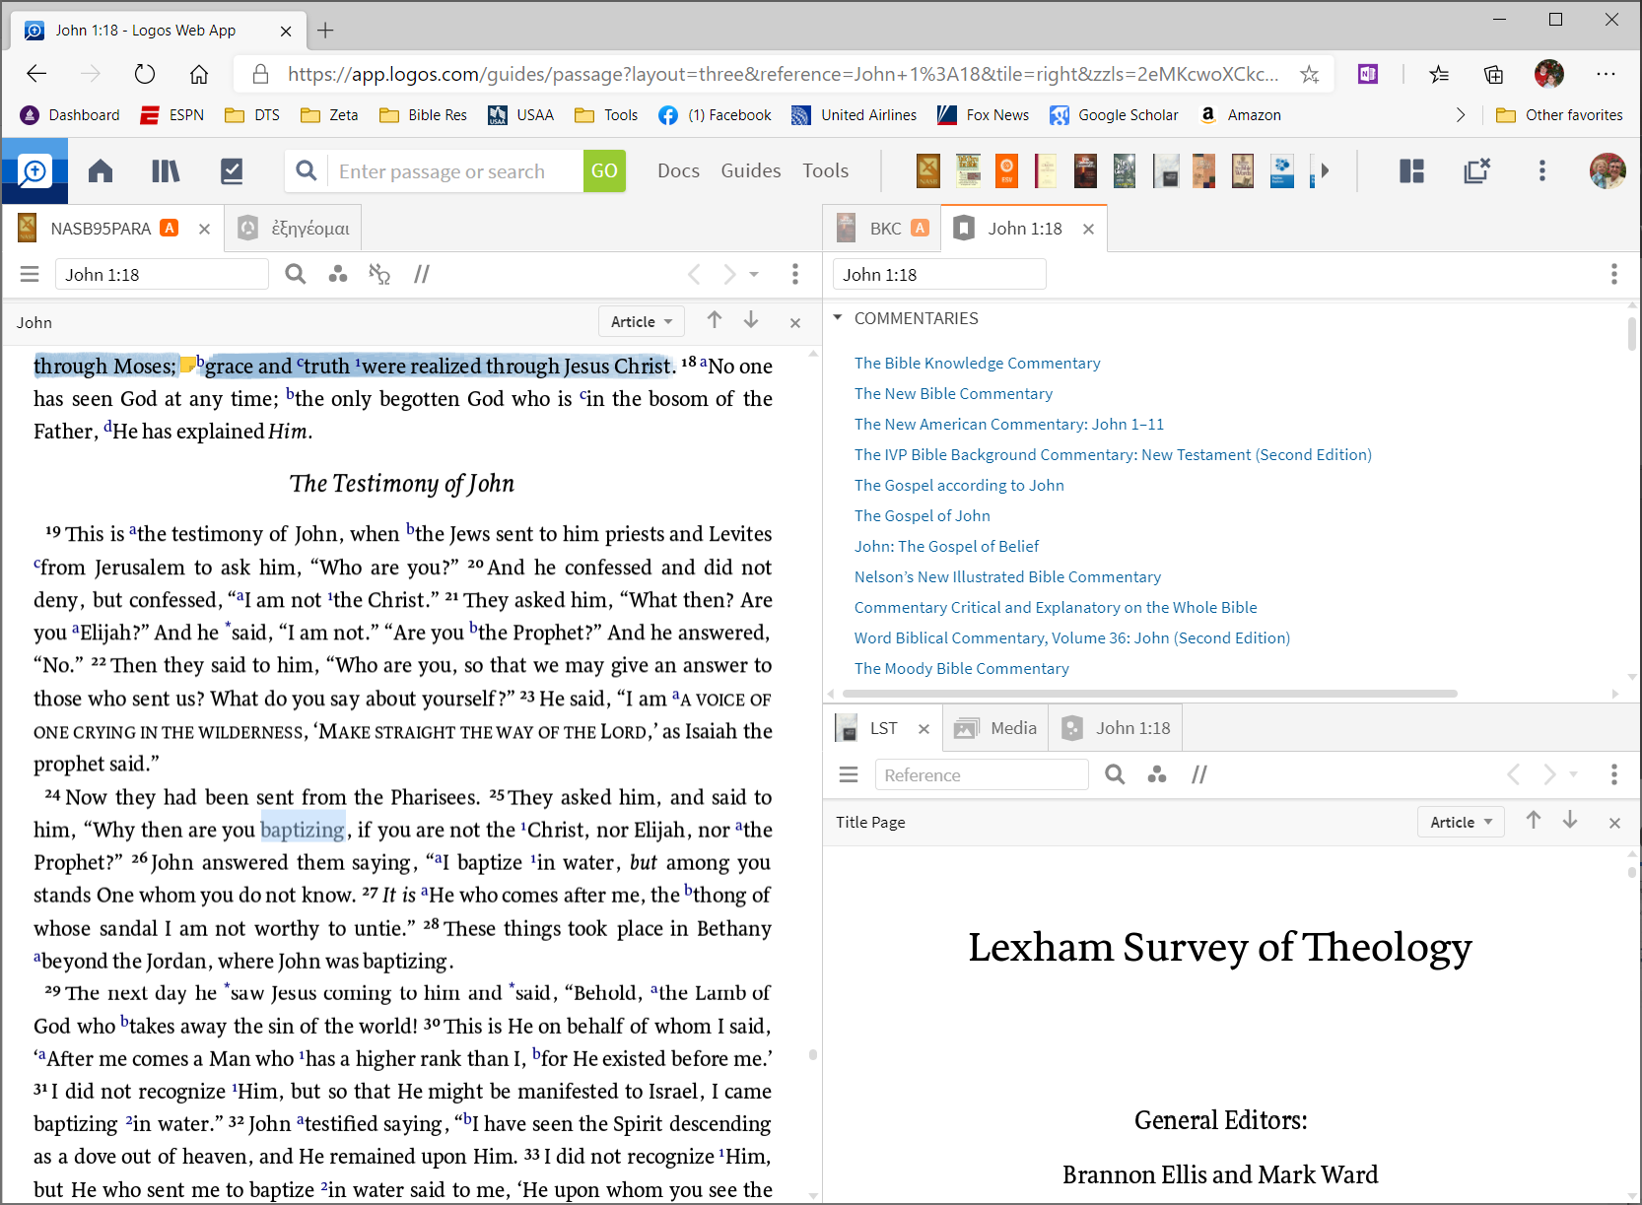
Logos Web App (https://app.logos.com)
A complete set of your resources with limited tool and guide functionality available from any web interface
(all your resources, notes, highlights, etc. are maintained on the Faithlife servers)

Slide 14
Top 5 Things to consider in getting started
Deep and/or Wide
Tailor to your needs and incrementally invest
Get a Quick Start
Master Basic Functionality and Essential Elements
Have the necessary hardware
REALLY consider an SSD; Older PC hardware will frustrate you
Understand the Source!!!!
Logos includes a range of different Biblical Perspectives
Use as a tool for your Spirit-led personal growth
It’s power is in providing an efficient and integrated Study

Slide 15
Take Advantage of Training Resources
For a nice 5 minute overview (https://faithlifetv.com/media/488945)
Quickstart: Master and Succeed (Type “Quickstart” in Go Box)
Tons of on line help at Logos (Logos.com/pro)
YouTube is your friend (search Logos 9)
Facebook Groups on Tips and Tricks
Moe Knows! ($) (mpseminars.com)
There is plenty of FREE help online

Slide 16
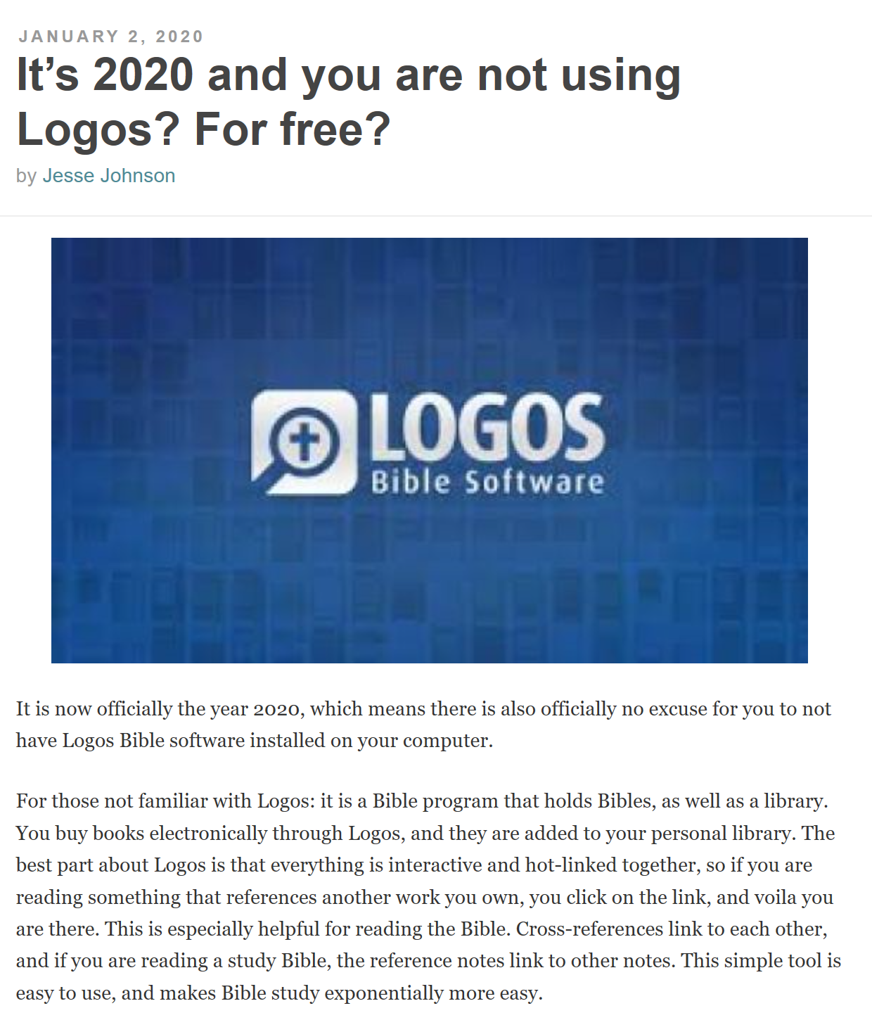
The Cripplegate Blog
Logos.com, Basic 8 Package Free
Lexham English Bible (LEB)
The Holy Bible: King James Version (KJV)
Commentary Critical and Explanatory on the Whole Bible
High Definition Commentary: Romans
Easton's Bible Dictionary
Lexham Bible Dictionary
The Treasury of Scripture Knowledge
Brand New: A 40-Day Guide to Life in Christ
Connect the Testaments: A 365-Day Devotional with Bible Reading Plan
The Pilgrim's Progress
A Pocket Lexicon to the Greek New Testament
The Abridged Brown-Driver-Briggs Hebrew-English Lexicon of the Old Testament
Christianity Today, vol. 1 (October 1956–September 1957) (25 issues)
Disputation of Doctor Martin Luther on the Power and Efficacy of Indulgences (95 Theses)
The Confessions of Saint Augustine
Faithlife Study Bible Infographics, Notes, Photos, Video Resources
Mobile Ed: NT313 Jesus and the Witness of the Outsiders (1 hour course - audio)

Slide 17
Book Name | Abbreviations | Book Name | Abbreviations | Book Name | Abbreviations | Book Name | Abbreviations
Genesis | Gen, Ge, Gn | Ecclesiastes | Eccles, Eccle, Ecc, Ec, Qoh | Matthew | Matt, Mt | 1 Timothy | 1 Tim, 1 Ti, I Ti, 1Ti, I Tim, 1Tim, I Timothy, 1st Tim,
Exodus | Exod, Exo, Ex | Song of Solomon | Song of Songs, Song, So, SOS, Canticles, Cant | Mark | Mrk, Mar, Mk, Mr | 2 Timothy | 2Timothy, 2nd Tim, 2nd Timothy, Second Tim
Leviticus | Lev, Le, Lv | Isaiah | Isa, Is | Luke | Luk, Lk | Titus | Titus, Tit, Ti
Numbers | Num, Nu, Nm, Nb | Jeremiah | Jer, Je, Jr | John | John, Joh, Jhn, Jn | Philemon | Philem, Phm, Pm
Deuteronomy | Deut, De, Dt | Lamentations | Lam, La | Acts | Act, Ac | Hebrews | Hebrews, Heb
Joshua | Josh, Jos, Jsh | Ezekiel | Ezek, Eze, Ezk | Romans | Rom, Ro, Rm | James | James, Jas, Jm
Judges | Judg, Jdg, Jg, Jdgs | Daniel | Dan, Da, Dn | 1 Corinthians | 1 Cor, 1 Co, I Co, 1Co, I Cor, 1Cor | 1 Peter | 1 Pet, 1 Pe, I Pe, 1Pe, I Pet, 1Pet, I Pt, 1 Pt, 1Pt
Ruth | Rth, Ru | Hosea | Hos, Ho | 2 Corinthians | 2 Cor, 2 Co, II Co, 2Co, II Cor, 2Cor | 2 Peter | 2P, II Peter, 2Peter, 2nd Peter, Second Peter
1 Samuel | 1 Sam, 1 Sa, 1S, I Sa, 1 Sm, 1Sa, 1Sam | Joel | Joe, Jl | Galatians | Gal, Ga | 1 John | 1 John, 1 Jn, I Jn, 1Jn, I Jo, 1John
2 Samuel | 2 Sam, 2 Sa, 2S, II Sa, 2 Sm, 2Sa, II Sam | Amos | Am | Ephesians | Ephes, Eph | 2 John | 2 John, 2 Jn, II Jn, 2Jn, II Jo, 2Jo
1 Kings | 1 Kgs, 1 Ki, 1K, I Kgs, 1Kgs, I Ki, 1Ki, | Obadiah | Obad, Ob | Philippians | Phil, Php, Pp | 3 John | III John, 3John, 3rd John, Third John
2 Kings | 2 Kgs, 2 Ki, 2K, II Kgs, 2Kgs, II Ki, 2Ki | Jonah | Jnh, Jon | Colossians | Col, Co | Jude | Jude, Jud, Jd
1 Chronicles | 1 Chron, 1 Ch, I Ch, 1Ch, 1 Chr, I Chr, 1Chr, I Chron, 1Chron | Micah | Micah, Mic, Mc | 1 Thessalonians | 1 Thess, 1 Th, I Th, 1Th, I Thes, 1Thes, I Thess | Revelation | Rev, Re, The Revelation
2 Chronicles | 2 Chron, 2 Ch, II Ch, 2Ch, II Chr, 2Chr, II Chron, 2Chron | Nahum | Nah, Na | 2 Thessalonians | 2 Th, II Th, 2Th, II Thes, 2Thes, II Thess, 2Thess
Ezra | Ezr, Ez | Habakkuk | Hab, Hab, Hb
Nehemiah | Neh, Ne | Zephaniah | Zeph, Zep, Zp
Esther | Esth, Es | Haggai | Haggai, Hag, Hg
Job | Jb | Zechariah | Zech, Zec, Zc
Psalms | Psalm, Pslm, Ps, Psa, Psm, Pss | Malachi | Mal, Mal, Ml
Proverbs | Prov, Pro, Pr, Prv
HINTS
USE LOGICAL ABBREVIATIONS!!!
USE SPACES (OR NOT) WITH VERSE NUMBERS
USE <TAB> WHILE IN A BIBLE TO ENTER VERSE

Slide 18
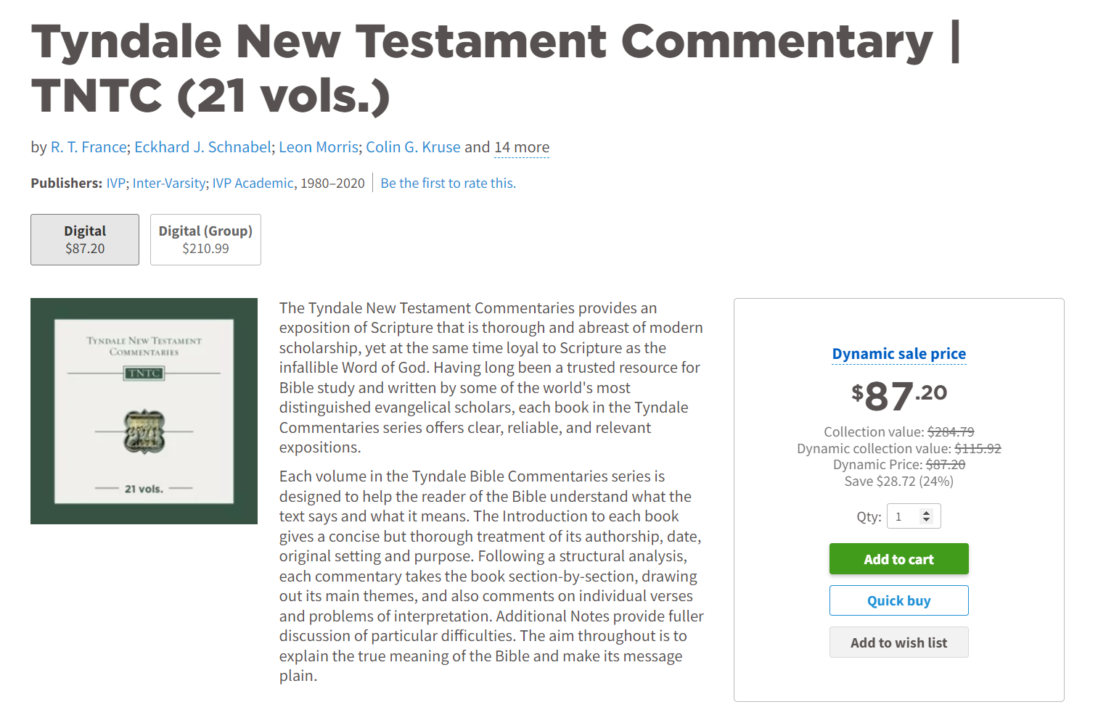
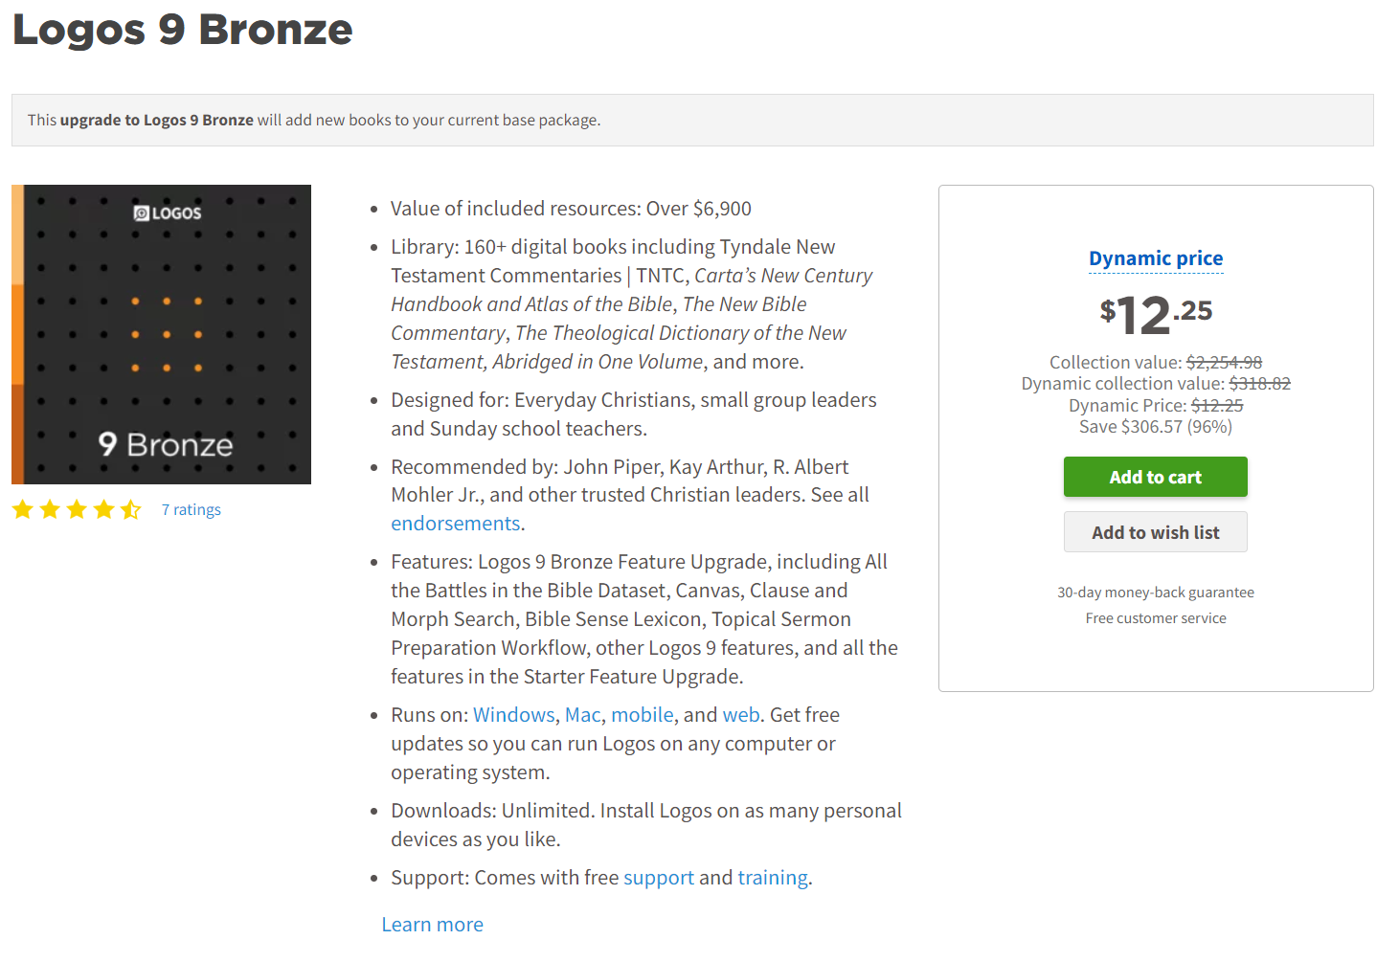

Slide 19
Here’s the Difference I got in Bronze

Slide 20
Instrument Panel Toolbar (at the top)
Panel Toolbar - Bible
Panel Toolbar - Commentary
Panel Toolbar – Basic Resource

Slide 21
Background
Kirk and Mary Streitmater
IBC Members, have attended since 2000
IBI Teacher for Bible and Grandparenting Courses
Graduated from Dallas Theological Seminary in 2021
MA in Christian Leadership
Personal Logos library ~ 3700 resources (will use my personal package for demonstration)
Intro: Name, Logos Experience/Package, plans for use

Slide 22
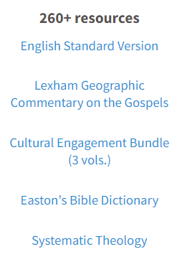
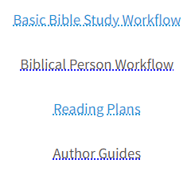
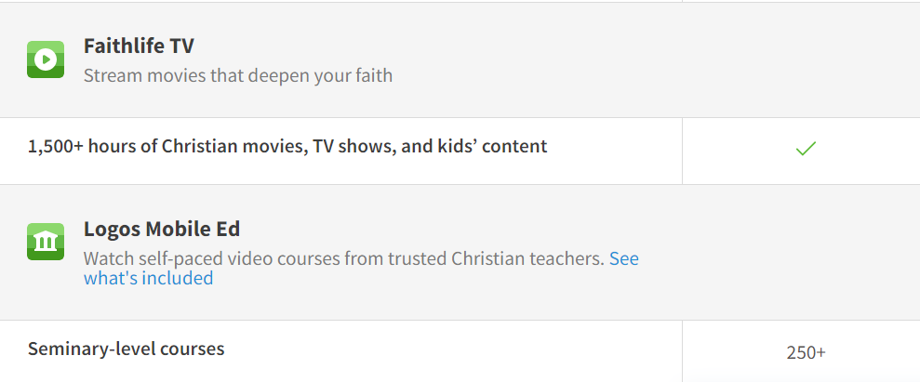
Logos Connect
Highlighted Books
Highlighted Features

Slide 23
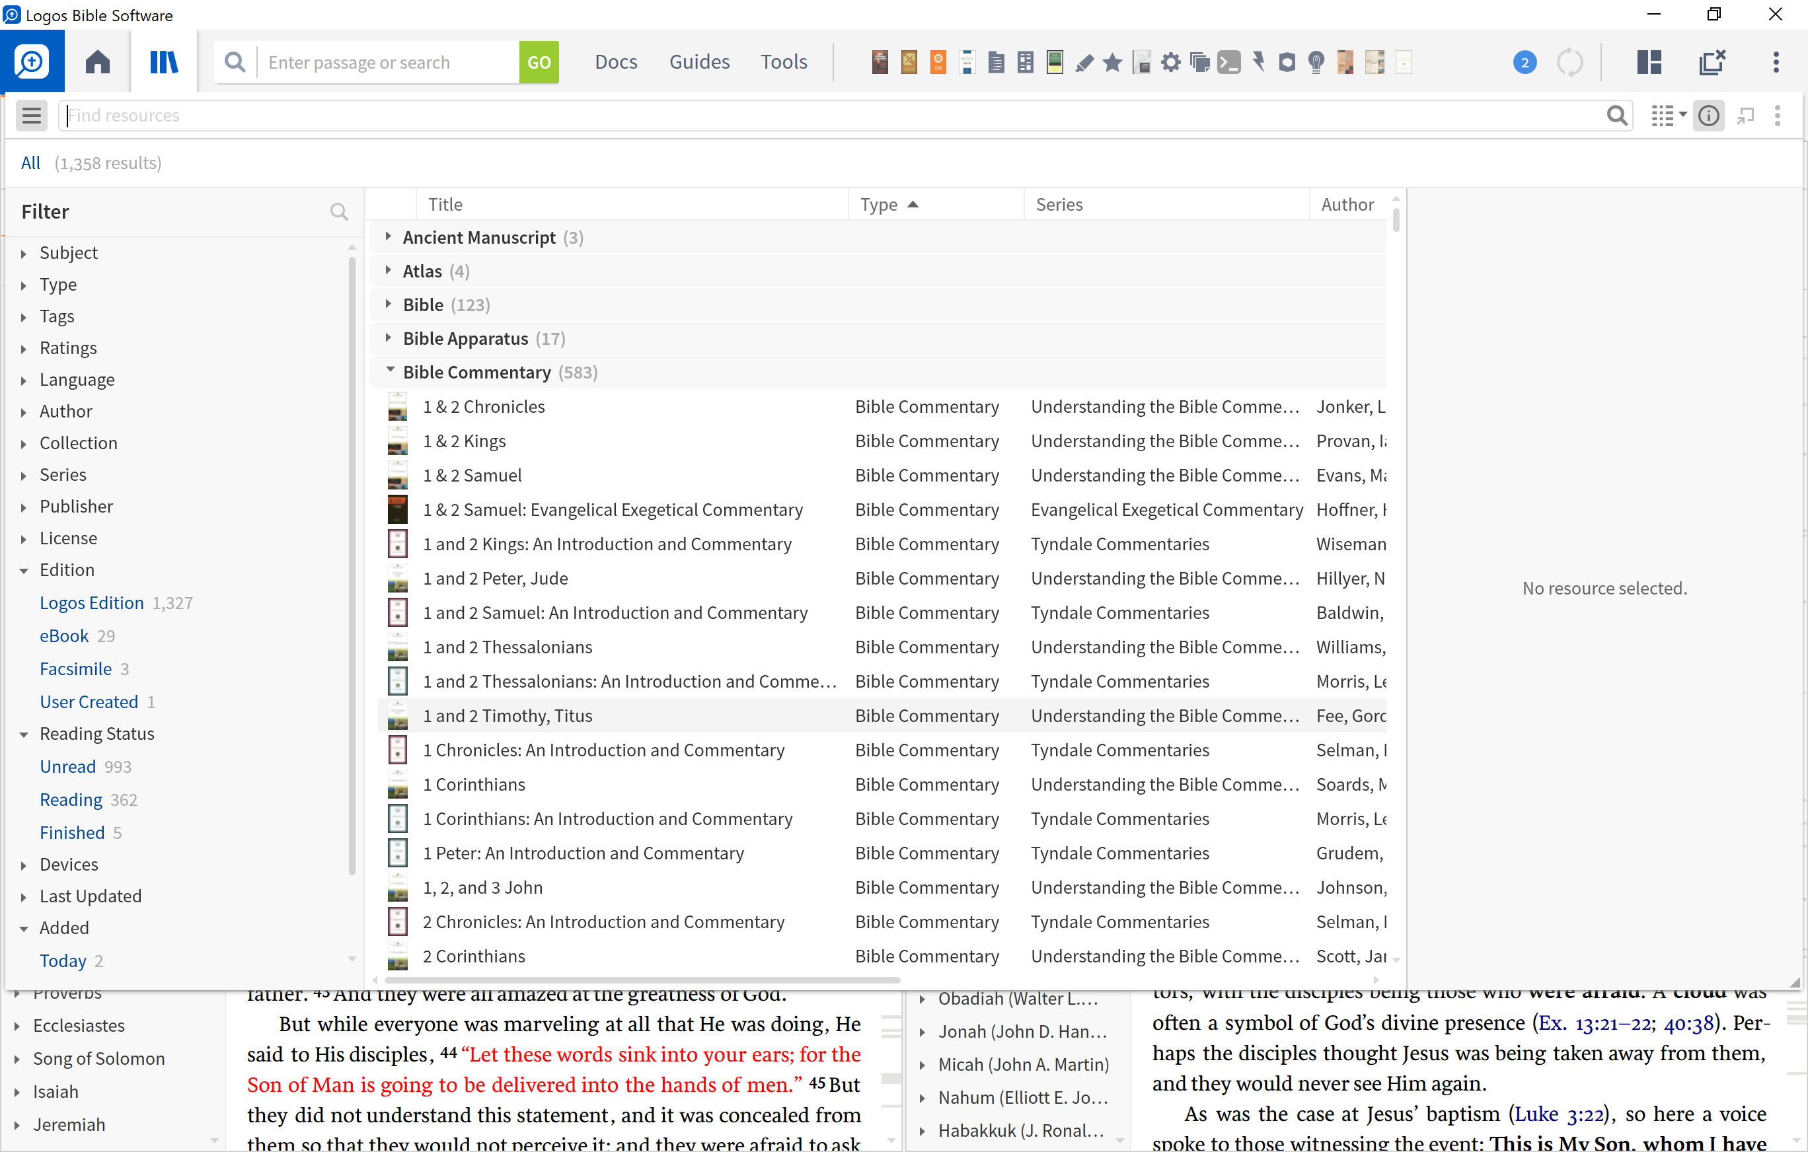
Library (CTRL – L)
Your digital library sorts, filters and organizes your personal resources
This is where you prioritize your resources!
(or CMD – L)

Slide 24
Interlinear Layered Text
Front View | Side View
16 “For God so loved the world, that He gave His only begotten Son, that whoever believes in Him shall not perish, but have eternal life. 17 For God did not send the Son into the world to judge the world, but that the world might be saved through Him. 18 He who believes in Him is not judged; he who does not believe has been judged already, because he has not believed in the name of the only begotten Son of God. 19 This is the judgment, that the Light has come into the world, and men loved the darkness rather than the Light, for their deeds were evil. 20 For everyone who does evil hates the Light, and does not come to the Light for fear that his deeds will be exposed. 21 But he who practices the truth comes to the Light, so that his deeds may be manifested as having been wrought in God.” 22 After these things Jesus and His disciples came into the land of Judea, and there He was spending time with them and baptizing. 23 John also was baptizing in Aenon near Salim, because there was much water there; and people were coming and were being baptized— 24 for John had not yet been thrown into prison. | English (Surface)
 | Hebrew / Greek Lemmas
 | Hebrew / Greek Manuscripts
 | Morphology
 | Louw-Nida Numbers
 | Sense
Source: MP Seminars

Slide 25
Panel Toolbar
1
2
3
4
5
6
7
8
9
10
11
The navigation/sidebar menu: opens the sidebar with tabs for the resource’s table of contents
1
2
The location box: displays your current location within the open resource (bible, book, commentary)
The inline search button: enables you to perform a Basic, Bible, or Morph searches
3
4
The visual filters button: allows you to choose which visual filters are displayed (“Look and Feel”)
5
The Factbook button: turns on a factbook panel for additional study on a topic
6
The interlinear button: toggles the inline interlinear and/or the interlinear ribbon
The multiple resources button: allows you to open two or more resources in parallel
7
The parallel resource sets button: choose which sets of parallel resources to use (with arrow keys)
8
9
The navigation arrows: move backward and forward through the panel’s history
10
The panel history button: displays the resource locations opened within current panel
11
The panel menu button: opens the resource panel menu and lets you select panel layout options

Slide 26
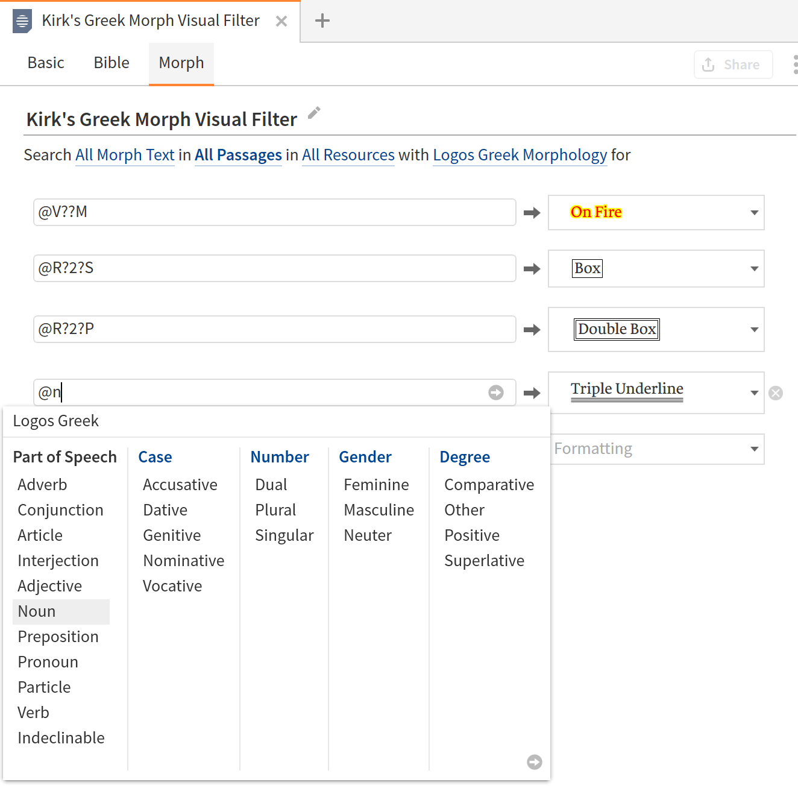
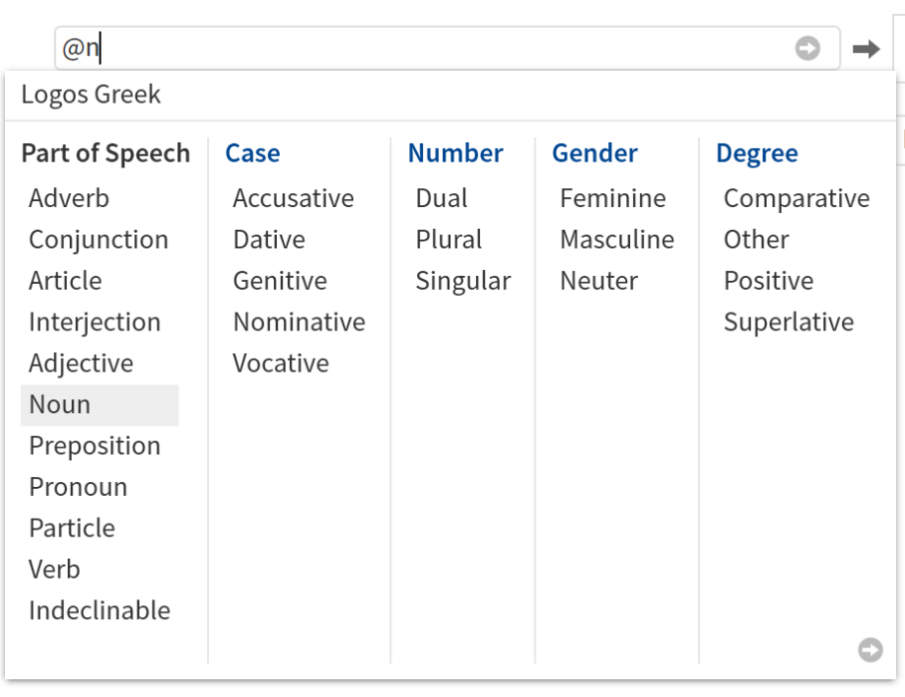
Morphological Visual Filter Options

Slide 27
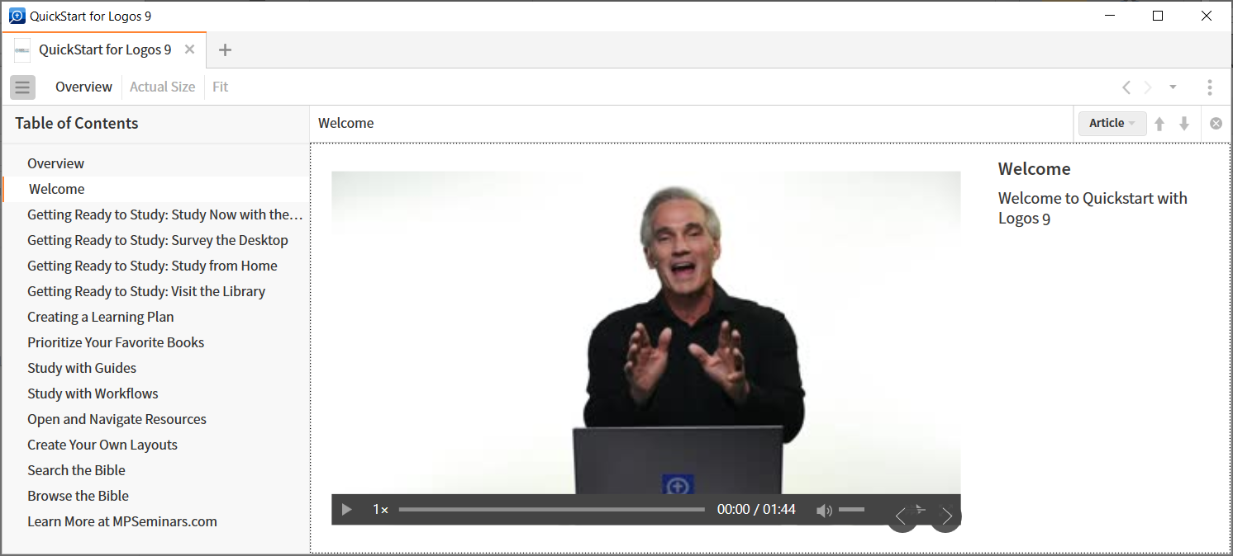
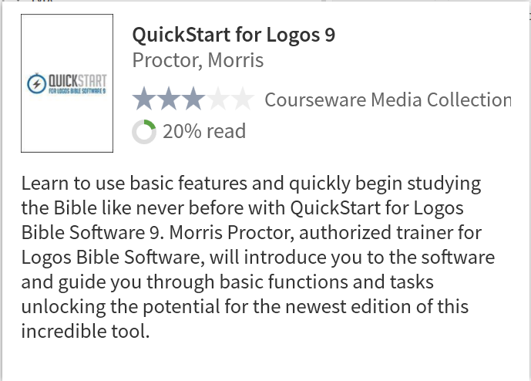
Logos 9 Quick Start (type “quickstart” in GO BOX)

Slide 28
Quickstart
Welcome
Study Now with the Go Box
Survey the Desktop
Study from Home
Visit the Library
Create a Reading Plan
Prioritize Your Favorite Books
Study with Guides
Study with Workflows
Open and Navigate Resources
Create Your Own Layouts
Search the Bible
Browse the Bible
Learn More

