Slide 1
Logos Week 2
Kirk Streitmater

Slide 2
Agenda
A quick overview of displays
- Instrument panel
- Panel and panel menu
Online Demo
- Basic layouts, guides, workflows and functions
- Highlighting strategy
- Q & A
- A couple of good resources

Slide 3
Logos can progress to your preferred level
Advanced Language Study
(Morphology, Hebrew/Greek Structure, Discourse features)
Language Study
(Interlinear, Hermeneutics, Louw-Nida, Seminary Study, Structure, Genre)
Passage/Themed Study
(Topics, Factbooks, Theology, Apologetics, Timelines, Patristic, Pericopes)
Linked Study
(basic doctrine, study bible, searches, word/concordance, text comparison)
Basic Study
(indexed Bible, commentary, dictionary, search, devotional, notes, highlighting, interactives)
Bronze, Silver, Gold
Most of us live here
Features/Resources
Starter
Fundamentals
+ Targeted
Resources
Tailor Your Features and Resources

Slide 4
Stepping through the necessary things to know
Build on Basic and Essential items…and practice
Basic Functionality:
Essential Things to Know:
Cool Features:
Layouts, Panels & Icons
Prioritized Resources
Home Page
Go Box
Guides
Tools and Docs
QUICKSTART X 3
Linking
Right Click
Basic Search
Hover
Information/Context
Shortcut bar
Highlights/Notes/Tagging
Shortcuts
Specific Resources
Advanced Search
Interactive Media
Passage Analysis
Bible Browser
Floating Windows

Slide 5
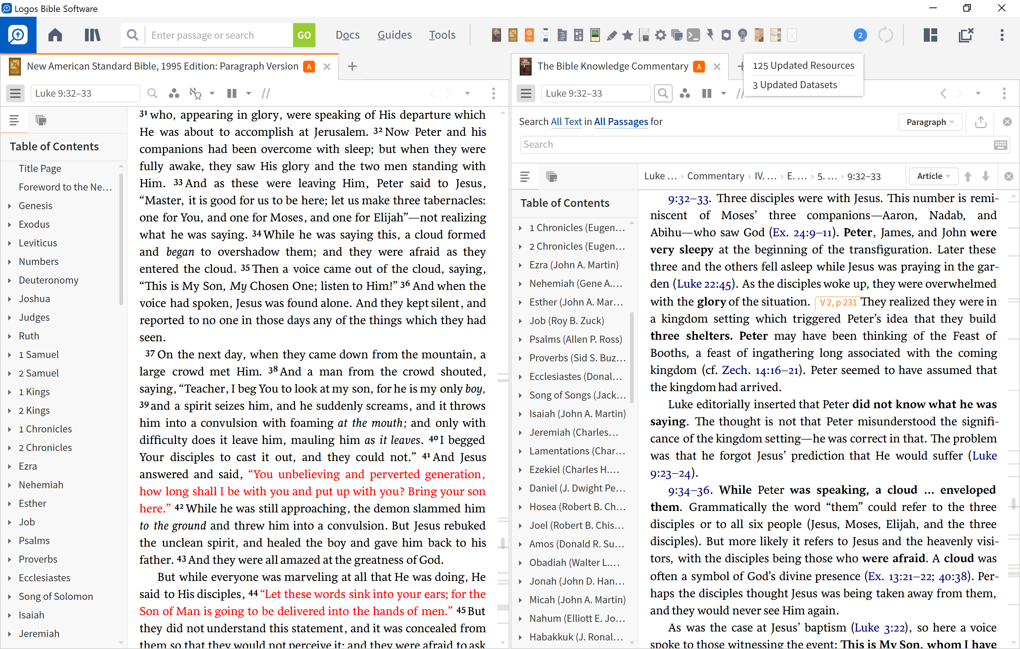
Close All
Shortcuts Bar
Search
Tools
Library (CTRL – L)
Guides
Layouts Menu
Panel Menu
Docs
Home
Go Box
The Instrument Panel

Slide 6
Navigation/
Side Bar
Panel Menu
The Resource Panel
Panel

Slide 7
Panel Toolbar
1
2
3
4
5
6
7
8
9
10
The navigation/sidebar menu: opens the sidebar with tabs for the resource’s table of contents
1
The location box: displays your current location within the open resource (bible, book, commentary)
2
The inline search button: enables you to perform a Basic, Bible, or Morph searches
3
The visual filters button: allows you to choose which visual filters are displayed (“Look and Feel”)
4
The interlinear button: toggles the inline interlinear and/or the interlinear ribbon
5
The multiple resources button: allows you to open two or more resources in parallel
6
The parallel resource sets button: choose which sets of parallel resources to use (with arrow keys).
7
8
The navigation arrows: move backward and forward through the panel’s history.
9
The panel history button: displays the resources and pages opened within current panel
10
The panel menu button: opens the resource panel menu and lets you select panel layout options

Slide 8
Book Name | Abbreviations | Book Name | Abbreviations | Book Name | Abbreviations | Book Name | Abbreviations
Genesis | Gen, Ge, Gn | Ecclesiastes | Eccles, Eccle, Ecc, Ec, Qoh | Matthew | Matt, Mt | 1 Timothy | 1 Tim, 1 Ti, I Ti, 1Ti, I Tim, 1Tim, I Timothy, 1st Tim,
Exodus | Exod, Exo, Ex | Song of Solomon | Song of Songs, Song, So, SOS, Canticles, Cant | Mark | Mrk, Mar, Mk, Mr | 2 Timothy | 2Timothy, 2nd Tim, 2nd Timothy, Second Tim
Leviticus | Lev, Le, Lv | Isaiah | Isa, Is | Luke | Luk, Lk | Titus | Titus, Tit, Ti
Numbers | Num, Nu, Nm, Nb | Jeremiah | Jer, Je, Jr | John | John, Joh, Jhn, Jn | Philemon | Philem, Phm, Pm
Deuteronomy | Deut, De, Dt | Lamentations | Lam, La | Acts | Act, Ac | Hebrews | Hebrews, Heb
Joshua | Josh, Jos, Jsh | Ezekiel | Ezek, Eze, Ezk | Romans | Rom, Ro, Rm | James | James, Jas, Jm
Judges | Judg, Jdg, Jg, Jdgs | Daniel | Dan, Da, Dn | 1 Corinthians | 1 Cor, 1 Co, I Co, 1Co, I Cor, 1Cor | 1 Peter | 1 Pet, 1 Pe, I Pe, 1Pe, I Pet, 1Pet, I Pt, 1 Pt, 1Pt
Ruth | Rth, Ru | Hosea | Hos, Ho | 2 Corinthians | 2 Cor, 2 Co, II Co, 2Co, II Cor, 2Cor | 2 Peter | 2P, II Peter, 2Peter, 2nd Peter, Second Peter
1 Samuel | 1 Sam, 1 Sa, 1S, I Sa, 1 Sm, 1Sa, 1Sam | Joel | Joe, Jl | Galatians | Gal, Ga | 1 John | 1 John, 1 Jn, I Jn, 1Jn, I Jo, 1John
2 Samuel | 2 Sam, 2 Sa, 2S, II Sa, 2 Sm, 2Sa, II Sam | Amos | Am | Ephesians | Ephes, Eph | 2 John | 2 John, 2 Jn, II Jn, 2Jn, II Jo, 2Jo
1 Kings | 1 Kgs, 1 Ki, 1K, I Kgs, 1Kgs, I Ki, 1Ki, | Obadiah | Obad, Ob | Philippians | Phil, Php, Pp | 3 John | III John, 3John, 3rd John, Third John
2 Kings | 2 Kgs, 2 Ki, 2K, II Kgs, 2Kgs, II Ki, 2Ki | Jonah | Jnh, Jon | Colossians | Col, Co | Jude | Jude, Jud, Jd
1 Chronicles | 1 Chron, 1 Ch, I Ch, 1Ch, 1 Chr, I Chr, 1Chr, I Chron, 1Chron | Micah | Micah, Mic, Mc | 1 Thessalonians | 1 Thess, 1 Th, I Th, 1Th, I Thes, 1Thes, I Thess | Revelation | Rev, Re, The Revelation
2 Chronicles | 2 Chron, 2 Ch, II Ch, 2Ch, II Chr, 2Chr, II Chron, 2Chron | Nahum | Nah, Na | 2 Thessalonians | 2 Th, II Th, 2Th, II Thes, 2Thes, II Thess, 2Thess
Ezra | Ezr, Ez | Habakkuk | Hab, Hab, Hb
Nehemiah | Neh, Ne | Zephaniah | Zeph, Zep, Zp
Esther | Esth, Es | Haggai | Haggai, Hag, Hg
Job | Jb | Zechariah | Zech, Zec, Zc
Psalms | Psalm, Pslm, Ps, Psa, Psm, Pss | Malachi | Mal, Mal, Ml
Proverbs | Prov, Pro, Pr, Prv
HINTS
USE LOGICAL ABBREVIATIONS!!!
USE SPACES (OR NOT) WITH VERSE NUMBERS
USE <TAB> WHILE IN A BIBLE TO ENTER VERSE
If remaining in the same book, just chapter and verse
If remaining in the same chapter, just verse number

Slide 9
3 ways to search…
Go Box
SeaRCH PANEL
INLINE SEARCH
Use the auto populate feature to get hints and recommendations for guides, tools, layouts, verses, subjects, etc.
BIBLE
English words
Advance options in sidebar
BASIC
MEDIA
MORPH
Search within a resource
Bibles
Commentaries
Books
Use CTRL + F (or CMD + F for Mac)
SIMPLE FIND
HINT: TAILOR YOUR SEARCH AREA

Slide 10
Demo
Layouts, Panels and Icons
Reviewing your library
Setting up your Preferred Resources
Preferred Bible
Preferred Whole Bible Commentary
Dragging a Commentary Series
Preferred Dictionary
Preferred Lectionary (where applicable)
Highlighting Strategy + Shortcuts
Basic Bible Study Layout
Linking resources
Setting up visual filters
Checking parallel resources
Work your way around resources
Visual Filters/Columns
Passage Study
Go Box
Layouts
Reading Plans & Daily Devotionals
Word Study – English/Greek/Hebrew
Introduction to Notes

Slide 11
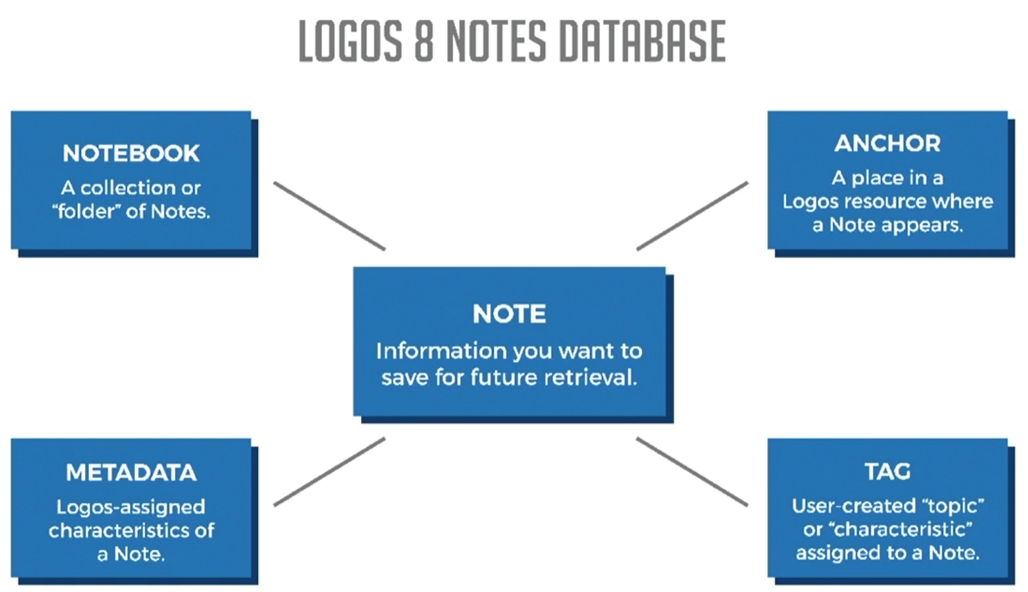
Logos Notes Summary
Source: MPSEMINARS.COM

Slide 12
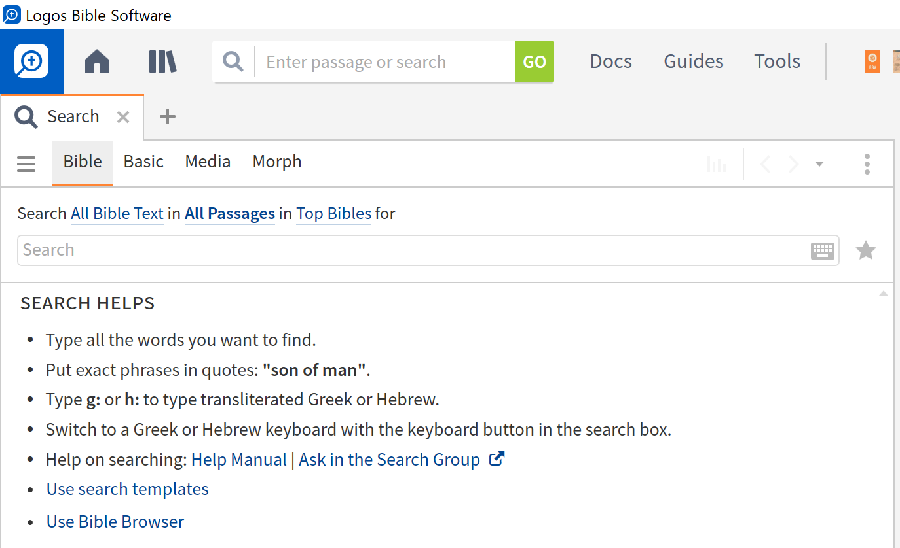
Search Panel Details
SELECT A SEARCH TYPE (OUR focus: Bible or Basic)
SELECT A SEARCH AREA
ENTER YOUR SEARCH TERMS
Check out the HELPS and TEMPLATES

Slide 13
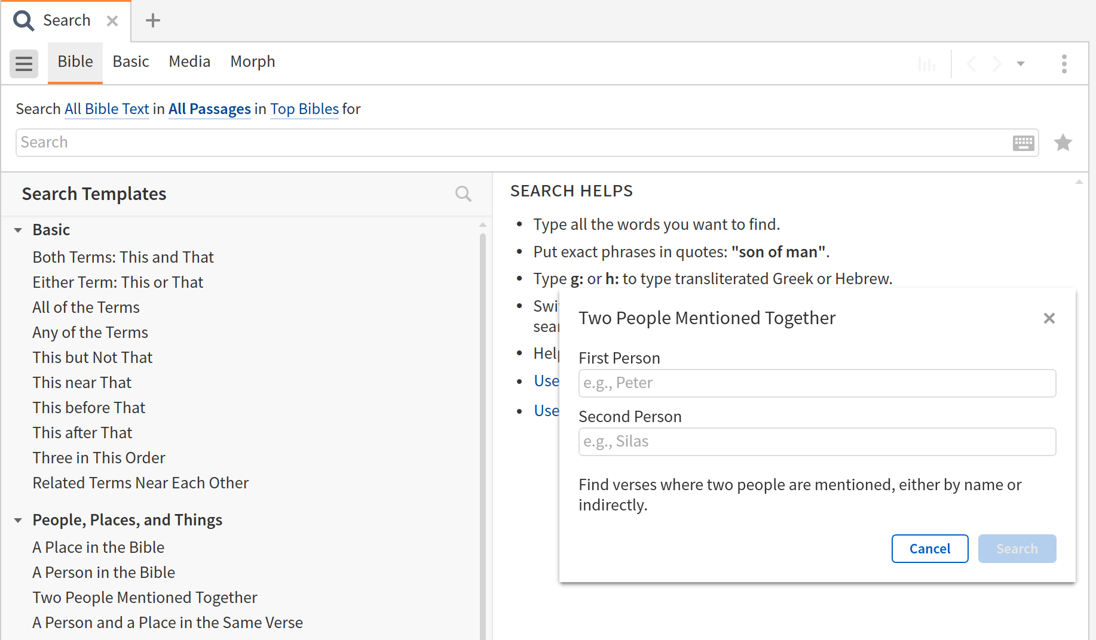
Search Templates (toggle the sidebar)

Slide 14
In line search

Slide 15
Some Resources
Topical Analysis of The Bible (in Starter)
The New Moody Atlas of the Bible
The International Standard Bible Encyclopedia
Talk thru the Bible
A good systematic theology (Erickson, MacArthur, LST)

Slide 16
Guides

Slide 17
Tools and References

