Slide 1
Logos Demonstration
Kirk Streitmater

Slide 2
Agenda
Background & Logos Intro
Stepping through the necessary
Logos 8 Quickstart
Online Demo
For today…
Watch
Listen
Ask Questions
&
Don’t sweat the details…

Slide 3
Background
Kirk and Mary Streitmater
IBC Members, have attended since 2000
Retired Air Force
Senior Program Manager
Currently enrolled at Dallas Theological Seminary
Includes Logos 8 seminary package that conveys at graduation (will use for week 1 demonstration)
3-year program concurrent with work and travel

Slide 4
What is Logos?
Logos Bible Software is a tool that combines a digital library of resources indexed to an integrated set of tools and features to support the study of:
Scripture
Theology
Biblical events, places and things
Original language
https://faithlifetv.com/media/677363

Slide 5
Logos can progress to your preferred level
Advanced Language Study
(Morphology, Hebrew/Greek Structure, Discourse features)
Language Study
(Interlinear, Hermeneutics, Louw-Nida, Seminary Study, Structure, Genre)
Passage/Themed Study
(Topics, Factbooks, Theology, Apologetics, Timelines, Patristic, Pericopes)
Linked Study
(basic doctrine, study bible, searches, word/concordance, text comparison)
Basic Study
(indexed Bible, commentary, dictionary, search, devotional, notes, highlighting, interactives)
Bronze, Silver, Gold
Most of us live here
Features/Resources
Starter
Fundamentals
+ Targeted
Resources
Tailor Your Features and Resources

Slide 6
Stepping through the necessary things to know
Build on Basic and Essential items…and practice
Basic Functionality:
Essential Things to Know:
Cool Features:
Layouts, Panels & Icons
Prioritized Resources
Home Page
Go Box
Guides
Tools and Docs
QUICKSTART X 3
Linking
Right Click
Basic Search
Hover
Information/Context
Shortcut bar
Highlights/Notes/Tagging
Shortcuts
Specific Resources
Advanced Search
Interactive Media
Passage Analysis
Bible Browser
Floating Windows

Slide 7
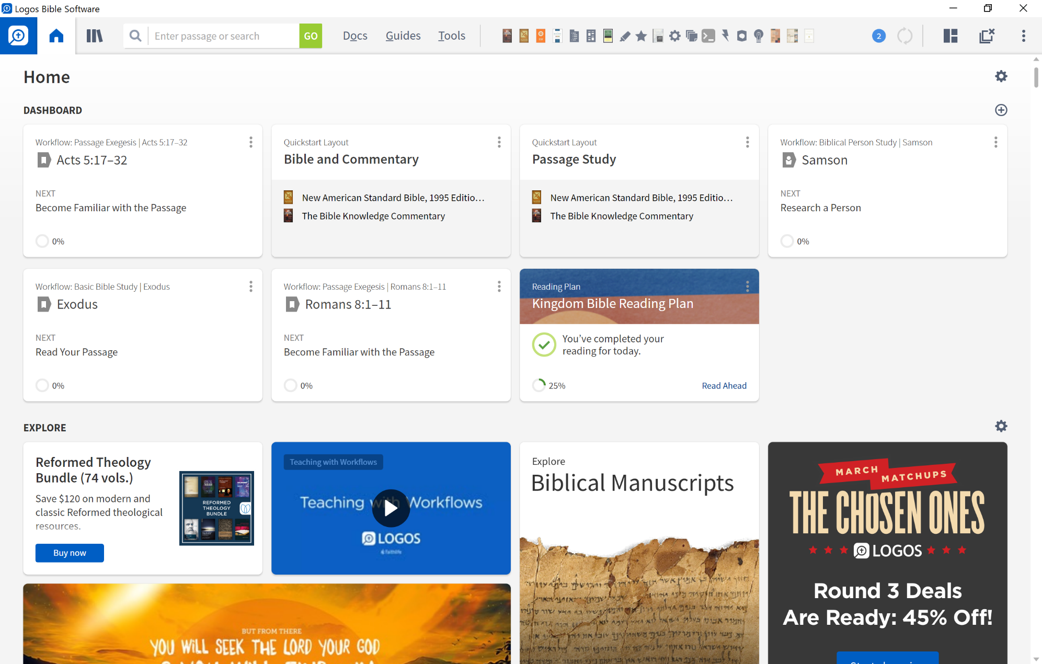
Home Page
A perfect jumping off point!!!

Slide 8
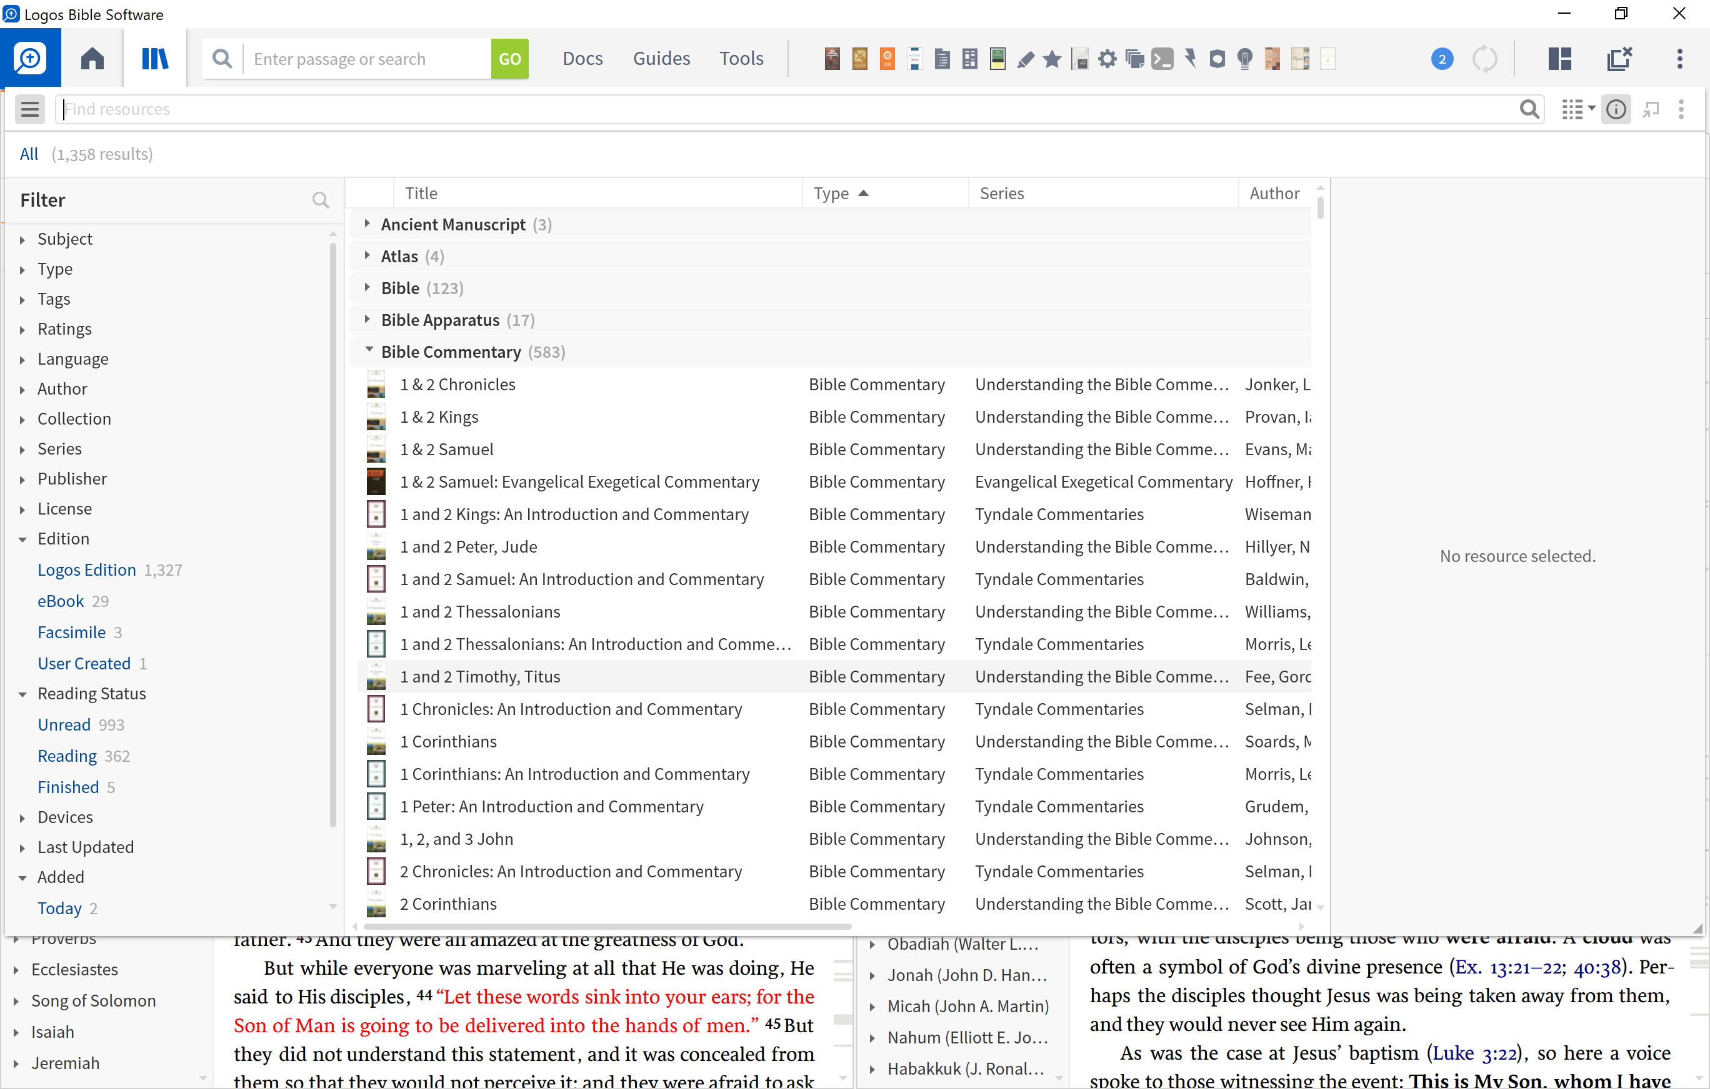
Library
You digital library that is sorted and organized
Where you prioritize your resources!
(CTRL – L)

Slide 9
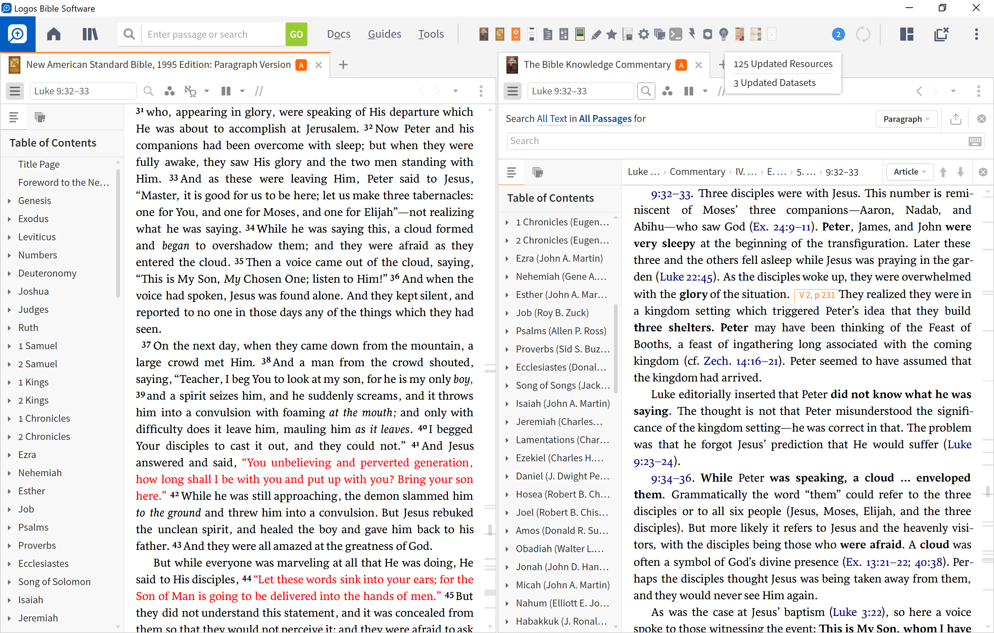
Close All
Shortcuts Bar
Search
Tools
Library (CTRL – L)
Guides
Layouts Menu
Panel Menu
Docs
Home
Go Box
Instrument Panel
Top 3
Go Box
Shortcuts Bar
Layout Menu
The Instrument Panel

Slide 10
Navigation/
Side Bar
Panel Menu
The Resource Panel
Panel

Slide 11
Panel Toolbar
1
2
3
4
5
6
7
8
9
10
The navigation/sidebar menu: opens the sidebar with tabs for the resource’s table of contents
1
The location box: displays your current location within the open resource (bible, book, commentary)
2
The inline search button: enables you to perform a Basic, Bible, or Morph searches
3
The visual filters button: allows you to choose which visual filters are displayed (“Look and Feel”)
4
The interlinear button: toggles the inline interlinear and/or the interlinear ribbon
5
The multiple resources button: allows you to open two or more resources in parallel
6
The parallel resource sets button: choose which sets of parallel resources to use (with arrow keys).
7
8
The navigation arrows: move backward and forward through the panel’s history.
9
The panel history button: displays the resources and pages opened within current panel
10
The panel menu button: opens the resource panel menu and lets you select panel layout options

Slide 12
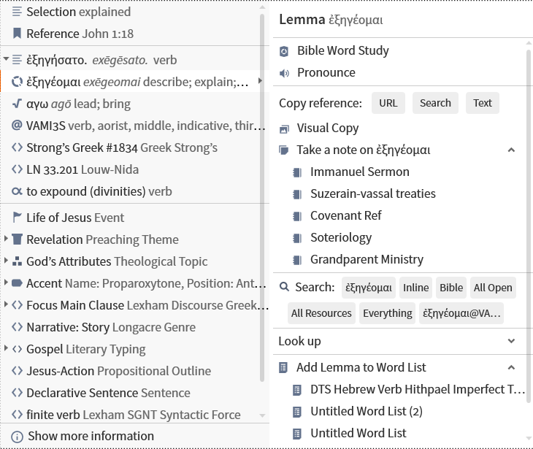
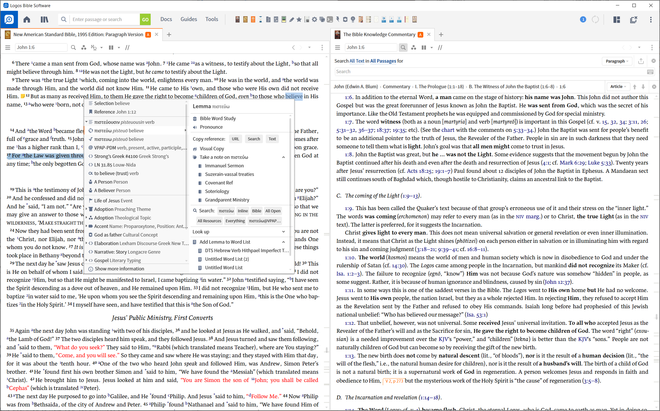
Context Menu
Context Menu

Slide 13
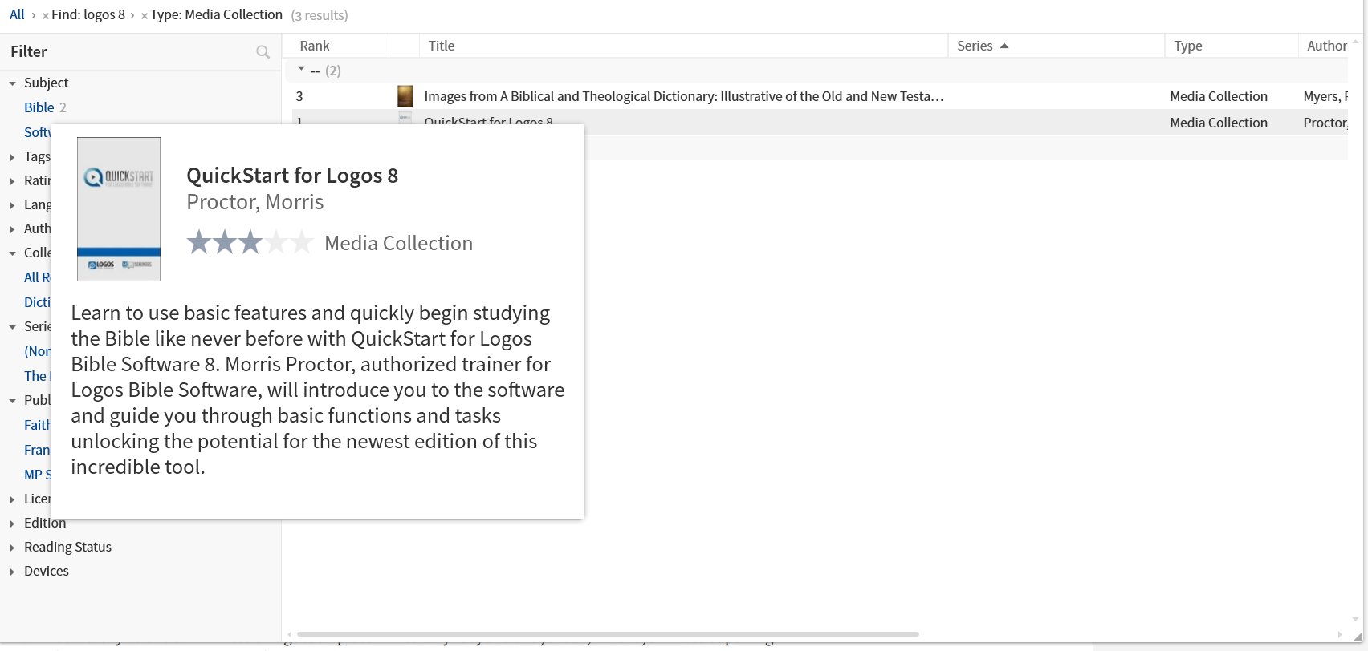
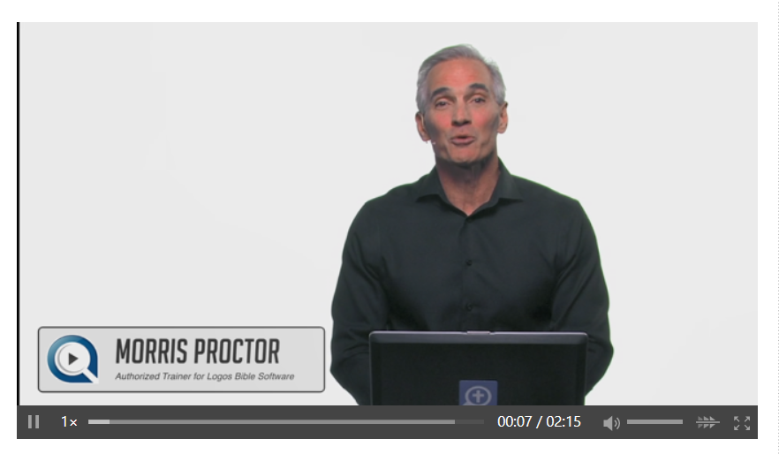
Logos 8 Quick Start (type “quickstart” in go box)

Slide 14
Three ways to study the bible
1. Passage Study
2. Topic Study (person, place, thing or event)
3. Word Study
To access:
Home Page: Select one of the “quick layouts”
Go box: Select a specific layout option on a subject
Guides menu: Select a specific guide (to open that panel)
Layout Icon: Select a predefined (or saved layout option)

Slide 15
Demo
Layouts, Panels and Icons
Work your way around the a bible
Work your way around a resources
Home Page
Go Box
Layouts
Word Study – English Example
Word Study – Hebrew Example
Word Study – Greek Example
Passage Study
Exegetical Guide
Workflow – Basic Bible Study
Interactive Media – Psalms Explorer
Interactive Media – Proverbs Explorer
Timeline Tool
Passage Lists
Logos Web App

Slide 16
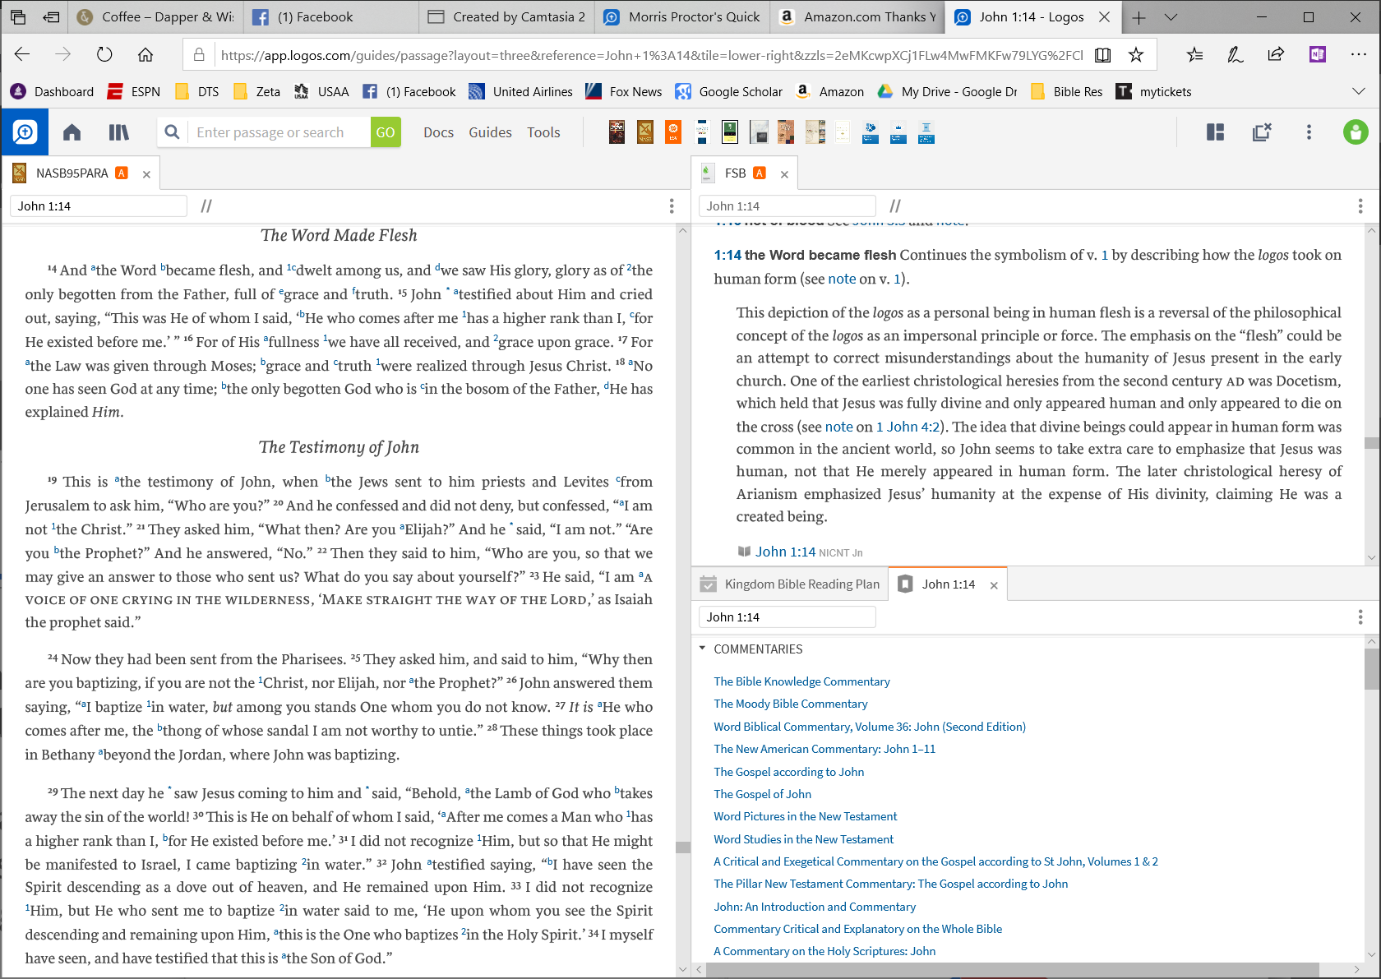
Logos Web App (https://app.logos.com)
A complete set of your resources and with limited tool and guide functionality available from any web interface
(all your resources, notes, highlights, etc. are maintained on the Faithlife servers)

Slide 17
Top 5 Things to consider in getting started
Deep and/or Wide
Tailor to your needs and incrementally invest
Get a Quick Start
Master Basic Functionality and Essential Elements
Have the necessary hardware
REALLY consider an SSD; Older PC hardware will frustrate you
Understand the Source!!!!
Logos includes a range of different Biblical Perspectives
Use as a tool for your Spirit-led personal growth
It’s power is in providing an efficient and integrated Study

Slide 18
Take Advantage of Training Resources
For a nice 5 minute overview (https://faithlifetv.com/media/488945)
Quickstart: Master and Succeed (Type “Quickstart” in Go Box)
Tons of on line help at Logos (Logos.com/pro)
YouTube is your friend (search Logos 8)
Facebook Groups on Tips and Tricks
Moe Knows! ($) (mpseminars.com)
There is plenty of FREE help online

Slide 19
Logos Fundamentals Set
This library includes:
Audio Bibles
Commentaries
Bible Knowledge Commentary, New Bible Commentary
Bible dictionaries and encyclopedias
Baker Encyclopedia of the Bible
Dictionary of Bible Theme
Lexham Bible Dictionary
Devotionals
Theological works
Several English translations and interlinears
CSB, ESV, LEB and KJV
And more
If you want some of our more advanced features, you’ll want to look into Logos 8 Starter or Logos 8 Bronze
Dynamic pricing is not available for this product. However, you may qualify for special pricing.
Overview
For those who want to begin digging into Scripture for themselves, Logos 8 Fundamentals is the smart choice.
An essentials-only package, Fundamentals helps you find biblical insights fast without getting overwhelmed. It offers the breadth of what a good Bible study library should have but leaves the depth to other base packages, so that it remains more accessible and affordable.

Slide 20
Logos Starter Set

Slide 21
Getting started…
Sale prices are dynamic, so you have to wait and see what is posted. Recommend you setup a free Logos account with a billing profile: https://www.logos.com/register
Recommend you work directly with Logos for the installation. Feel free to get things set up and we will use the next class for beginners orientation.

Slide 22
Backup

Slide 23
Kirk’s Selections for Resources
Topical Analysis of The Bible (in Starter)
Commentaries to consider
New International Commentary of OT/NT
New American Commentary
Baker Exegetical Commentary of NT
The New Moody Atlas of the Bible
The International Standard Bible Encyclopedia
Talk thru the Bible
A good systematic theology (Erickson, MacArthur, LST)

Slide 24
WHAT ARE DR. MICHAEL EASLEY’S TOP BOOK RECOMMENDATIONS? (https://michaelincontext.com/ask-dr-e-episode-10/)
AB Bruce – Training of the 12 (free PDF)
Any/all* of Derek Kidner’s Commentaries*
Howard Hendricks – Living By the Book
DE Hiebert- any/all of his commentaries*
Anything by Ron Rhodes (Reasoning from the Scriptures)
A Single-Volume Theology Handbook
Paul Enns Moody Handbook
Wayne Grudem, Systematic Theology
Charles Ryrie, Basic Theology
Floyd H. Barackmann, Practical Christian Theology
Walter A. Elwell, Evangelical Dictionary of Theology
A commentary on the whole Bible*
Moody Bible Commentary
Bible Knowledge Commentary
Talk Thru The Bible – Wilkinson + Boa
*Be sure to use a commentary that corresponds to the Bible translation you read.
A book on prayer
Dr. Ken Boa, Handbook to Prayer
The Valley of Vision

Slide 25
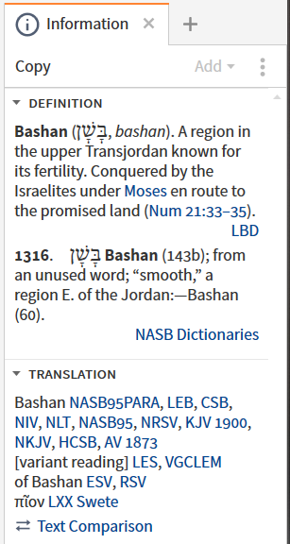
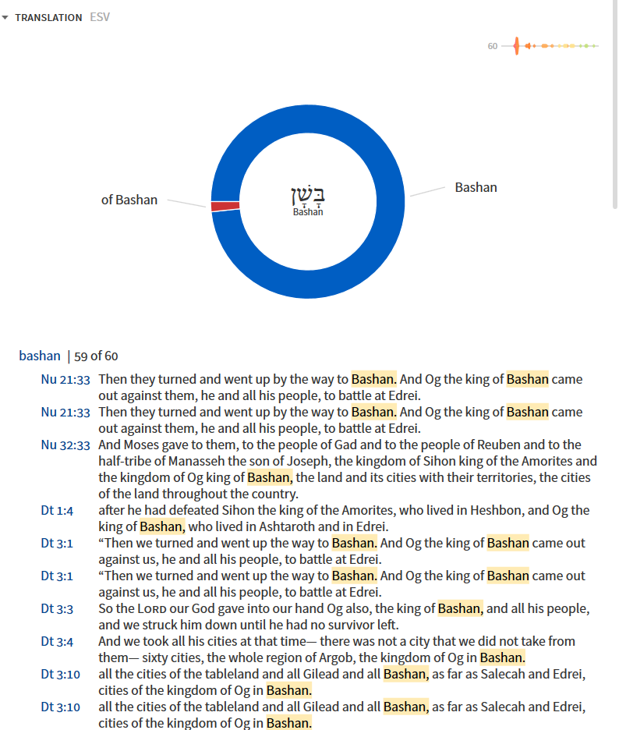
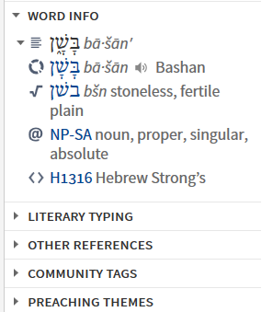
Information Bar
Example: Psalm 68:15
It places details of the context menu to a stand alone panel on the far right of display

Slide 26
Lexham Survey of Theology

Slide 27
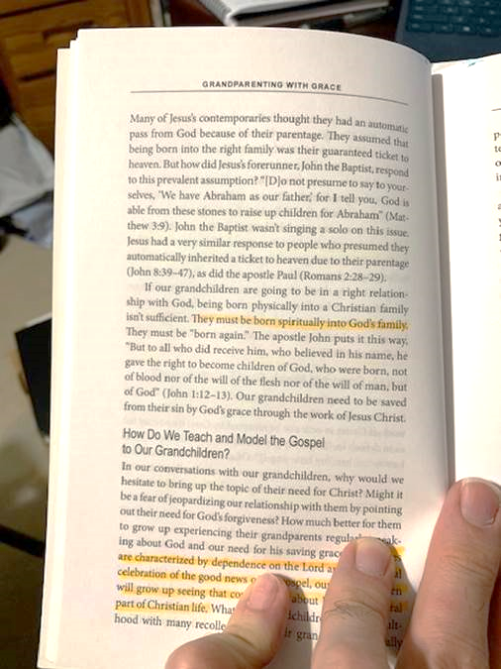
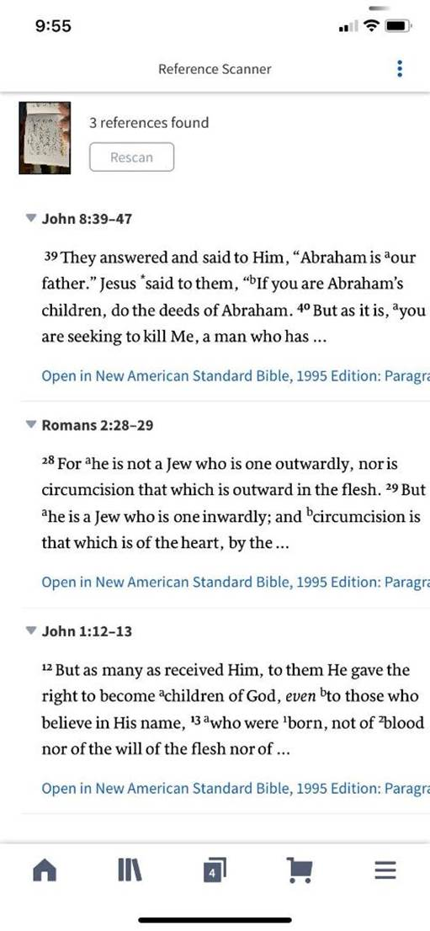
Reference Scanner
You can scan a book page or your computer screen and it will find the references (except where there is a line break) and then build you a passage list.

Slide 28
Guides

Slide 29
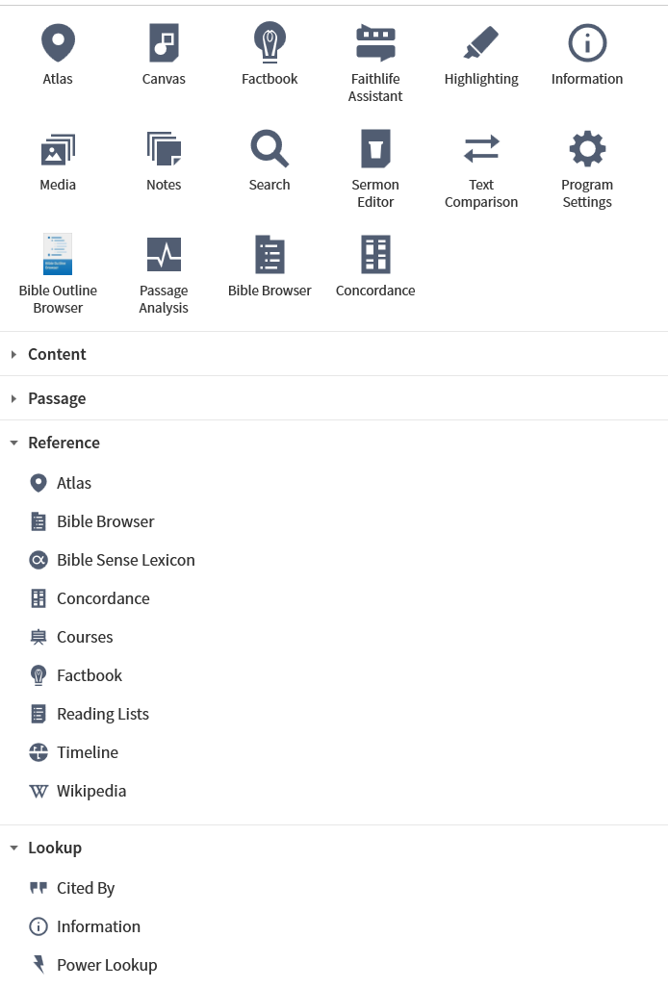
Tools and References

Slide 30
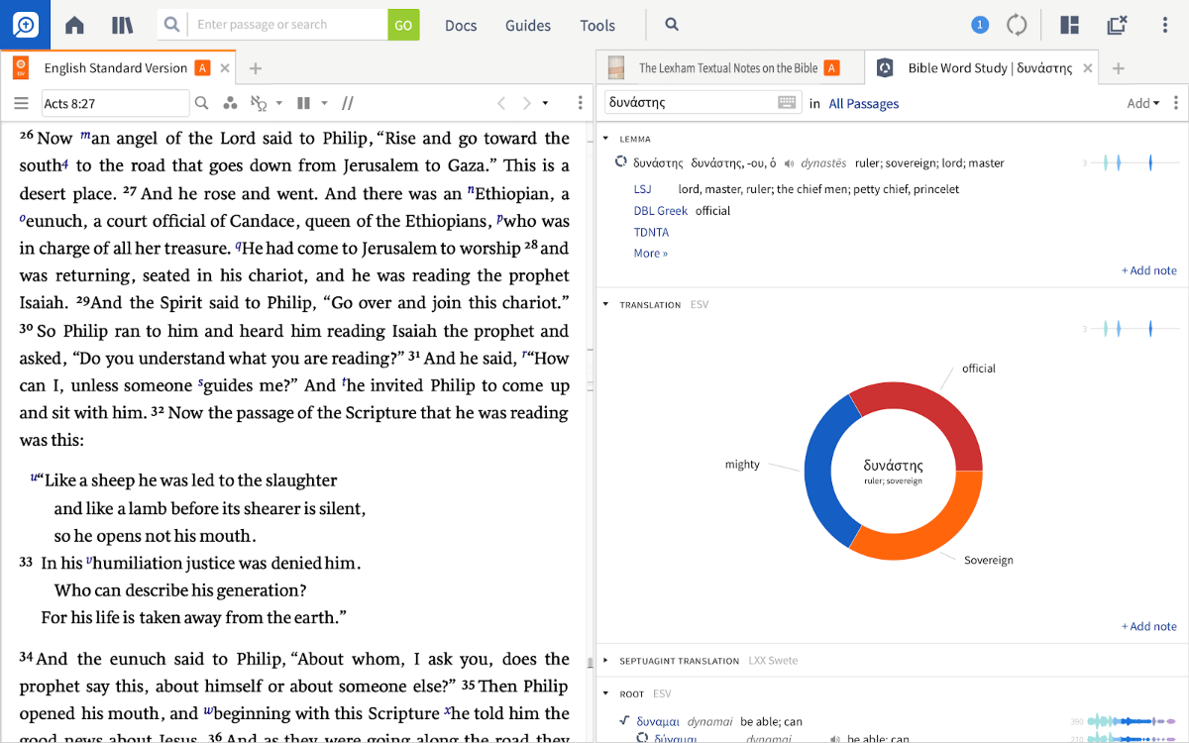
Logos.com
Provides the most robust and integrated set of bible study and doctrinal resources, books and tools where a single click can open dictionaries, commentaries, lexicons, and step-by-step guides

