Slide 1
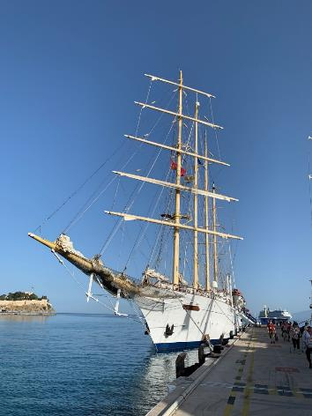
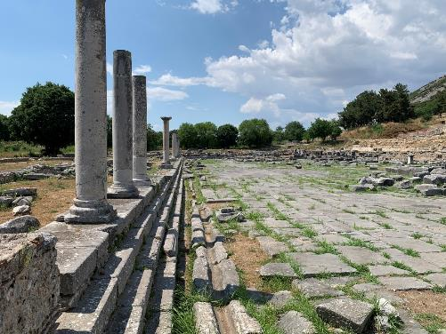
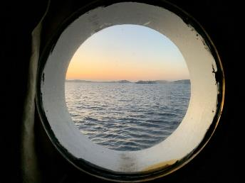
Journey’s of Paul

Slide 2
Key Elements of Paul’s Missionary Journeys
First Missionary Journey | Second Missionary Journey | Third Missionary Journey
circa 47 – 48* | circa 48 – 51* | circa 51 – 54*
Acts 13:1 – 14:28 | Acts 15:36 – 18:22 | Acts 18:23 – 21:16
Key Locations | Key Locations | Key Locations
Antioch | Antioch | Antioch
Cyprus | Troas (Macedonia call) | Ephesus – 1 Corinthians
Lystra | Philippi | Troas
Derby | Thessalonica | Philippi – 2 Corinthians
 | Berea | Thessalonica
Galatians? | Athens (Mars Hill) | Corinth - Romans
 | Corinth – 1 / 2 Thessalonians | …doubling back
Antioch | Antioch | Jerusalem
Start
End
Jerusalem Council (AD 49)
* International Standard Bible Encyclopedia, Revised pg 691

Slide 3
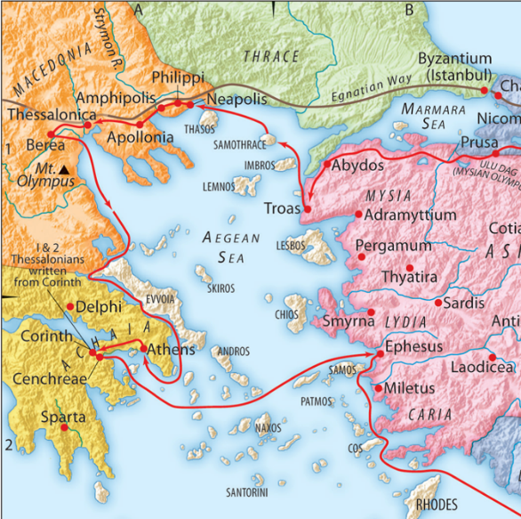
Journey’s of Paul Itinerary
May | Location
25th | Santorini / GR
26th | Athens / GR
27th | Athens / GR
28th | Corinth / GR
Star Flyer
29th | Mykonos / GR
30th | Ephesus / TK
31st | Patmos / GR
Jun | Location
1st | Pergamum / TK
2nd | Philippi / GR
3rd | At sea
4th | Istanbul / TK
5th | Depart

Slide 4
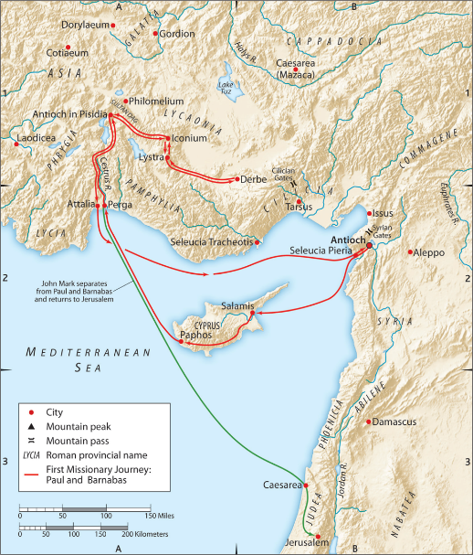
Paul’s First Missionary Journey
Acts 13:2 – Sent off
While they were worshiping the Lord and fasting, the Holy Spirit said, “Set apart for me Barnabas and Saul for the work to which I have called them.” Then after fasting and praying they laid their hands on them and sent them off.
Seleucia
Cyprus
Paphos
Perga
Antioch in Pisidia
Iconium, Lystra, Derby
Derby, Lystra, Iconium
Antioch in Pisidia
Attalia
Antioch
Acts 15 – Jerusalem Council

Slide 5
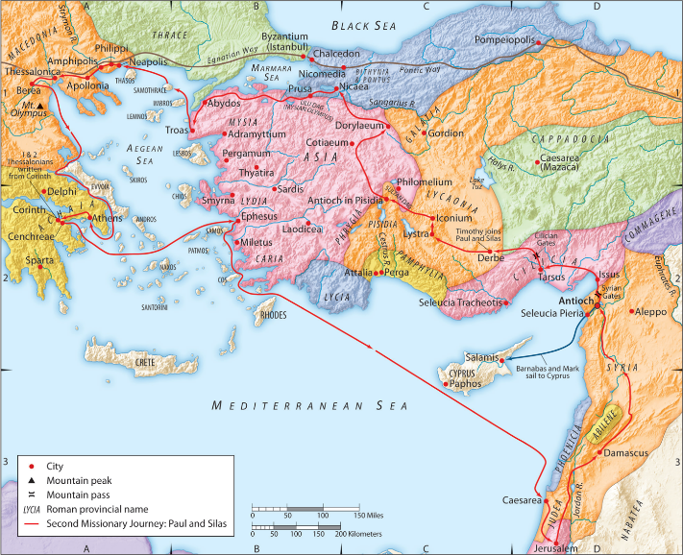
Paul’s Second Missionary Journey
Acts 16
Timothy joins Paul in Derbe
As they went on their way through the cities, they delivered to them for observance the decisions that had been reached by the apostles and elders who were in Jerusalem. So the churches were strengthened in the faith, and they increased in numbers daily. (vv 4-5)

Slide 6
Traveling through Asia
Acts 16:6-10
And they went through the region of Phrygia and Galatia, having been forbidden by the Holy Spirit to speak the word in Asia. And when they had come up to Mysia, they attempted to go into Bithynia, but the Spirit of Jesus did not allow them. So, passing by Mysia, they went down to Troas. And a vision appeared to Paul in the night: a man of Macedonia was standing there, urging him and saying, “Come over to Macedonia and help us.” And when Paul had seen the vision, immediately we sought to go on into Macedonia, concluding that God had called us to preach the gospel to them.
Notes:
Philip of Macedon

Slide 7
The Conversion of Lydia - Philippi
Acts 16:11-14,15
So, setting sail from Troas, we made a direct voyage to Samothrace, and the following day to Neapolis, and from there to Philippi, which is a leading city of the district of Macedonia and a Roman colony. We remained in this city some days. And on the Sabbath day we went outside the gate to the riverside, where we supposed there was a place of prayer, and we sat down and spoke to the women who had come together…. And after she was baptized, and her household as well, she urged us, saying, “If you have judged me to be faithful to the Lord, come to my house and stay.” And she prevailed upon us.
Notes:
Philip of Macedon

Slide 8
Philippi
Strategic Location
Along the Via Ignatia
Gateway into Europe
Summary of the Ruins
City outline
Prison Area
Following his ascension to the throne Philip II of Macedon, the father of Alexander the Great, realized the strategic importance of Krenides and captured and rebuilt the city, renaming it Philippi. (circa 357 BC)
Philippi was situated near the eastern end of the Egnatian Road (Via Egnatia), the major overland route traversing the Balkan peninsula.
G. L. Borchert, “Philippi,” ed. Geoffrey W. Bromiley, The International Standard Bible Encyclopedia, Revised (Wm. B. Eerdmans, 1979–1988), 834.
In the time of the Emperor Augustus this city became a Roman colony, i.e., a military settlement of Roman soldiers, there planted for the purpose of controlling the district recently conquered.
M. G. Easton, Illustrated Bible Dictionary and Treasury of Biblical History, Biography, Geography, Doctrine, and Literature (New York: Harper & Brothers, 1893), 546.
Notes:
Philippi gained worldwide fame in 42 bc. when the imperial armies of Antony and Octavian defeated the Republican generals Brutus and Cassius (the assassins of Julius Caesar). The victory opened the way for the emergence of the Roman Empire under the rule of Octavian (Augustus).
Walter A. Elwell and Barry J. Beitzel, Philippi, Baker Encyclopedia of the Bible (Grand Rapids, MI: Baker Book House, 1988), 1677.

Slide 9
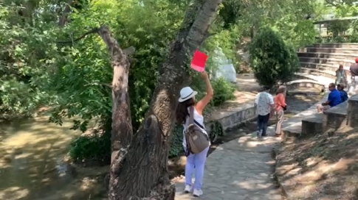
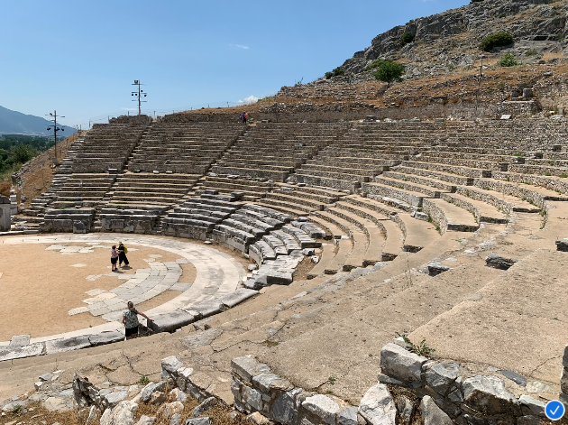
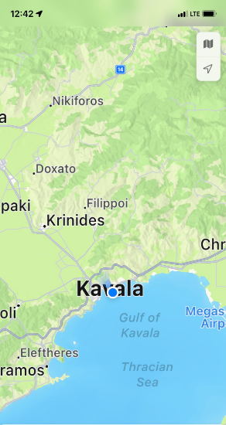
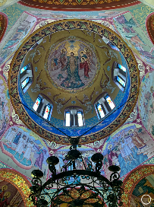
Philippi
Zigaktis River
Theater of Philippi
Baptistery of St Lydia

Slide 10
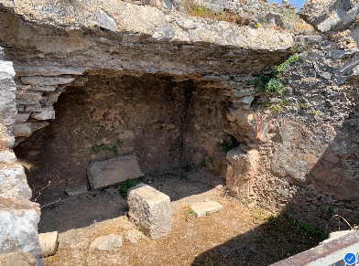
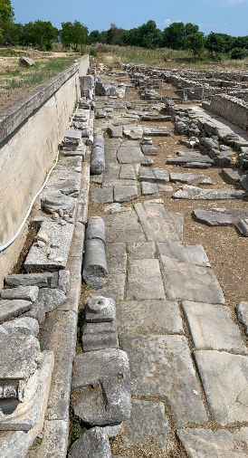
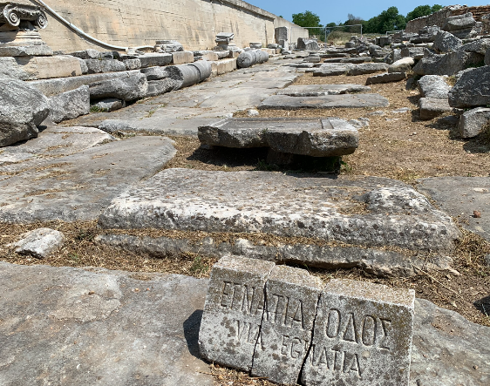
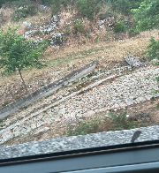
Philippi
Via Ignatia
Philippian “Jail”

Slide 11
Paul Addresses the Areopagus - Athens
Acts 16:16-17
Now while Paul was waiting for them at Athens, his spirit was provoked within him as he saw that the city was full of idols. So he reasoned in the synagogue with the Jews and the devout persons, and in the marketplace every day with those who happened to be there.
So Paul, standing in the midst of the Areopagus, said: “Men of Athens, I perceive that in every way you are very religious.”
…as even some of your own poets have said, ‘For we are indeed his offspring.’
Acts 16:22-34
Notes:
Philip of Macedon

Slide 12
Athens
Strategic Location
More of a passthrough after leaving Berea
Summary of the Ruins
Areopagus / Mars Hill
Acropolis
The Areopagus or rocky hill in Athens, northwest of the Acropolis, where the Athenian supreme tribunal and court of morals was held
John D. Barry et al., eds., Mars Hill, The Lexham Bible Dictionary (Bellingham, WA: Lexham Press, 2016).
The Golden Age of Athens was a period of democracy, prosperity, and the growth of western philosophy and literature. From Socrates (who was executed ca. 399 BC) to Plato (427–348 BC), Athens was the birthplace and home to the foundations and founders of western philosophy
Zachary G. Smith, “Athens,” ed. John D. Barry et al., The Lexham Bible Dictionary (Bellingham, WA: Lexham Press, 2016).
Notes:
Corinth Canal, connecting the Ionian Sea and the Aegean, a distance of 3.5 mi (5.6 km). Constructed in 1881–1893, it follows the route planned and begun by Nero in a.d. 66. (B. Van Elderen)
D. H. Madvig, Corinth, ed. Geoffrey W. Bromiley, The International Standard Bible Encyclopedia, Revised (Wm. B. Eerdmans, 19791988), 773.

Slide 13
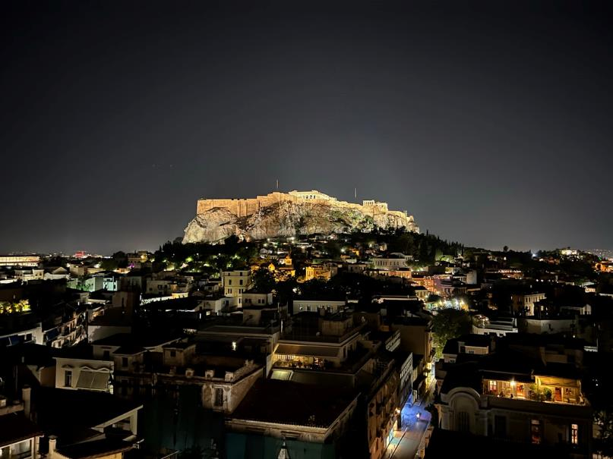
Athens

Slide 14
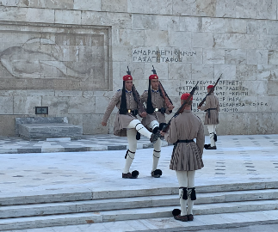
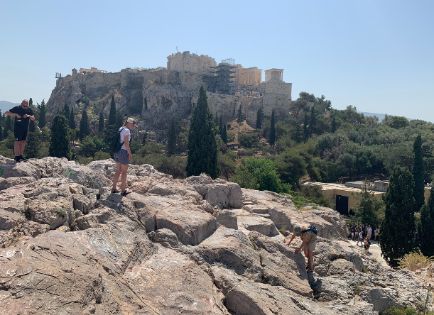
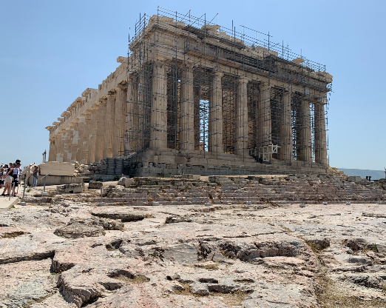
Athens
Changing of the Guard
Mars Hill
Parthenon

Slide 15
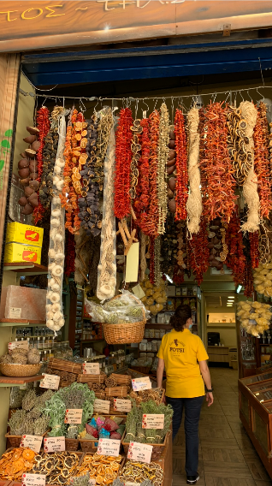
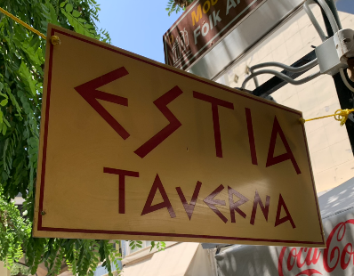
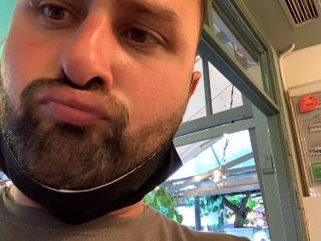
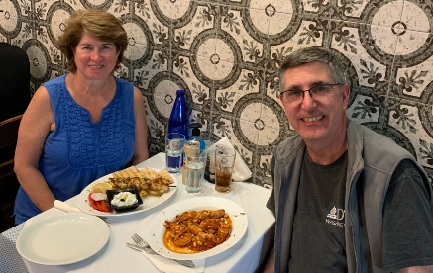
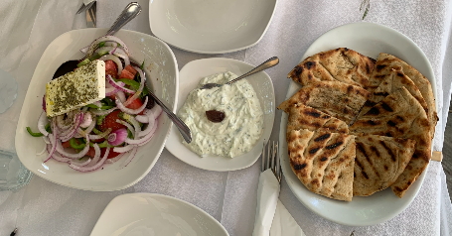
Journeys for Food and Service

Slide 16
Paul In Corinth
Acts 18:1-4
After this Paul left Athens and went to Corinth. And he found a Jew named Aquila, a native of Pontus, recently come from Italy with his wife Priscilla, because Claudius had commanded all the Jews to leave Rome. And he went to see them, and because he was of the same trade he stayed with them and worked, for they were tentmakers by trade. And he reasoned in the synagogue every Sabbath, and tried to persuade Jews and Greeks.
Notes:
Philip of Macedon

Slide 17
Paul In Corinth
Acts 18:9-11
And the Lord said to Paul one night in a vision, “Do not be afraid, but go on speaking and do not be silent, for I am with you, and no one will attack you to harm you, for I have many in this city who are my people.” And he stayed a year and six months, teaching the word of God among them.
Paul, having remained many days longer, took leave of the brethren and put out to sea for Syria, and with him were Priscilla and Aquila. In Cenchrea he had his hair cut, for he was keeping a vow.
Acts 18:18
Notes:
Philip of Macedon

Slide 18
Corinth
Strategic Location
Isthmus that joins the Peloponnesus
Summary of the Ruins
Temple of Apollo
Acro-Corinth
The Temple of Aphrodite
Cenchreae
Rich Corinthian Leather
Prominent city of Greece, formerly the capital of the ancient province of Achaia, in which the apostle Paul preached. The site of ancient Corinth lies to the west of the isthmus separating the Peloponnesian peninsula from mainland Greece.
Walter A. Elwell and Barry J. Beitzel, “Corinth,” Baker Encyclopedia of the Bible (Grand Rapids, MI: Baker Book House, 1988), 513.
The degree to which Corinth was given over to vice is apparent as early as the time of Aristophanes by the coining of the word korinthiázomai (lit “Corinthianize”), meaning “practice immorality”; similarly “Corinthian girl” (Gk. Korinthia kórē) designated a prostitute.
D. H. Madvig, “Corinth,” ed. Geoffrey W. Bromiley, The International Standard Bible Encyclopedia, Revised (Wm. B. Eerdmans, 1979–1988), 773.
Notes:
Corinth Canal, connecting the Ionian Sea and the Aegean, a distance of 3.5 mi (5.6 km). Constructed in 1881–1893, it follows the route planned and begun by Nero in a.d. 66. (B. Van Elderen)
D. H. Madvig, Corinth, ed. Geoffrey W. Bromiley, The International Standard Bible Encyclopedia, Revised (Wm. B. Eerdmans, 19791988), 773.

Slide 19
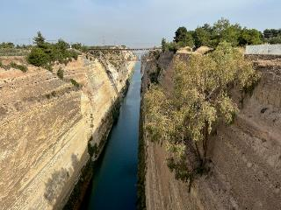
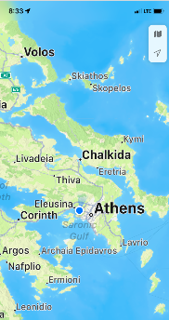
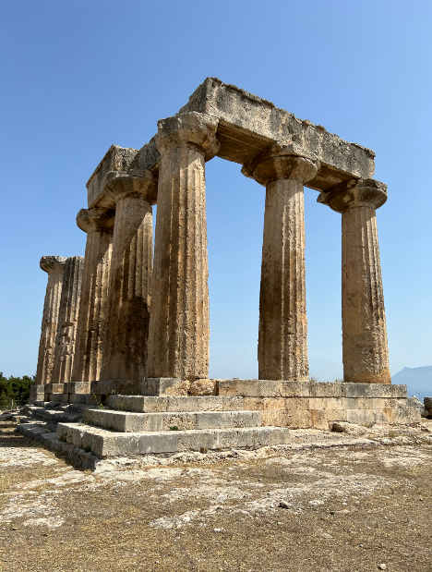
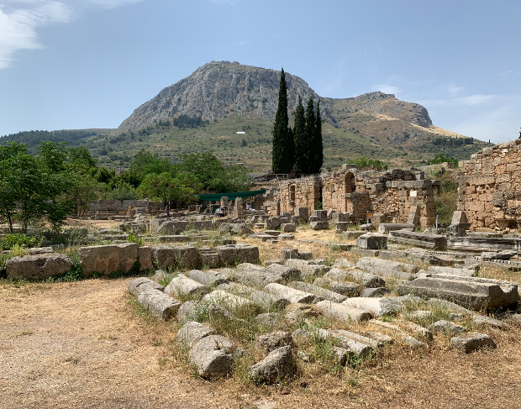
Corinth
Isthmus
Temple of Apollo
Acro-corinth

Slide 20
Paul In Ephesus – 2nd Missionary Journey
Acts 18:19-20
They came to Ephesus, and he left them there. Now he himself entered the synagogue and reasoned with the Jews. When they asked him to stay for a longer time, he did not consent, but taking leave of them and saying, “I will return to you again if God wills,” he set sail from Ephesus.
Notes:
Philip of Macedon

Slide 21
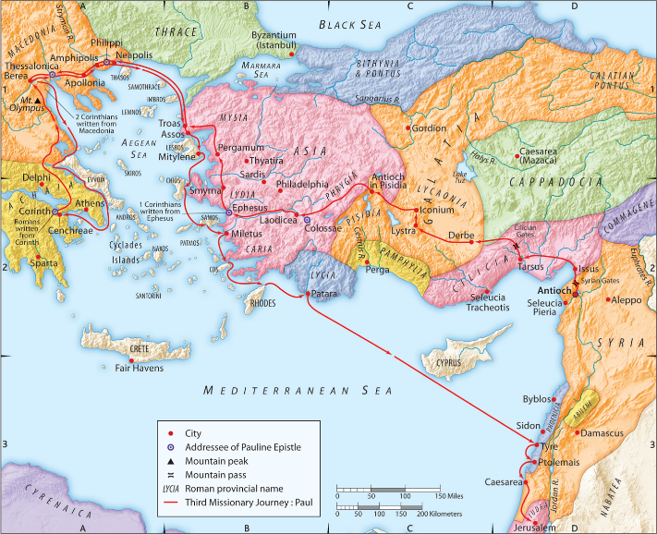
Paul’s Third Missionary Journey
Acts 18:22,23
When he had landed at Caesarea, he went up and greeted the church, and went down to Antioch.
Paul’s Third Missionary Journey
And having spent some time there, he left and passed successively through the Galatian region and Phrygia, strengthening all the disciples.

Slide 22
Paul In Ephesus – 3rd Missionary Journey
Acts 19:1
And it happened that while Apollos was at Corinth, Paul passed through the inland country and came to Ephesus. There he found some disciples.
And he entered the synagogue and for three months spoke boldly, reasoning and persuading them about the kingdom of God. But when some became stubborn and continued in unbelief, speaking evil of the Way before the congregation, he withdrew from them and took the disciples with him, reasoning daily in the hall of Tyrannus. This continued for two years, so that all the residents of Asia heard the word of the Lord, both Jews and Greeks.
Acts 19:8-10
Notes:
20 So athe word of the Lord was growing mightily and prevailing. Ac 19:20.

Slide 23
Paul In Ephesus – 3rd Missionary Journey
Acts 19:23, 25-26
About that time there occurred no small disturbance concerning the Way. For a man named Demetrius… “Men, you know that our prosperity depends upon this business. You see and hear that not only in Ephesus, but in almost all of Asia, this Paul has persuaded and turned away a considerable number of people, saying that gods made with hands are no gods at all.
When they heard this and were filled with rage, they began crying out, saying, “Great is Artemis of the Ephesians!”
Acts 19:28
Notes:
Philip of Macedon

Slide 24
Ephesus
Strategic Location
Capital of proconsular Asia
Large commercial center
Summary of the Ruins
Wealthy Courtyards
Temple of Diana/Artemis *
Library of Ephesus
Largest theater in the world at the time
Ephesus was the third largest city in the Roman empire. Its population is estimated to have been around 250,000 during the time of early Christianity. The ethnic make-up of the inhabitants of Ephesus included (but was not limited to): Lydians, Ionians, Greeks, a native population of Anatolians, and a large Jewish constituency
The Artemis shrine in Ephesus provided the area with a lucrative tourist business from pilgrims traveling to the temple. In addition, the temple served as a financial institution and lent out money from the wealth deposited at the shrine.
David Seal, “Ephesus,” ed. John D. Barry et al., The Lexham Bible Dictionary (Bellingham, WA: Lexham Press, 2016).
* Temple is one of the seven wonders of the ancient world

Slide 25
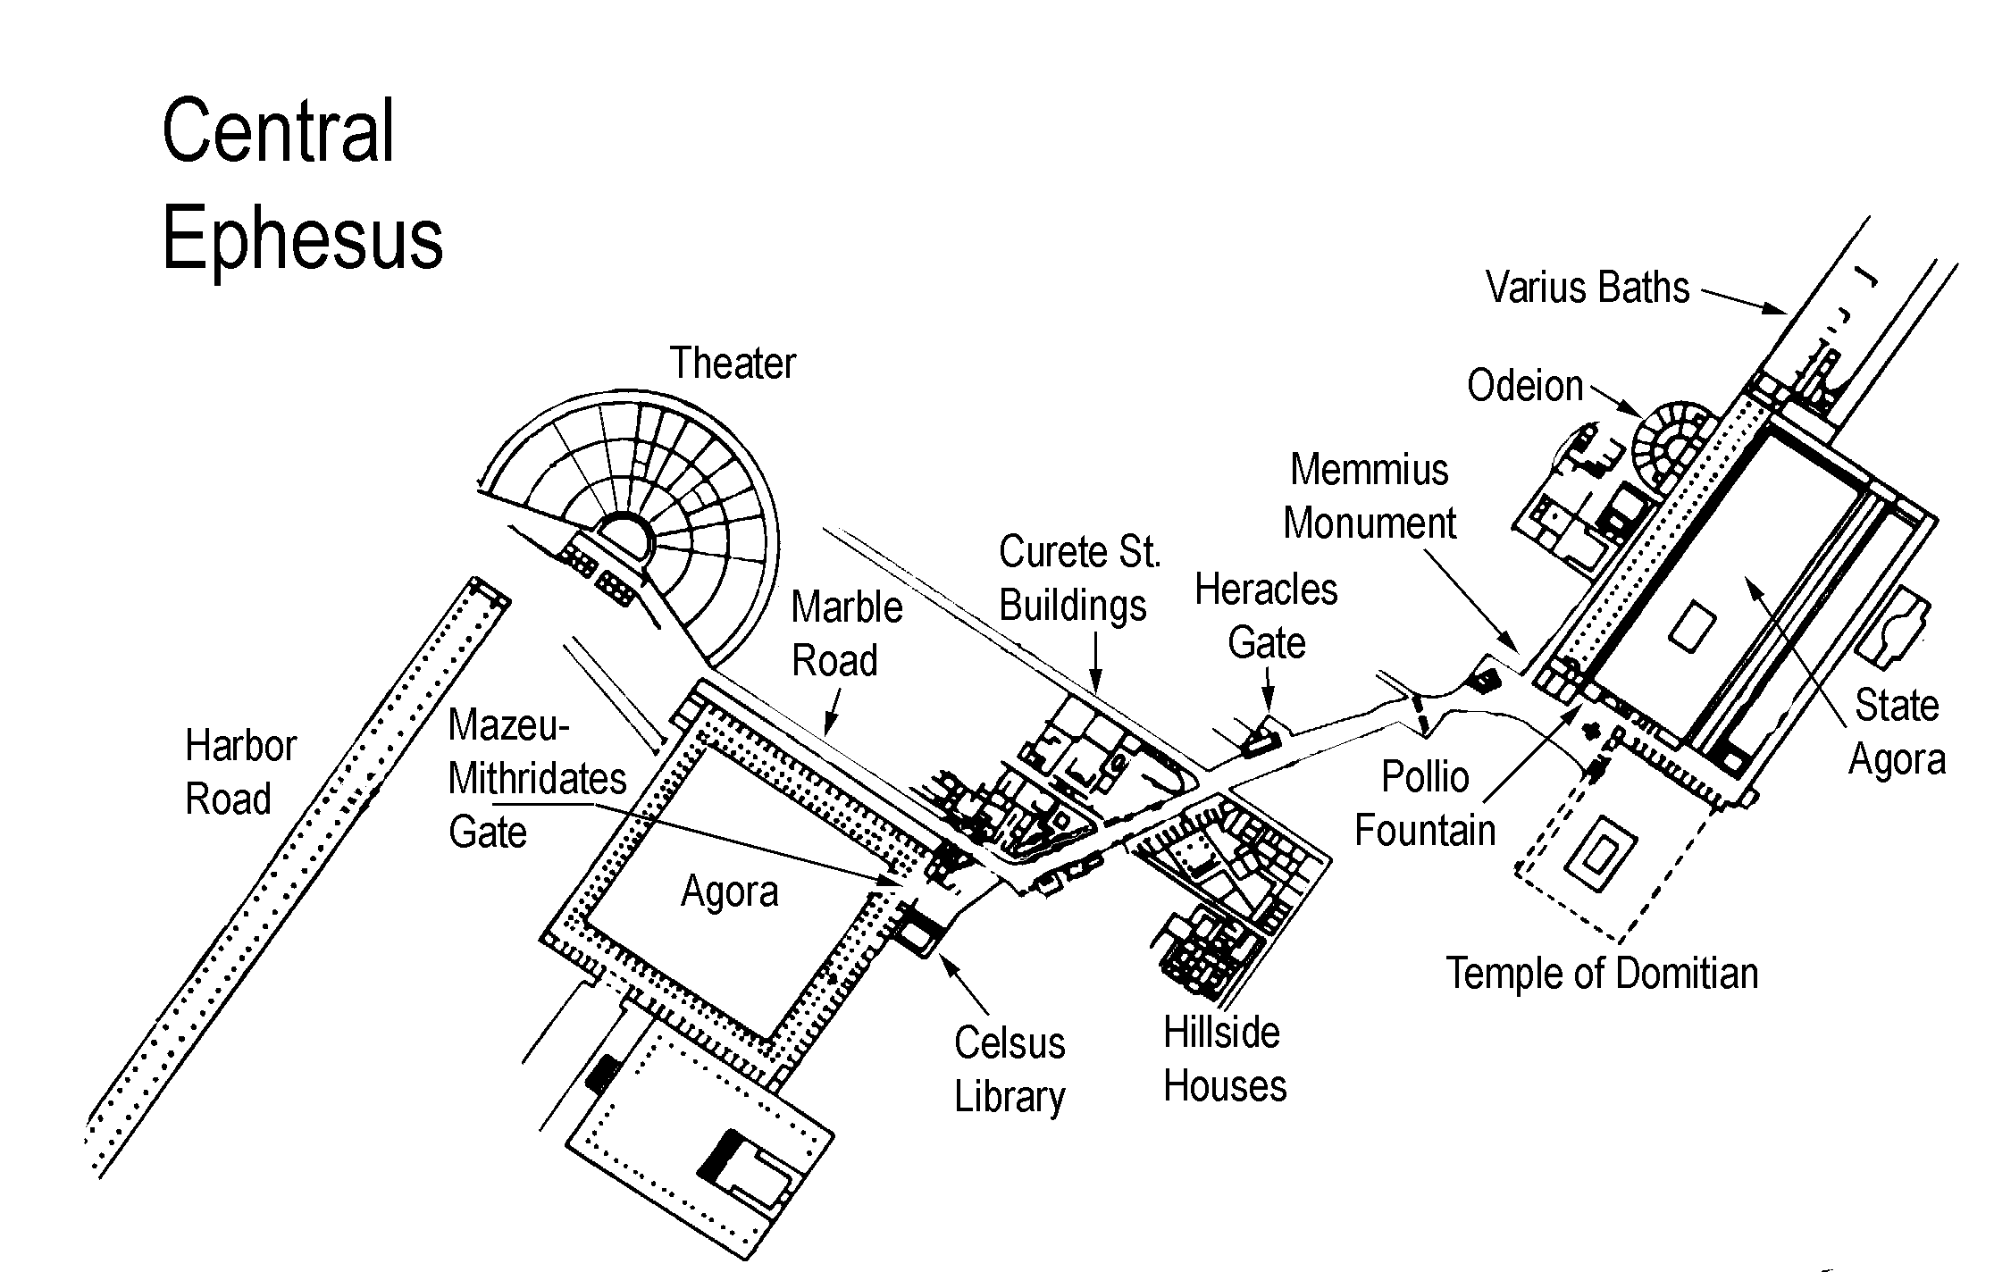
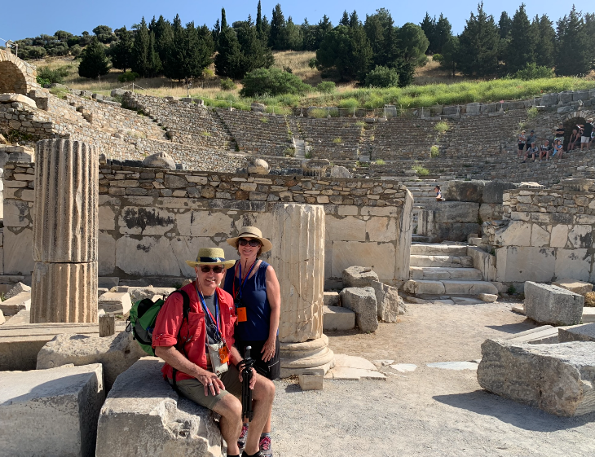
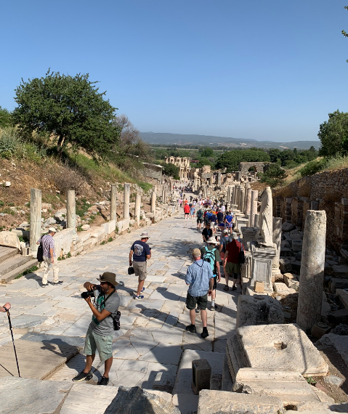
Ephesus
The Odeion
Walking Street of Ephesus
Ephesus Center Map (ntimages.net)

Slide 26
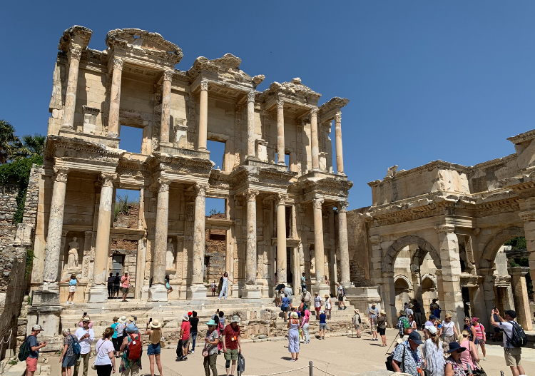
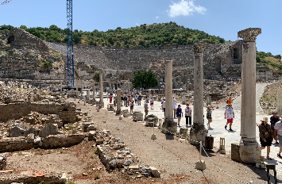
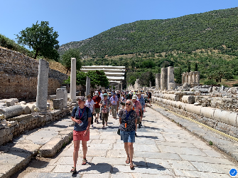
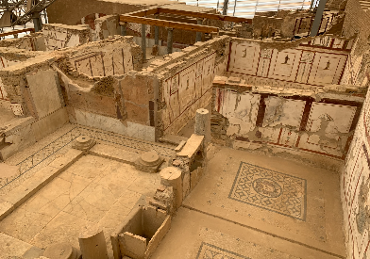
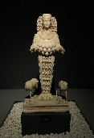
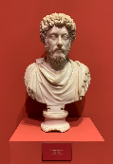
Ephesus
Library of Celsus
Harbor Road
The Agora
Hillside Houses
Goddess Diana
Marcus Auerlius

Slide 27
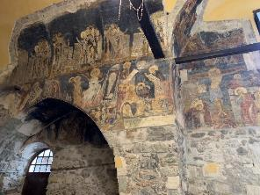
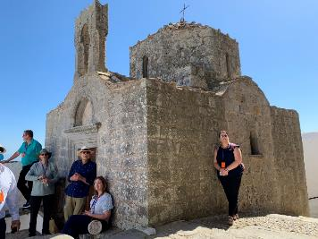
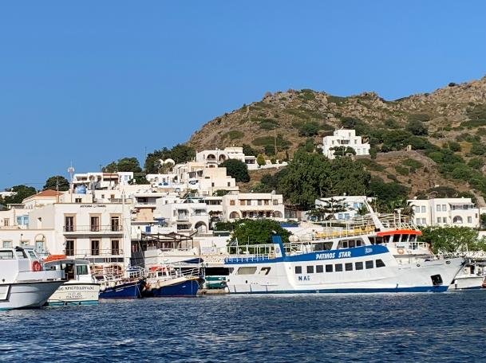
Other Sites - Patmos
Monastery Artwork
Greek Chapel outside Monastery
Rev 1:9
I, John, your brother and fellow partaker in the tribulation and kingdom and perseverance which are in Jesus, was on the island called Patmos because of the word of God and the testimony of Jesus.

Slide 28
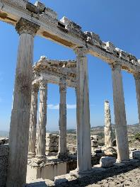
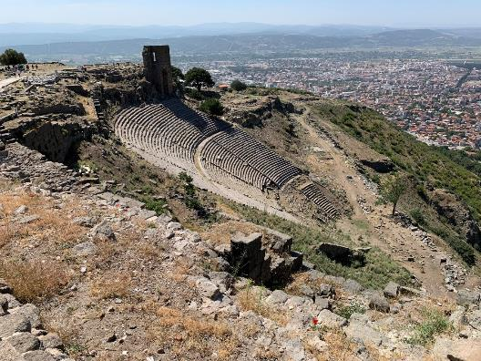
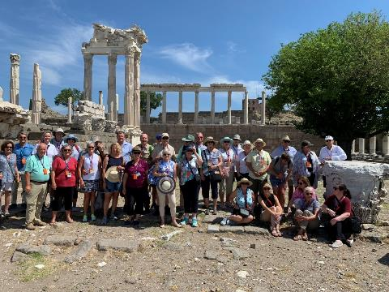
Other Sites - Pergumum
Rev 1:11
“Write in a book what you see, and send it to the seven churches: to Ephesus and to Smyrna and to Pergamum and to Thyatira and to Sardis and to Philadelphia and to Laodicea.”
Theater at Pergumum
Acropolis

Slide 29
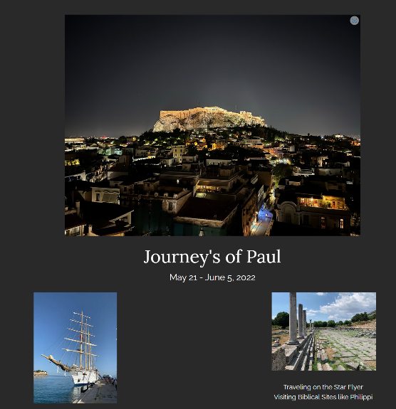
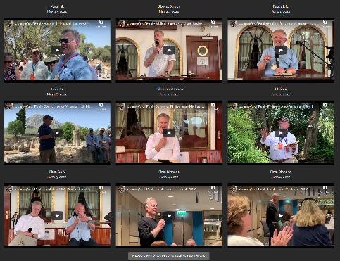
Journey’s of Paul – Pictures and Lessons
Hagiazo.net/Journeys-Of-Paul-2022

Slide 30
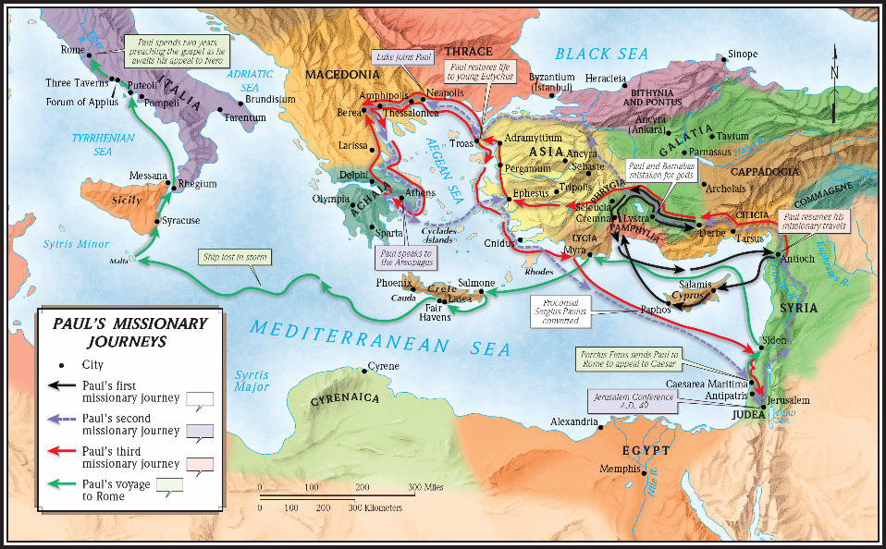
Map of Paul’s Missionary Journeys

