Slide 1
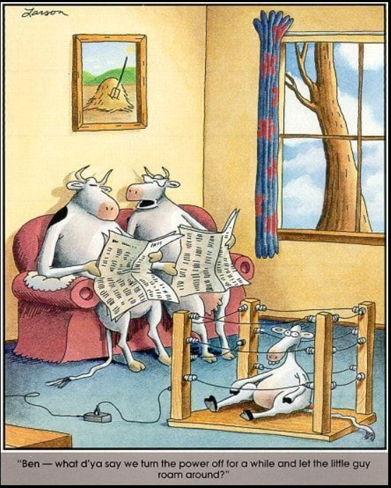
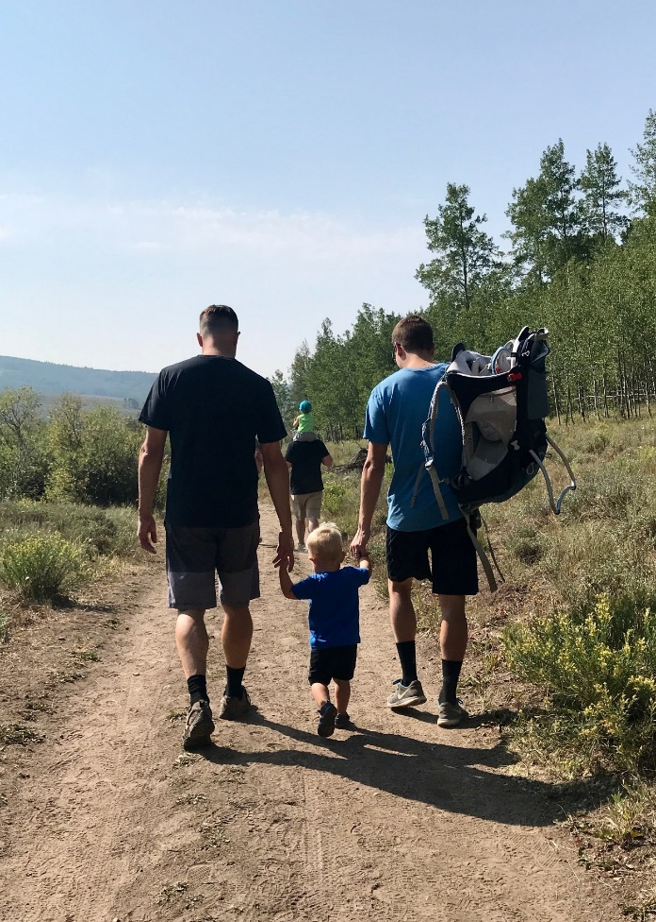
Grandparent Ministry
Lesson 8
Gospel Grandparenting in Today’s Culture
Therefore welcome one another as Christ has welcomed you, for the glory of God.
Romans 15:7
Ben, what d’ya say we turn the power off for a little while and let the little guy roam around?

Slide 2
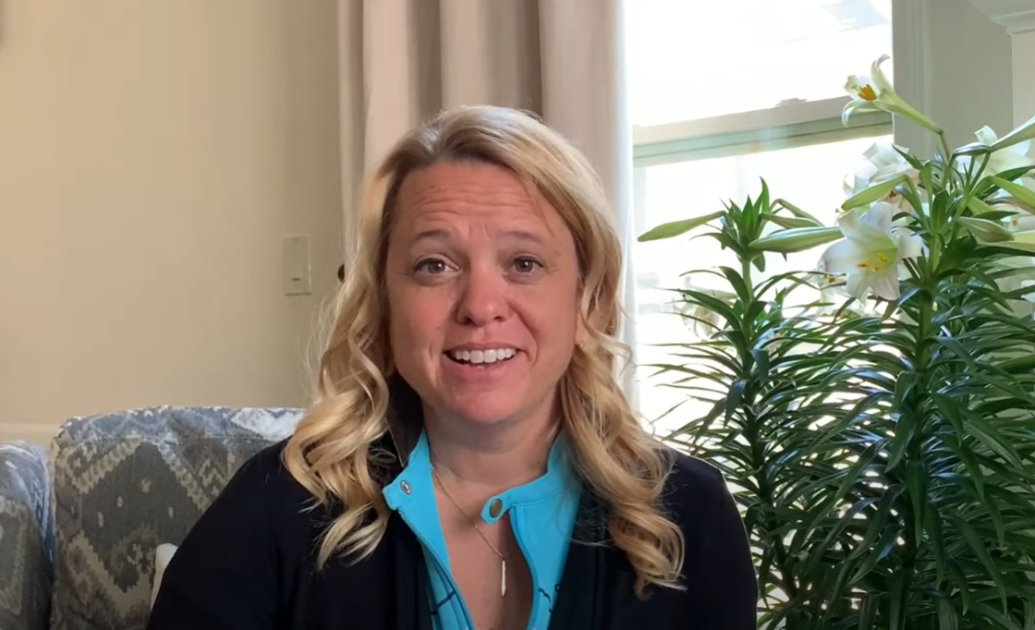
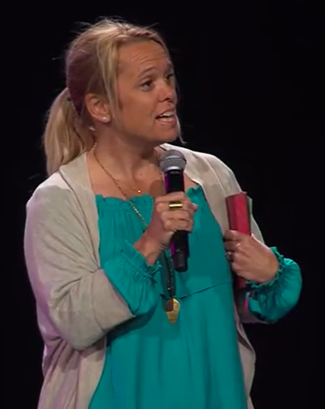
What you know to be true…
Tyler Truths
https://www.youtube.com/watch?v=-pDZNfykDLs
Bravery is really just about availability - Beth G.
Beth Guckenberger – Short Testimony

Slide 3
Big Idea
Gospel empowered, Christ-reflected grandparents can take the initiative to nurture a close relationship over long distances and difficult circumstances

Slide 4
Statistics
Nearly half of all grandparents live at least 200 miles from at least one or more of their grandchildren
The number of people looking for divorces was 34 percent higher from March through June compared to 2019
https://nypost.com/2020/09/01/divorce-rates-skyrocket-in-u-s-amid-covid-19/
Currently in America, about 2.7M grandparents are the primary caregivers for their grandchildren
A nearly 60% jump in suicides by young Americans since 2007 has experts alarmed and somewhat puzzled.
https://www.webmd.com/depression/news/20200911/suicide-rate-keeps-rising-among-young-americans#1
Research indicates that the kind of grandparent individuals become is, in part, dependent on their perceptions of their own grandparents, their parents’ attitudes toward grandparents, and the stereotypes of grandparents created by society and the media.
- J. Mulvihill

Slide 5
Challenges for Today
Distance
Divorce
Blended Families & Adoption
Other Challenging Situations

Slide 6
The Challenge of Distance
Nearly half of all grandparents live at least 200 miles from at least one or more of their grandchildren
Ideas to connect
Intentional visits and trips
Cards, calls and packages

Slide 7
The Challenge of Divorce
Has anyone had to deal with that situation? How were you affected and how did you deal with it?
Approaches
Lay it before God - 1 Peter 5:7
“Casting all your anxiety on Him, because he cares for you”
Share with the body of Christ
Guard against bitterness
BE THE ROCK!
Applies to both the parents and the grandparents

Slide 8
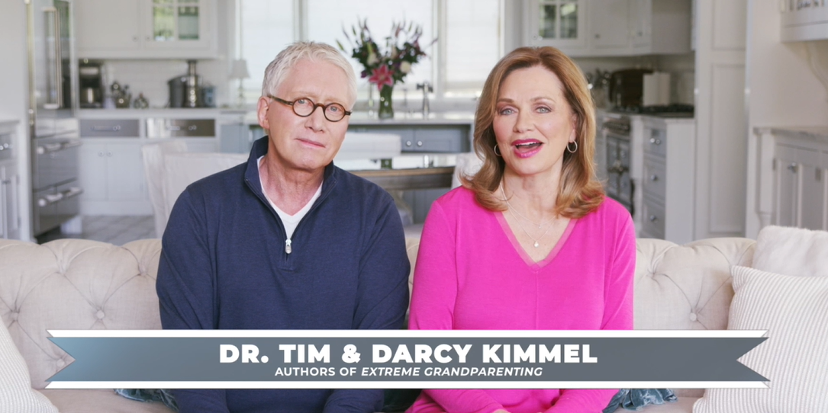
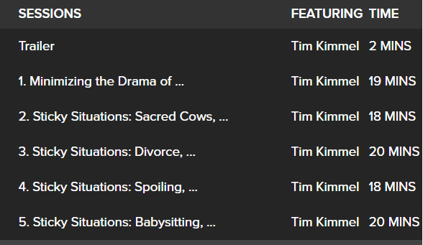
Solving Sticky Situations
Tim & Darcy Kimmel
Giving a Blessing
Leaving a Legacy
Bearing a Torch
Setting a Standard
RightNow Media :: Streaming Video Bible Study : Grace Based Grandparenting: Solving the Sticky Situations : Tim Kimmel : Grace Based Families

Slide 9
RightNowMedia Resources
Kimmel Resources
Grace Based Foster Parenting

Slide 10
Solving Sticky Situations
As we hold up a torch to moral living…God's power and presence working through us can be an example of how not only to survive spiritually, but actually thrive.
God want to use us to show our grandchildren what people look like who are not intimidated by an antagonistic culture.
Our grandchildren are growing up in a culture that is both toxic and antagonistic to the priorities that our creator says are important.

Slide 11
Other Challenging Situations
Becoming the Primary Caregivers
Difficult Relationships
Special needs grandchildren

Slide 12
Discussion Questions:
What are some challenges you are facing as a grandparent? What makes them so hard?
What are some ways you have stayed connected to grandchildren who live some distance away? Are there ways you could improve your connectedness, now that you’ve read this chapter?
What would have to happen for you to be able to visit your long-distance grandchildren? What could you be doing to make that visit possible?

Slide 13
Discussion Questions:
Has your family been impacted by divorce? What special challenges have you experienced because of divorce in your extended family?
What truths of the gospel have you found helpful in your difficulties as a grandparent?

Slide 14
Action Steps
If you have not already done so, download whatever app is necessary for you to have video calls with your long-distance grandchildren. Begin scheduling regular video calls.
Do you need to pursue reconciliation with a family member? Discuss and pray about this with a Christian friend, then make that call, requesting an opportunity to have a humble, loving, heart-to-heart conversation.

Slide 15
Action Steps
Are you in a small group or accountability group at your church? If so, be open about the struggles you are facing in your family, requesting prayer support as a parent or grandparent. If you’re not in a group, what do you need to do to join one?
Seek out the fellowship of other grandparents and pray for one another as you face difficulties and challenges, asking the Lord to remind you of the power and promises of the gospel.

Slide 16
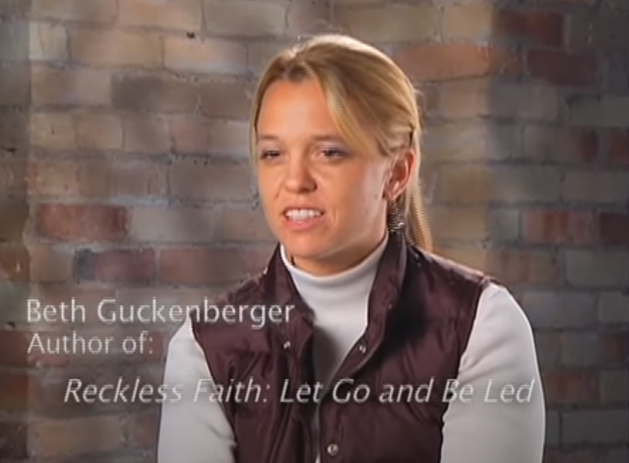
Blended Families & Adoption
We are all adopted!
Flip the script…
Loving Children
https://www.youtube.com/watch?v=k7q6ukLCnpk
“By God’s grace, we can reflect him as we chose to move toward these new grandchildren”
- Larry McCall

Slide 17
BACK2BACK Ministries
Learn the practices of trauma-informed care
Back2Back has created a separate organization — Trauma Free World — completely dedicated to providing trauma training to adults and organizations around the world.
Around the world we’re establishing footholds of deep, holistic care for orphaned and vulnerable children. Our goal isn’t a temporary fix or short-term relief, we’re committed to helping orphaned and vulnerable children eradicate all forms of generational poverty in their lives – spiritual, physical, educational, emotional, and social.

