Slide 1
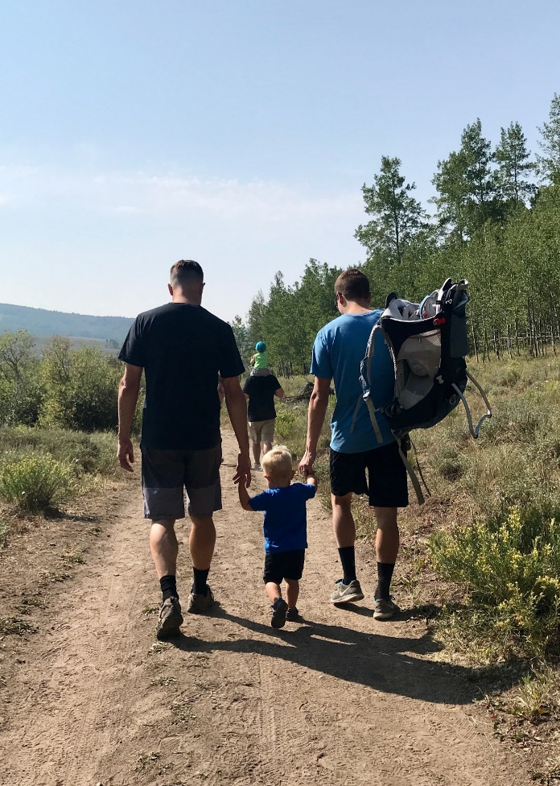
Grandparent Ministry
Lesson 7
The Power of a Praying Grandparent
The effective prayer of a righteous [grandparent] can accomplish much.
James 5:16 (adapted, NASB)

Slide 2
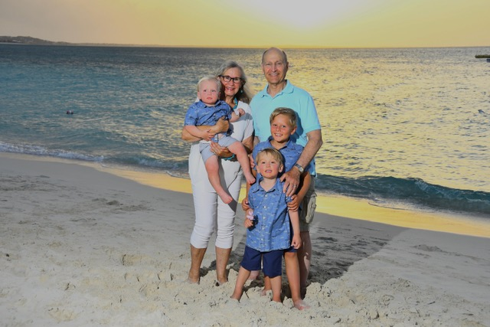
Introducing
Winslow (5), Esther (3), Florence (almost 11 months), Zoe (10 months), Henry (10 months)
Bobby (8 yrs); Luke (3 yrs); Chase (18 mo); Kari Grace
Diane and Peter Sutton

Slide 3
Big Idea
As grandparents, we want to model in very tangible ways that we live in the presence of a sovereign, loving God who wants us to talk to him. (pg 59)

Slide 4
The Family
The role of grandparents in the lives of grandchildren can be especially meaningful at transition points, such as leaving home, when the tensions between parents and child are at their highest. Think of the advantage for a child of any age who can draw on unconditional support and love from both maternal and paternal grandparents. Grandparents who have intense relationships with grandchildren during their childhood promote continuation of the relationship into adulthood (Geurts, Van Tilburg, and Poortman 2012a).
Balswick, Jack O.; Balswick, Judith K.. The Family (p. 179). Baker Publishing Group.

Slide 5
The Power of a Praying Grandparent
Praying for ourselves as grandparents
Praying for our grandchildren’s parents
Praying for our grandchildren
Praying with our grandchildren

Slide 6
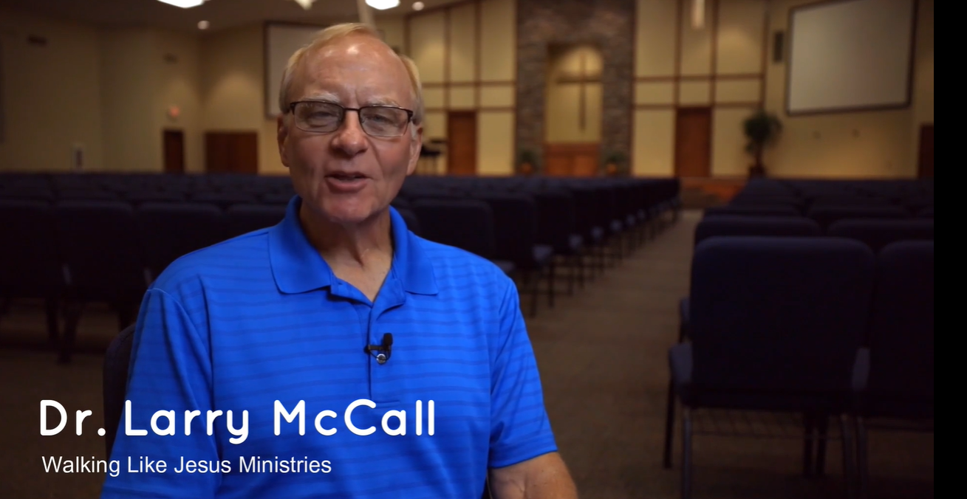
Larry McCall
Lord, please give my grandchildren, by your grace, such a high estimation of Jesus Christ that they want Him more than anything this world has to offer, more than everything this world has to offer.
https://vimeo.com/454089599

Slide 7
Kirk’s typical “undisciplined” prayer
Lord, I thank you for this day that I may be serve you and others to Your glory. Lord as the tasks of today…like the report and two call backs, not to mention the flight next week that still needs to be ticketed…did my frequent flyer number get added?...that’s right, numbers! I forgot to return the attendance list—and not just the list,
but the…
It’s starts out strong…and then kind of tails off

Slide 8
Praying for ourselves
Structure
A specific time and place
Using a journal or log book
Build out a list
Puritan Prayer Books
Daily Devotionals
Reading Programs
For this reason I bow my knees before the Father, from whom every family in heaven and on earth is named, that according to the riches of his glory he may grant you to be strengthened with power through his Spirit in your inner being, so that Christ may dwell in your hearts through faith—that you, being rooted and grounded in love, may have strength to comprehend with all the saints what is the breadth and length and height and depth, and to know the love of Christ that surpasses knowledge, that you may be filled with all the fullness of God. (Ephesians 3:14–19)

Slide 9
Handbook to Prayer: Praying Scripture back to God
“The problem with prayer is heightened by the fact that people often succumb either to the extreme of all form and no freedom, or the opposite extreme of all freedom and no form. The first extreme leads to a rote or impersonal approach to prayer, while the second produces an unbalanced and undisciplined prayer life that can degenerate into a litany of one “gimme” after another. Handbook to Prayer was designed to make prayer a more enriching and satisfying experience by providing both form and freedom in the practice of prayer.”

Slide 10
Praying for the Parents
Praying for their salvation is clearly a priority, if applicable
Let’s pray that our adult children wo
Christian graces that we needed in raising kids…Wisdom? Faith? Love? Compassion? Humility?
Pray for the leadership in the home and the possibility of godly mentors that come alongside
They are God’s designated “primary disciple makers” in the lives of our grandchildren. So, how should we pray for our grandchildren’s parents?

Slide 11
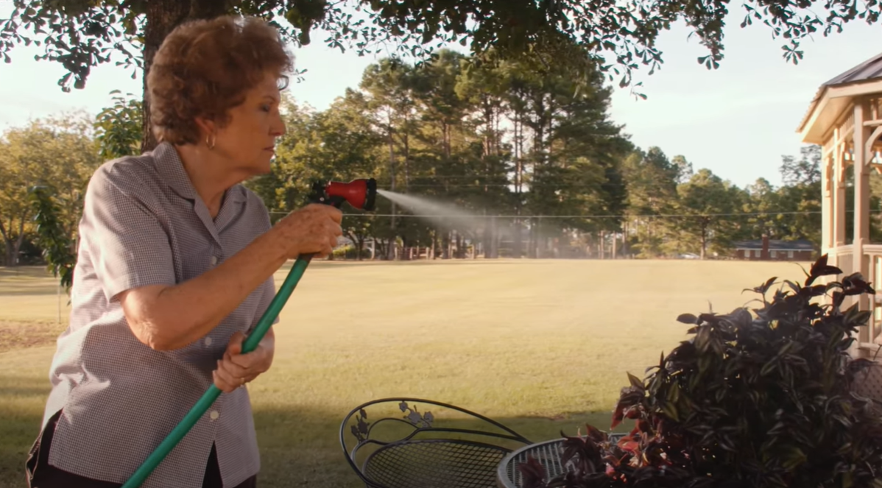
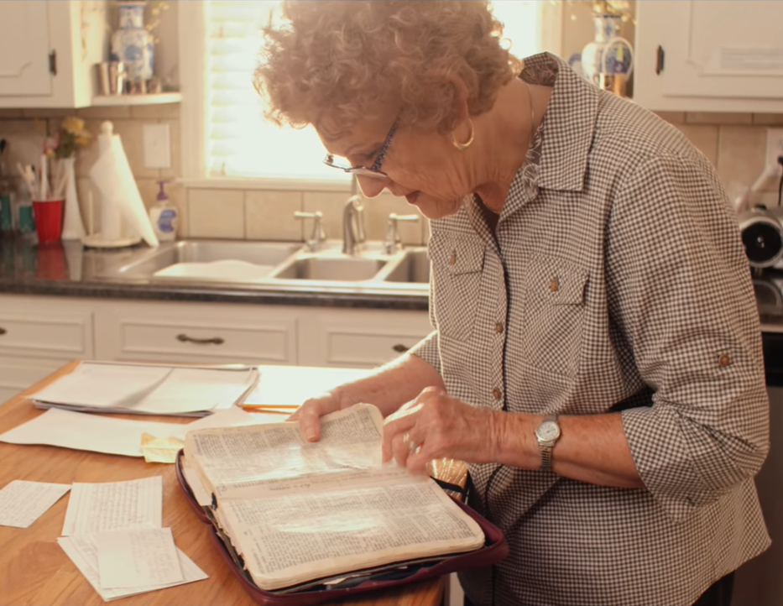
The Mighty Influence of a Praying Mom: Rhonwyn Kendrick’s Story
(142) The Mighty Influence of a Praying Mom: Rhonwyn Kendrick’s Story - YouTube

Slide 12
Praying for our grandchildren
Is our focus safety and happiness?
Psalm 78:7: “so that they should set their hope in God”
Consider the prayers of Paul
Ephesians 3:14–19, Philippians 1:9–11, Colossians 1:9–14, Ephesians 1:15–23, and 2 Thessalonians 1:3
See the other 22 references in the chapter
“When a child is born, there is a candle lighted that must burn to eternity, either in heaven or hell; the consideration whereof should awaken us to pray with all possible earnestness for the salvation of their souls, next to our own.”
Matthew Henry (Pg 59)
Consider expanding the application of so that...

Slide 13
Prayer Ministry
Prayer Ministry - Christian Grandparenting Network
30-Day Prayer Challenge
Other Prayer Related Links

Slide 14
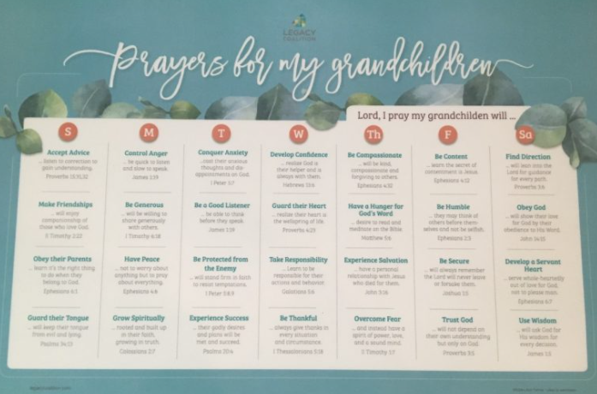
Resources
31 Days of Prayer for your Grandkids | Family Matters (gracebasedfamilies.com)
Prayers for My Grandchildren Placemat: 18 x 12 inches with vinyl top and rubber non-slide surface on the back | Legacy Coalition (churchgrowth.org)

Slide 15
Praying with our grandchildren
Start early
Let’s not miss opportunities to pray with our grandchildren!
Encourage and affirm after they pray
Weave it into the events and concerns in their daily lives
Make it engaging

Slide 16
Discussion Questions:
As you think about your own desires to grow as a gospel-centered grandparent, how would you like to pray for yourself?
How would you like your spouse, kids, or fellow-grandparents to pray for you and your ministry of grandparenting?
What are some ways you want to pray for your grandchildren’s parents?
As you think about your typical prayers for your grandchildren (Their safety? Happiness?), how might you want your prayers to grow after reading this chapter?
If you are in a grandparenting group, what prayer requests for your family would you like to share with your fellow grandparents?

Slide 17
Action Steps
Start a prayer journal—either on paper or electronically—with an entry for each grandchild. You might want to have a place for both prayer requests and answers to prayer.
Ask your grandchildren’s parents for prayer requests for themselves, as well as for their children.
Make a habit of regularly asking each of your grandchildren how you can be praying for them. If appropriate, seize the moment and pray for them there and then, either in person or over the phone.
If you have grandchildren old enough to have their own phones, how about sharing prayer requests and answers to prayer via text messages?

