Slide 1
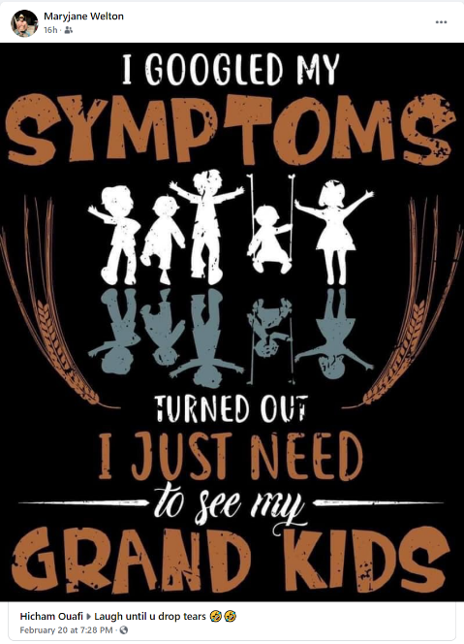
As seen on facebook

Slide 2
Grandparent Ministry
Lesson 4
Our Grandchildren Need a Savior
Fear not, for I have redeemed you…
everyone who is called by my name, whom I created for my glory, whom I formed and made. Isaiah 43:1,7

Slide 3
Big Idea
Understanding our grandchildren's need for salvation can help us point them to their need for Jesus every day--for forgiveness and the power to follow him

Slide 4
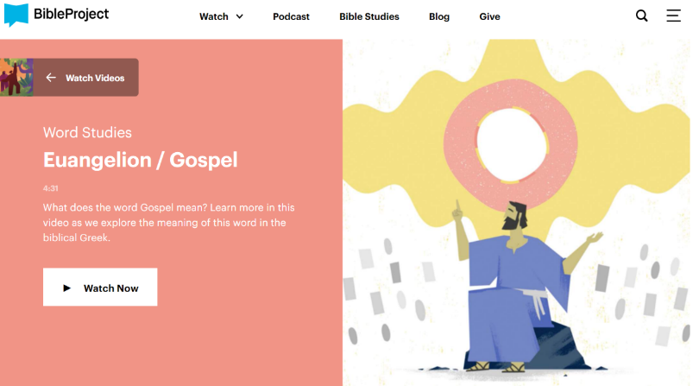
The Bible Project
Watch: Gospel (Euangelion) Word Study Video | BibleProject™

Slide 5
My Grandchild Needs a Savior
Isn’t my grandchild already good enough for God?
How do we teach and model the gospel to our grandchildren?
…our grandchildren’s problems are not merely external. They need more than protection from bad influences. They need rescue internally; they need new hearts! (p. 12)
Royalty Free Clipart Image of a Girl Running to Her Grandparents. Clipart. iCLIPART for Schools, Vital Imagery Ltd., 01-07-2013, https://schools.iclipart.com/download.php?iid=625288&tl=clipart. Accessed 10-10-2020.

Slide 6
Courageous Grandparenting Building a Legacy Worth Outliving You By Cavin Harper
Biblical Role: Storyteller
Hindrance factors
Fear
Discouragement
Practical Storytelling Ideas
Family time
Christian holidays
Prayer
Read together
Audio Recordings
Wrong priorities
Abdication

Slide 7
Blotch
https://www.youtube.com/watch?v=1qZsR2wyagU

Slide 8
Wordless Book
The Wordless Book is a Christian evangelistic book.
https://en.wikipedia.org/wiki/Wordless_Book
https://www.youtube.com/watch?v=GtDIQsUXRuw
https://www.youtube.com/watch?v=Ym1tlWjKhXc
https://www.youtube.com/watch?v=AxpN0jxHYMU
https://www.youtube.com/watch?v=CMrKS4j1s1w
Evidence points to Charles Spurgeon, in a message given on January 11, 1866 to several hundred orphans regarding Psalm 51:7 "Wash me, and I shall be whiter than snow."
It is called a "book", as it is usually represented with pages, although it can be shown on a single page or banner.

Slide 9
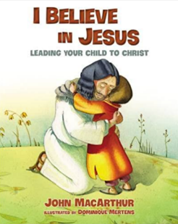
< 5 yrs
6 – 10 yrs
11 – 14 yrs
15+ yrs
Source: Mulvihill, Josh. Equipping Grandparents (Grandparenting Matters): Helping Your Church Reach and Disciple the Next Generation (pp. 102-107). Baker Publishing Group.

Slide 10
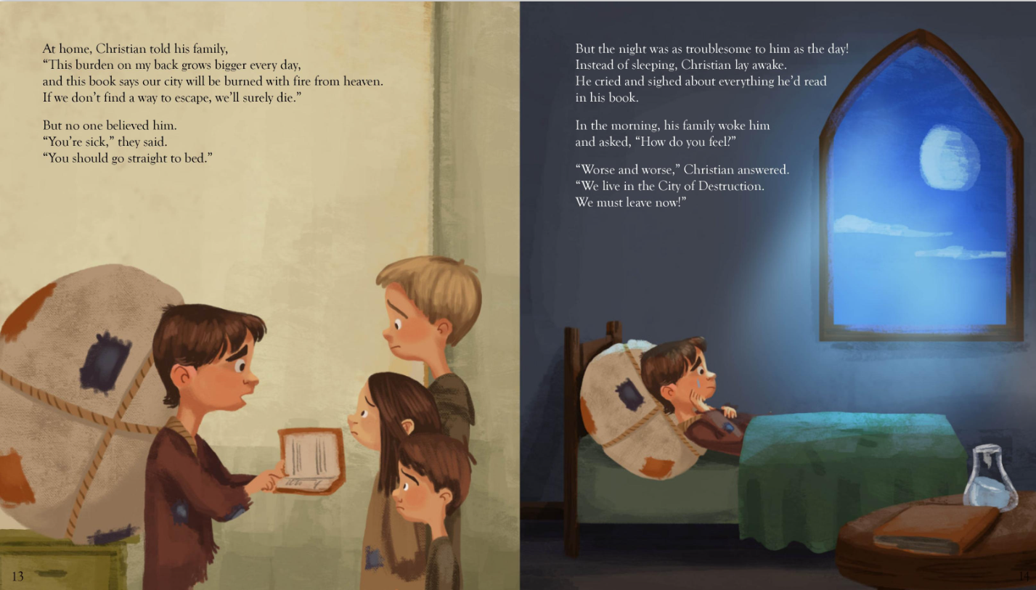
Pilgrim’s Progress – for kids
John Bunyan's Pilgrim's Progress Fully Illustrated & Adapted for Kids

Slide 11
Focus on the Family
The Wordless Book is a Christian evangelistic book.
Leading Your Child to Christ - Focus on the Family
Excerpts
“Introducing Your Child to God” is copyrighted © 2009 by Larry Fowler
“Leading Your Children to the Savior” is copyrighted © 2017 by Kelly J. Stigliano;
“Teaching Kids About God’s Big Story” is copyrighted © 2015 by Michelle Anthony;
“How to Share the Gospel With Your Children” is copyrighted © 2017 by Ann Vande Zande;
“Make Time to Talk About Faith” is adapted from Faith Begins at Home, published by Regal, and is copyrighted © 2007 by Regal;
“4 Challenges to Your Child’s Faith” is copyrighted © 2019 by Natasha Crain;
“7 Ways Your Kids Can Connect With God” is copyrighted © 2016 by Christie Thomas. Used by permission.

Slide 12
How would you respond to the following question?
Grandma/Grandpa am I going to heaven?
Explore?
Clarify?
Present?
Pray?
Leave open?
Follow-up?
Encourage?
Display?
Make whatever frames your response biblically based,..

Slide 13
Questions:
How many of us heard the gospel from our grandparents?
If not, who told you the Gospel?
What aroma will your grandchildren recall years from now when reflecting on you?
What is it that your grandchildren need more than anything else?
How do you explain the Gospel to a six-year-old? What would you want to include in your conversation?

Slide 14
Action Steps:
If you do not do so already, begin today to pray daily for your grandchildren to come to embrace the gospel, the good news of Jesus Christ.
Check out these resources that can help us understand how to explain the gospel to children: Show Them Jesus, by Jack Klumpenhower or the booklet Leading Your Child to Christ, by Marty Machowski.

Slide 15
Music Options
Alexa
Alexa, play Christian Music
Alexa, play K-LOVE
Alexa, Play the Donut Man
Alexa, open worship twenty four seven
Alexa, Open Family Life Radio
Alexa, play…
Michael W. Smith
Silly Songs by Larry
The Praise Baby Collection
https://www.youtube.com/channel/UCPnSGazEYMdEhSsaaGW_E9w

