Slide 1
Grandparenting (with Grace)
An Introduction

Slide 2
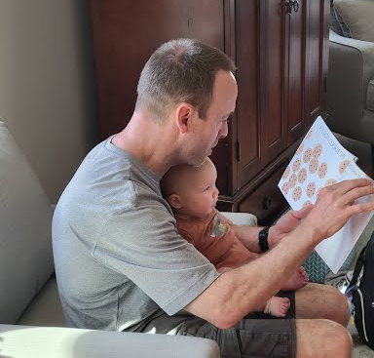
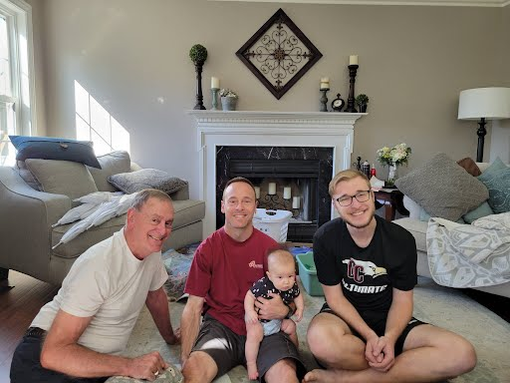
Clingenpeel Gentlemen
The Streitmater Family

Slide 3
There are 30 million of us Christian grandparents in the United States alone. Think of what we could do if we could unleash all of that potential influence. Larry Fowler, Legacy Coalition
Robert Doisneau
Getty Images

Slide 4
Some Facts
Most Americans (83%) ages 65 and older say they have grandchildren at 50 – 64 it drops to 52%
More grandparents are living with a grandchild. About 7 million (2013) up from 5.8 million (2000)
About 10% of all children live in a household with a grandparent
About one-third of those children also have two parents in the home
In 2017, over 50% of adult attendees at Immanuel include people 50 years and older
https://www.census.gov/library/publications/2014/demo/p20-576.html
https://www.pewresearch.org/fact-tank/2015/09/13/5-facts-about-american-grandparents/

Slide 5
Big Idea
In God’s redemptive plan, the family structure plays a prominent role in the biblical story
Within that structure, specific roles exist for passing on God’s instruction that apply to the family and more broadly to society
Grandparents maintain an important role within he family structure in providing training, equipping and encouragement

Slide 6
The Family as the Centerpiece for God’s Redemptive Plan
Humanity was not an afterthought, but a valued part of His creation
The redemptive plan was first given to Abraham and passed down through his offspring
The kinsman-redeemer was a biblical role of protection and restoration (gōʾēl; Lev 25; Ruth 3:9)
Paul held a firm identity as parentally responsible for his spiritual offspring and their growth (1 Cor 4:16, 11:1; 1 Thes 1:6).
The human family is “the most ancient of all societies and the only one that is natural.”
Rousseau
The Syntopicon: An Index to the Great Ideas, ed. Mortimer J. Adler, Second Edition ed., vol. 1 (Chicago; London; New Delhi; Paris; Seoul; Sydney; Taipei; Tokyo: Encyclopædia Britannica, Inc., 1990), 386.

Slide 7
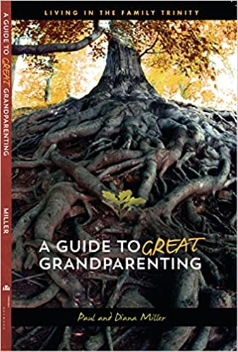
The Family Trinity
Grandparents
A three generation unit built around three different but complementary relationships.
Coaching
Modeling
Instructing
Parents
Grandchildren

Slide 8
The “Real” Family Trinity (in process)
Grandparents
Grandparents
Often a complex, multi- generation and non-nuclear unit built around many different and evolving relationships.
Parents
Parents
Grandchildren
Parents

Slide 9
What is out there?
Grandparenting with Grace Class
Additional Organizations
Legacy Coalition
Grace Based Families
Christian Grandparent Network
Family Life
Grandkids Matter
Additional Resources
Extreme Grandparenting
Courageous Grandparenting
See Hagiazo.net

Slide 10
Grandparenting with Grace
(1208) Grandparenting Course - Introduction - YouTube

Slide 11
Our Approach
Cover a key topic/chapter
Introduce One Big Idea
Identify Available Resources
Encourage Intentional Action
We will all have unique goals!

Slide 12
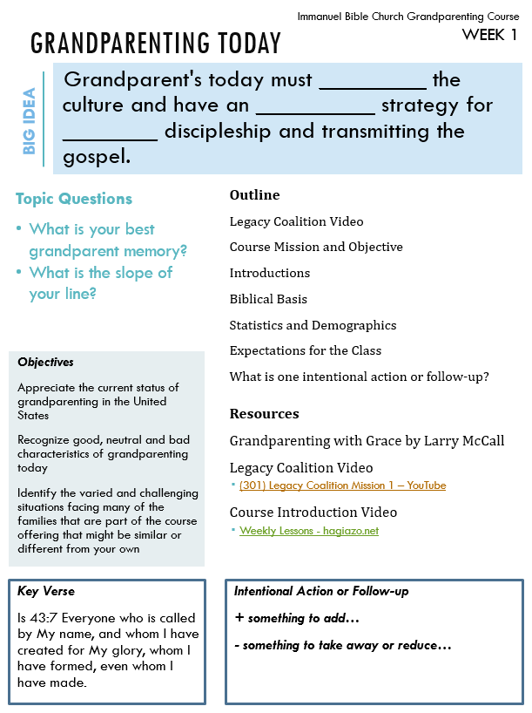
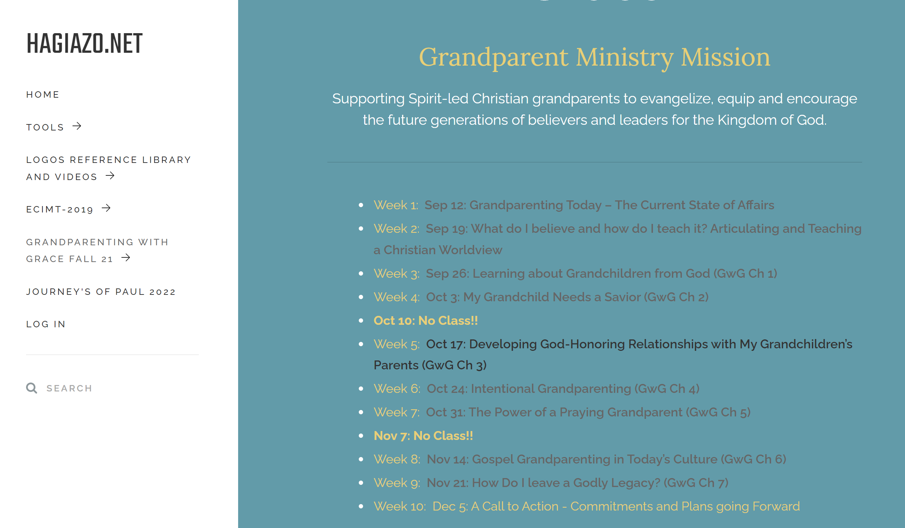
Handouts
Online Material
Primary Text

Slide 13
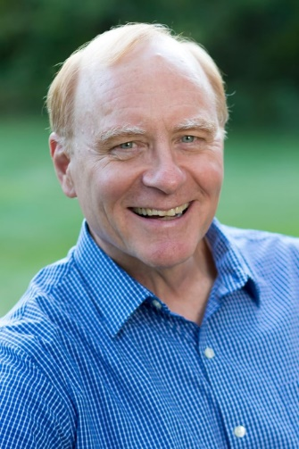
Course Outline
Grandparenting Today – The Current State of Affairs
What do I believe and how do I teach it? Articulating and Teaching a Christian Worldview
Learning about Grandchildren from God (GwG Ch 1)
My Grandchild Needs a Savior (GwG Ch 2)
Developing God-Honoring Relationships with My Grandchildren’s Parents (GwG Ch 3)
Intentional Grandparenting (GwG Ch 4)
The Power of a Praying Grandparent (GwG Ch 5)
Gospel Grandparenting in Today’s Culture (GwG Ch 6)
How Do I leave a Godly Legacy? (GwG Ch 7)
A Call to Action - Commitments and Plans going Forward
+ and perhaps an online visit with Larry!

Slide 14
Praying for you
February 5th, 2021
Hi, Kirk and Tom.
Just wanted you to know that I'm excited to see you launch the grandparenting class this weekend there at Immanuel. I'll be praying for much fruit in the lives of the grandparents, their extended families and the church.
Feel free to pass along updated praises and requests as you have time and assure the grandparents in your class that they are being prayed for.
Thanks!
In His amazing grace, Larry
Coming in a few weeks…
A Zoom Night Session with Larry McCall on the Ministry of Grandparenting!

Slide 15
Courageous Grandparenting
Supporting Text
The Course will draw insights from these Grandparenting Resources as well as other online and physical material
Building a Legacy Worth Outliving You
By Cavin Harper
A Guide to Great Grandparenting
Extreme Grandparenting
The Ride of Your Life!
By Tim & Darcy Kimmel
By Paul and Diana Miller

Slide 16
Coming This Fall
Grandparenting with Grace
10 week class with online resources
Sunday Morning in Person
Weekday Night on Zoom
Legacy Grandparenting Summit
Oct 21st / 22nd 2022, Jacksonville FL
or
100+ simulcast locations including Church of the Apostles, Fairfax VA
Early Bird until July 31st
Look out for IBC announcements
Contact via email:
streitmaterk@verizon.net

Slide 17
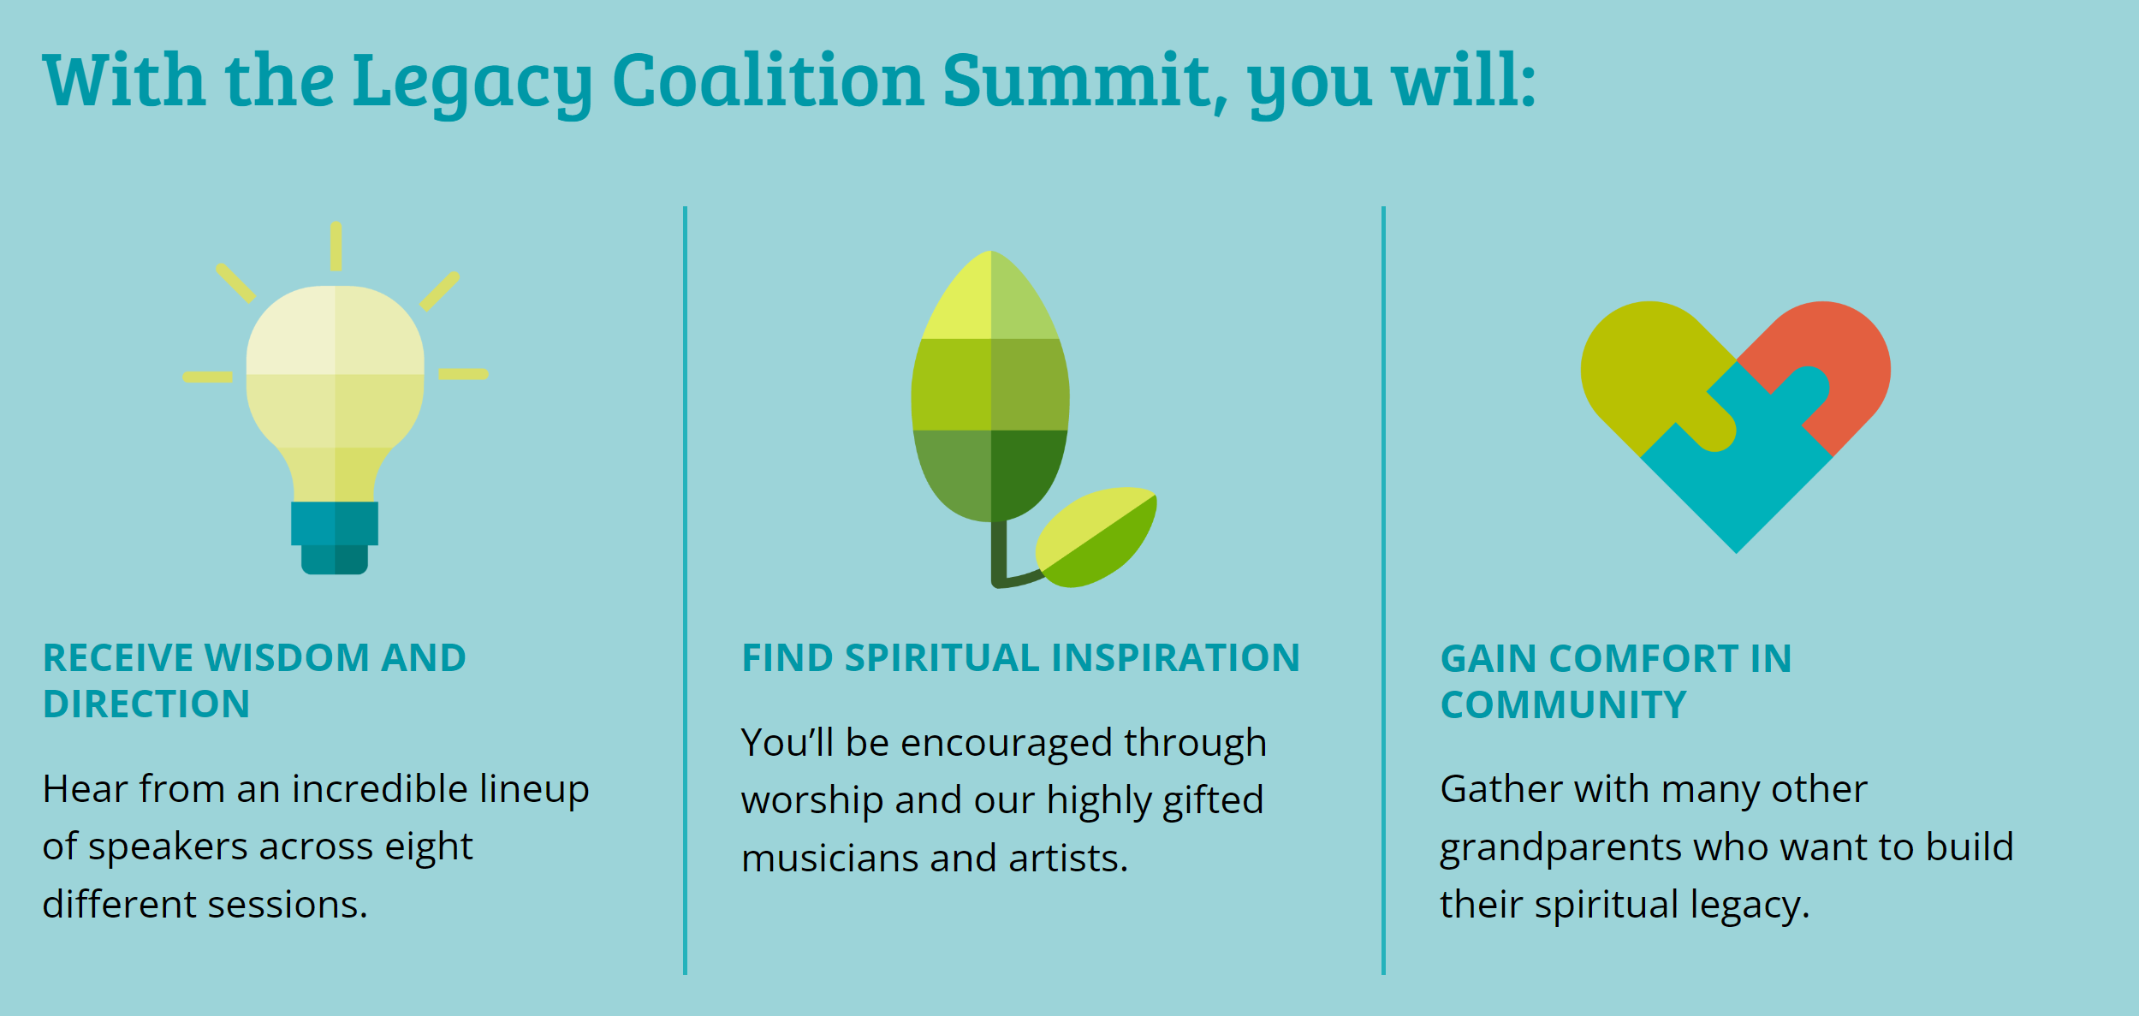
Legacy Coalition Summit
October 21-22
2022
Crosswater Community Church Jacksonville, FL
Livestream:
100+ SITES ACROSS THE U.S. AND CANADA
Receive Wisdom and Direction
Find Spiritual Inspiration
Gain Comfort in Community

Slide 18
Legacy Coalition Resources
https://legacycoalition.com/
Free Resource Posted on the Website
WEEKLY WEBINAR – Mondays 8pm EST
Conversations about Intentional Christian Grandparenting: From our presenters each week, you’ll learn how to nurture your grandchildren’s faith and overcome obstacles.

Slide 19
Hagiazo.net
Grandparent Ministry Page
Tools
Apologetic Resources

